Slide 1

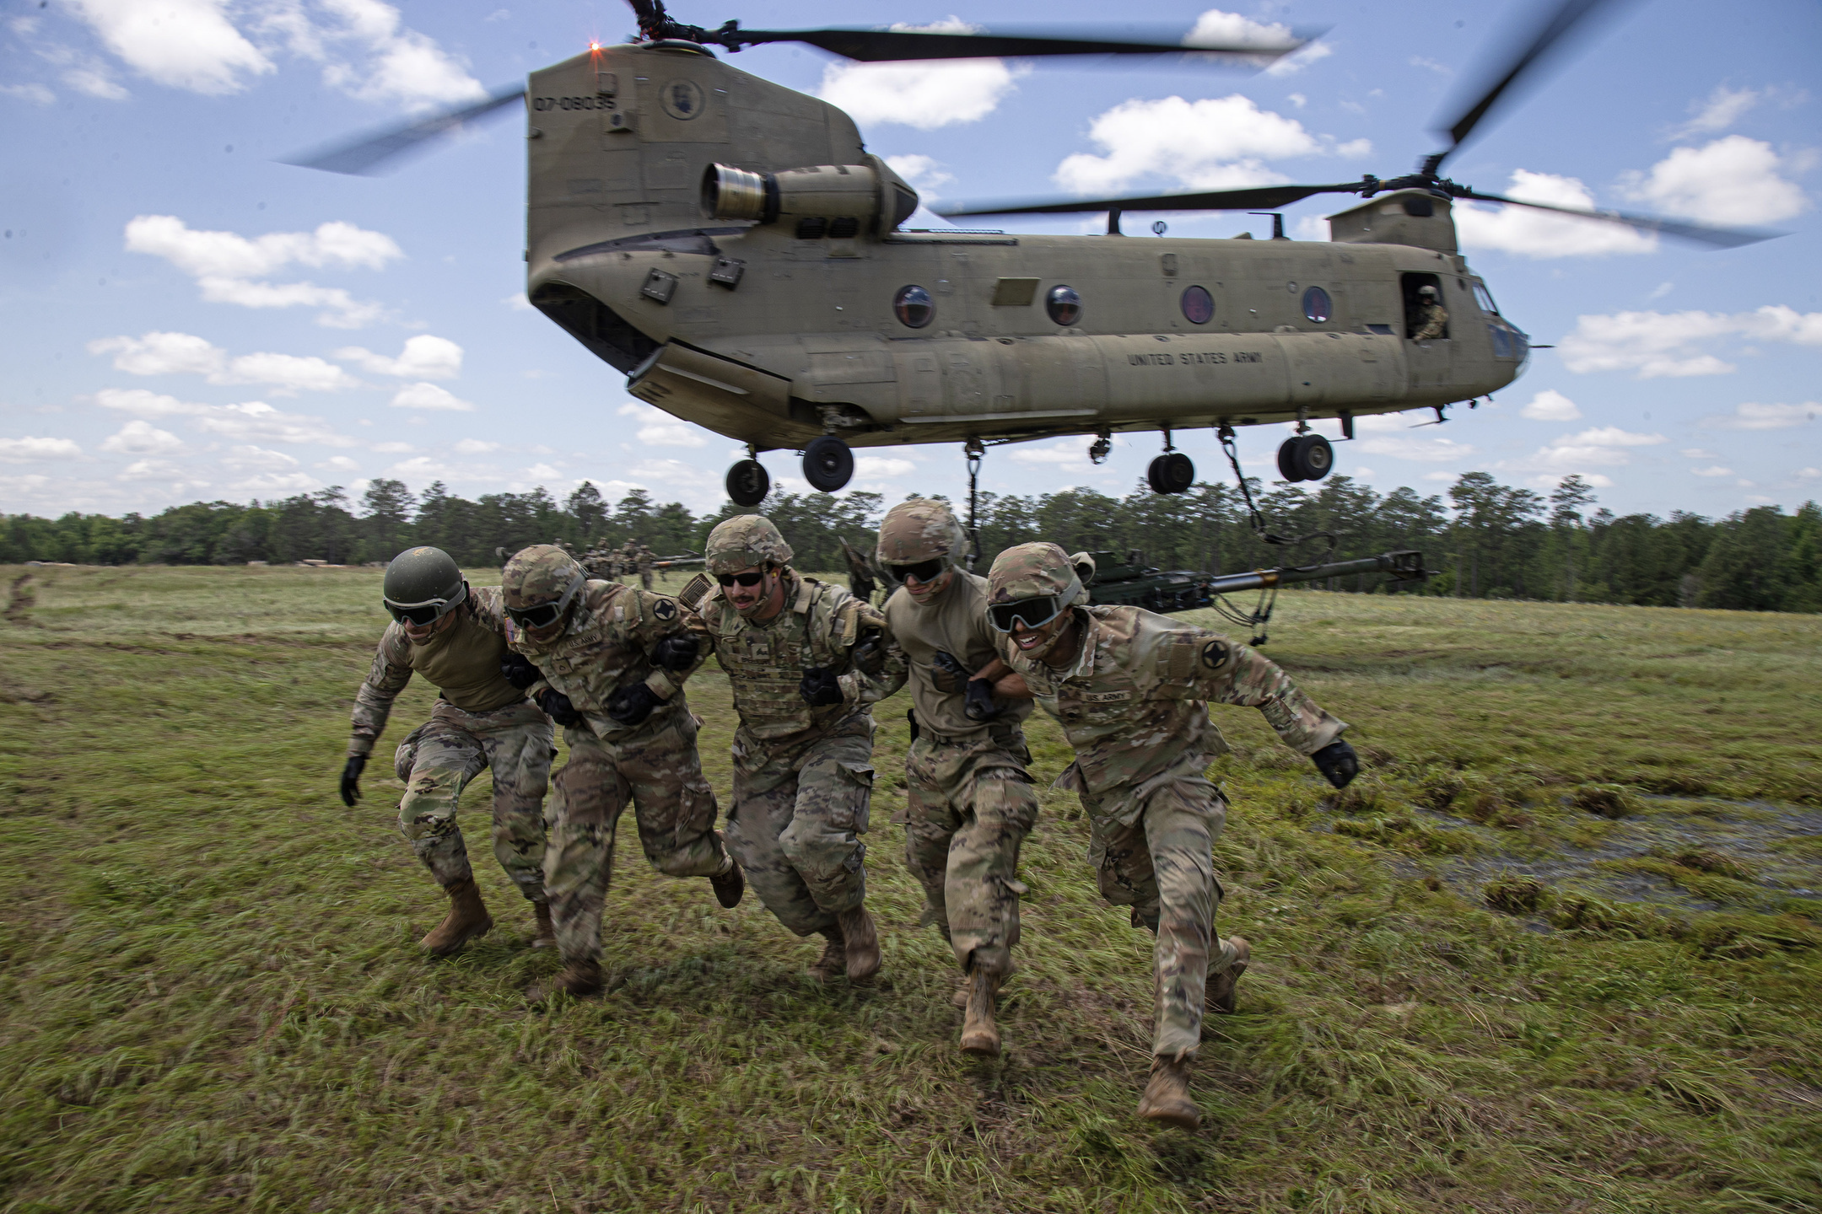
BRIDGING THE GAP
Mitigating the Stress of Relationships, on the Job and at Home

Slide 2


"Introduction to Bridging the Gap"
Intro and Learning Objectives
(INSERT VIDEO HERE)

Slide 3


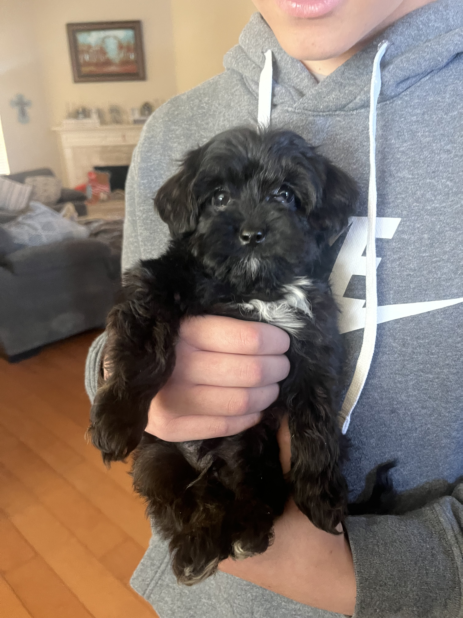



Slide 4


Meet my family
Chloe (Coco), Alisha, Ava (Sis),
Cael, Brody (Neener)

Slide 5
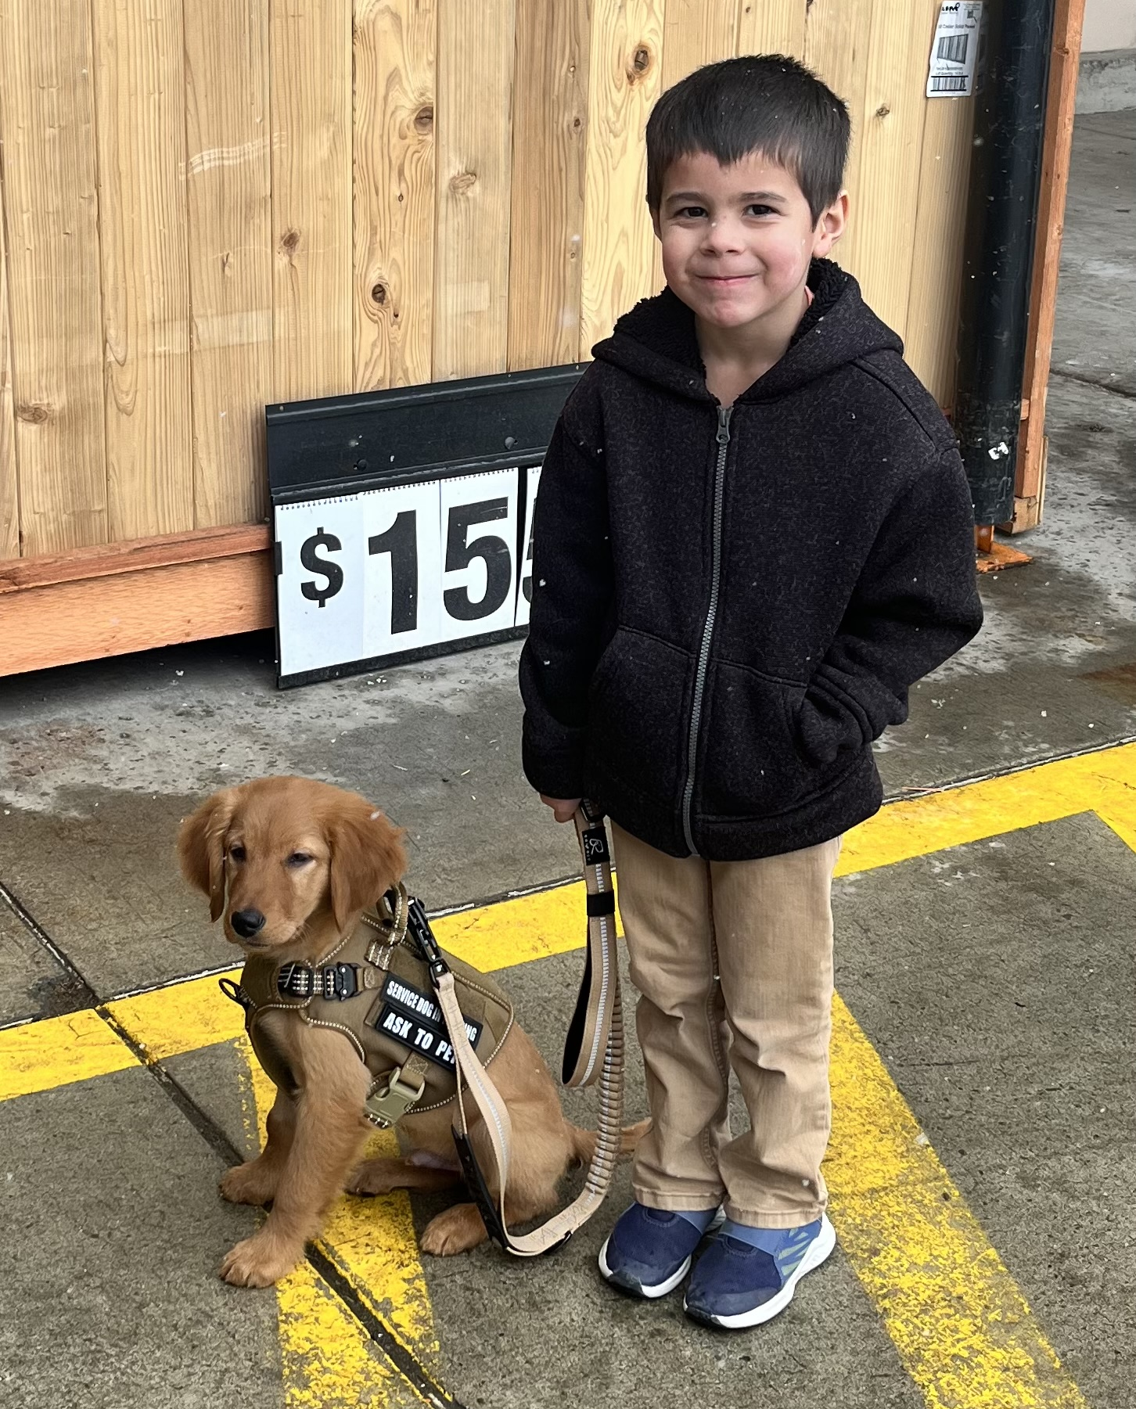
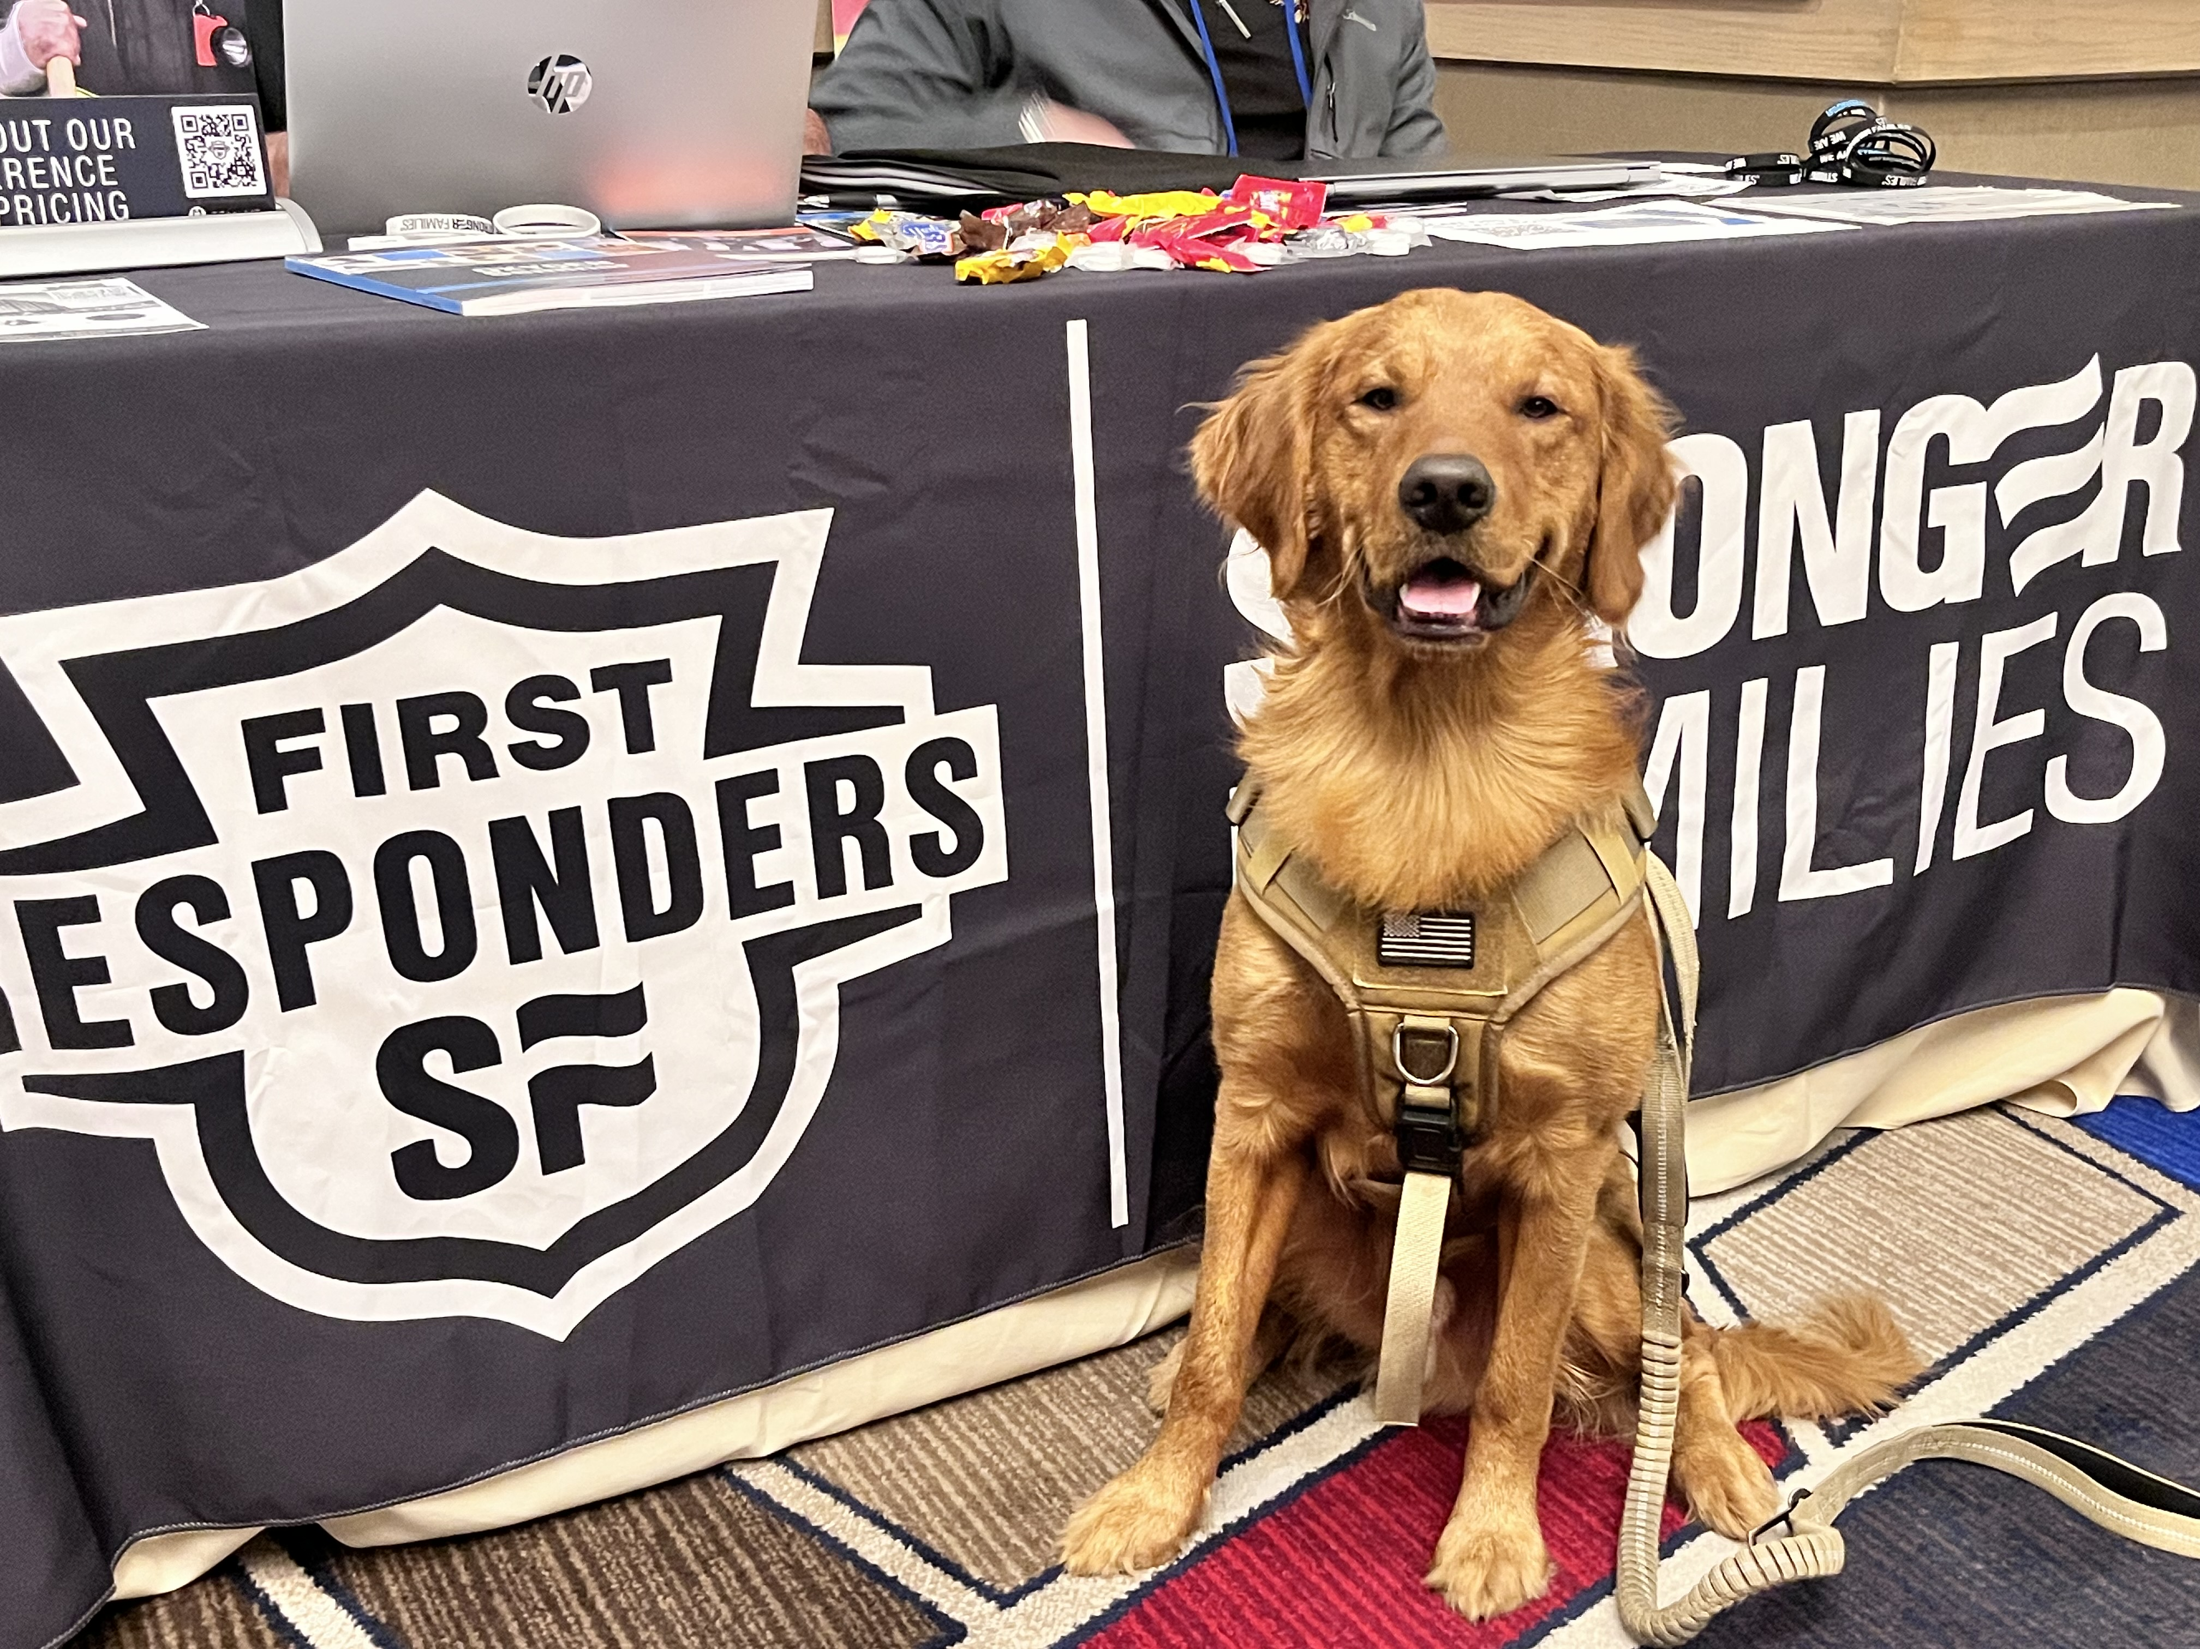

Slide 6
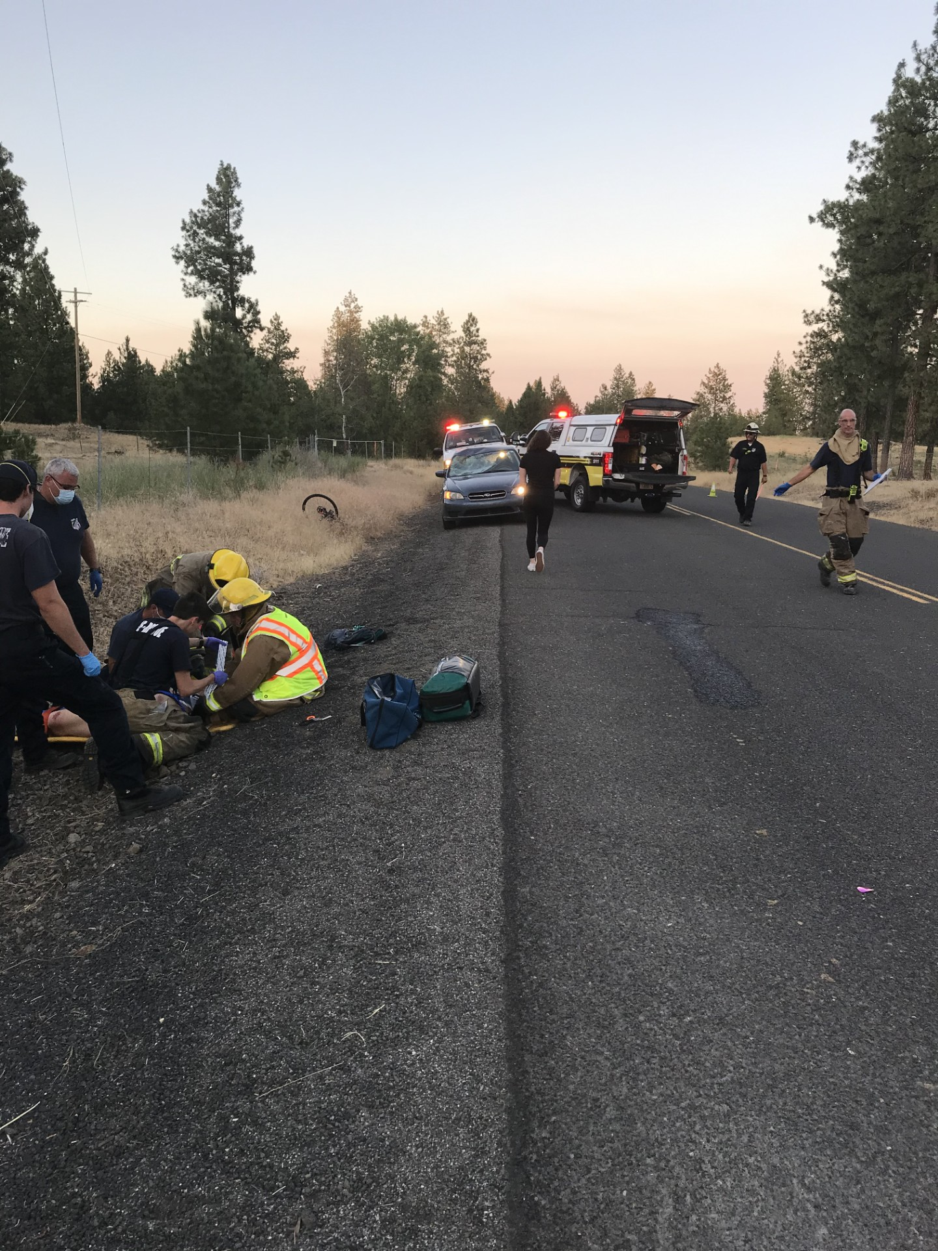
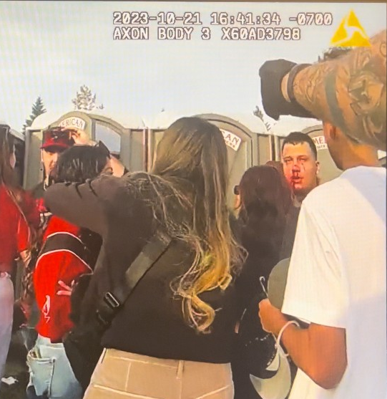
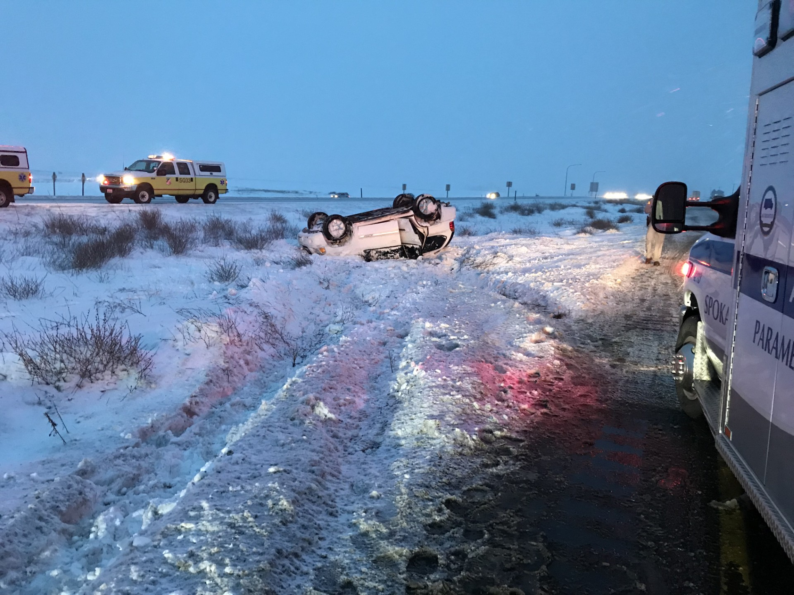
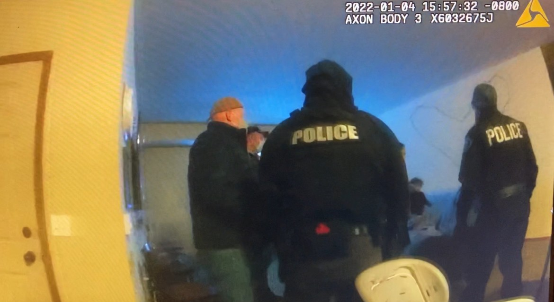
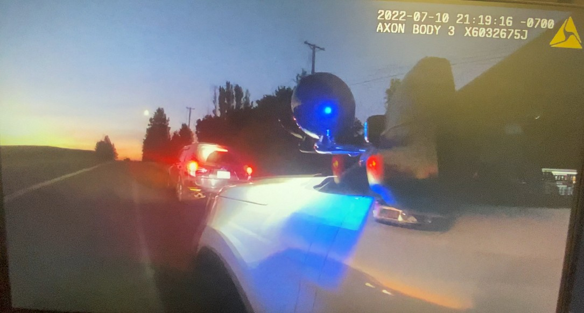
This…
This...
...is what I was married to

Slide 7


Slide 8
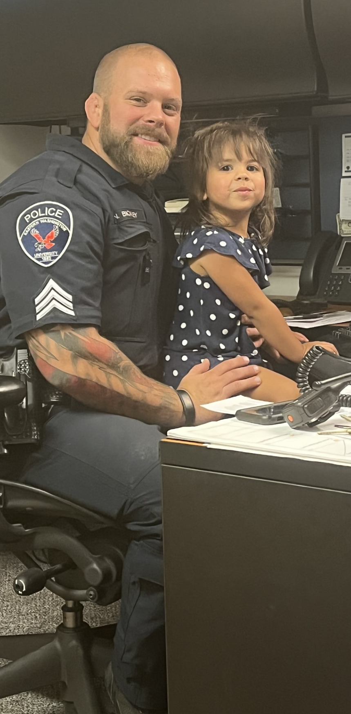
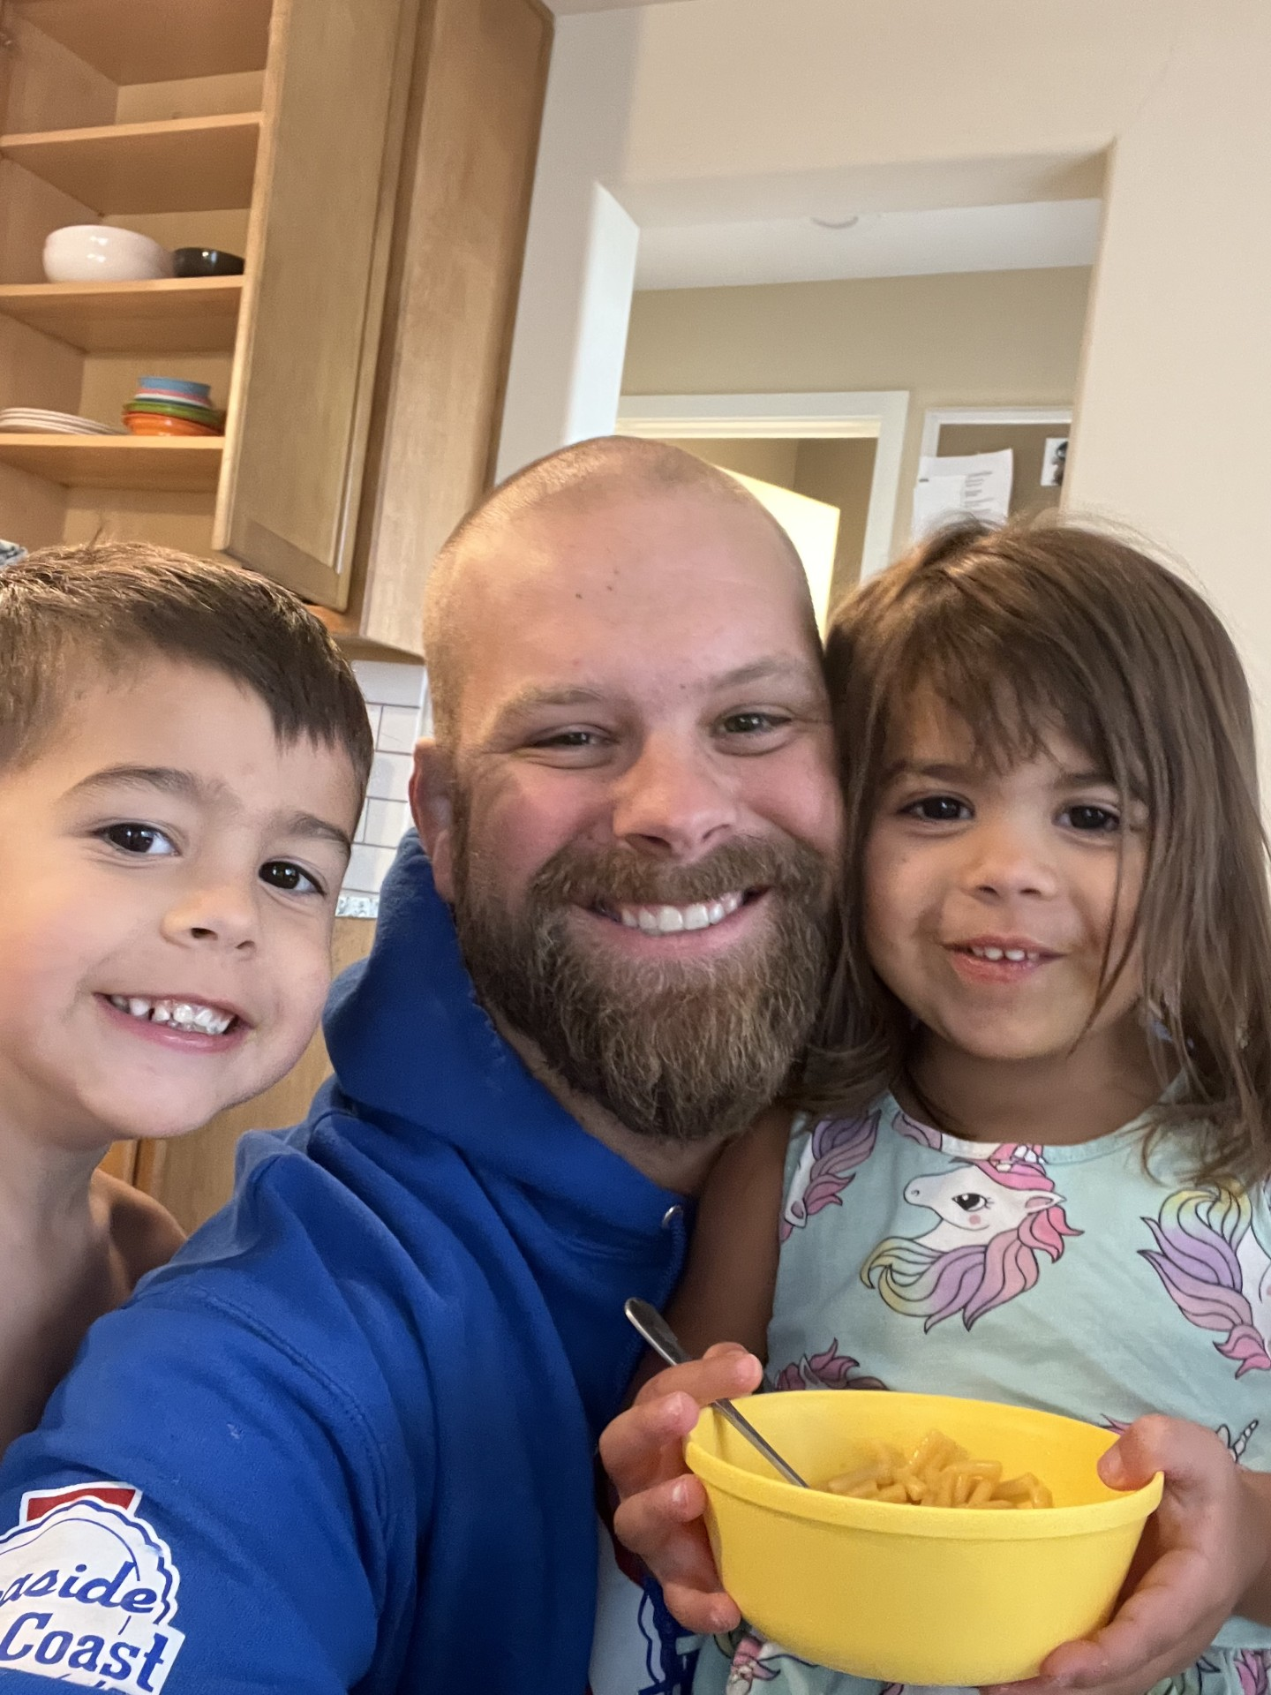
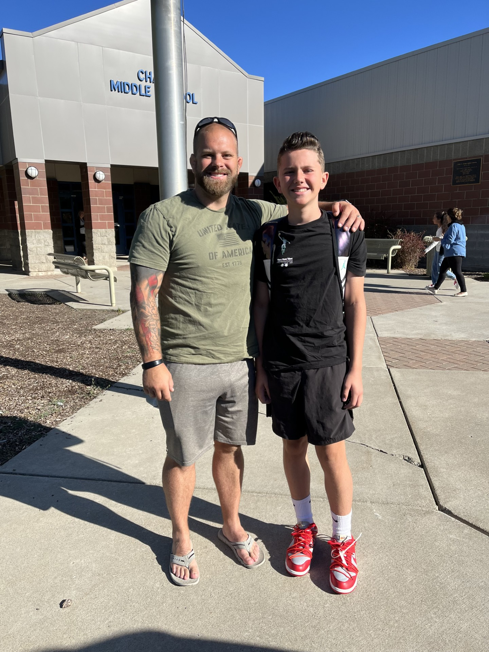

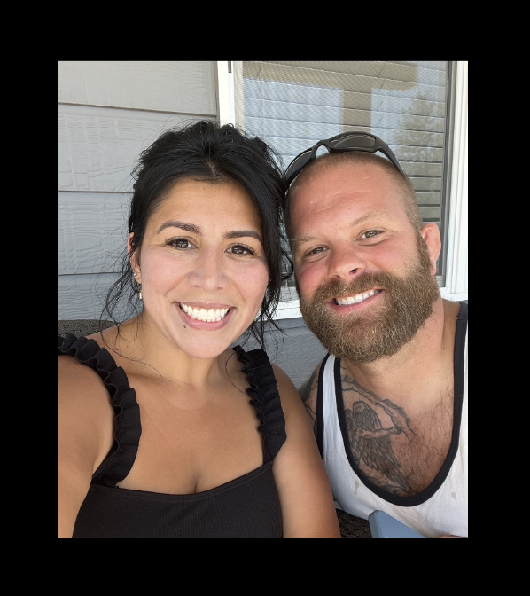
The mask I wore

Slide 9
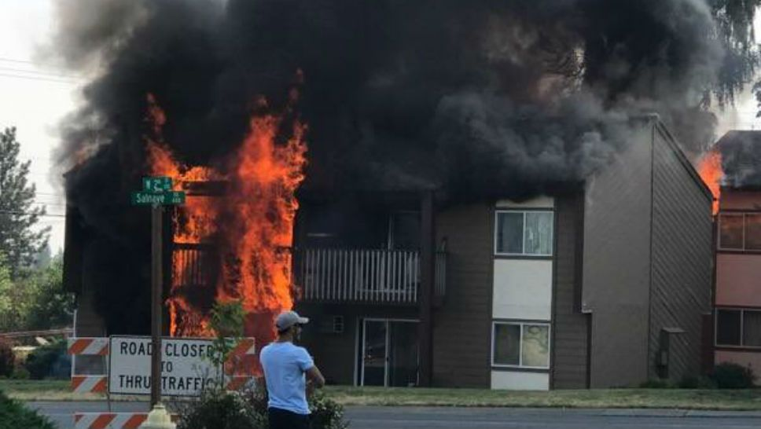
Stress In The Military
Looks Different
Life-and-death decisions
Witnessing human suffering
Intense workloads
Risk of personal harm
Deployments and Separation from family
Nick

Slide 10
Stress IS NOT BAD!
Your body’s response to stress/danger is normal and appropriate
  The bodies NATURAL response to UNNATURAL situations
  Your body saying ”Pay attention!”
Your mind is designed to remember stressful/threatening things, not forget them
Velcro for the bad, Teflon for the good,” Rick Hanson PhD
Your mind’s response to the way your body feels is what creates the problem
  Judgment
  Stigma
  Shame

Slide 11
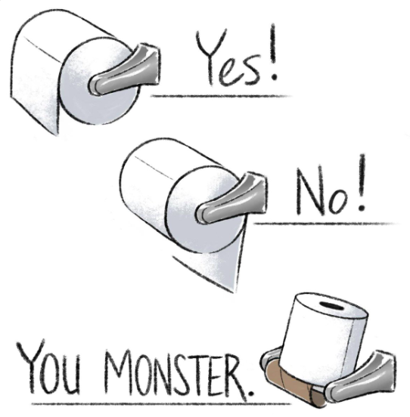

Slide 12
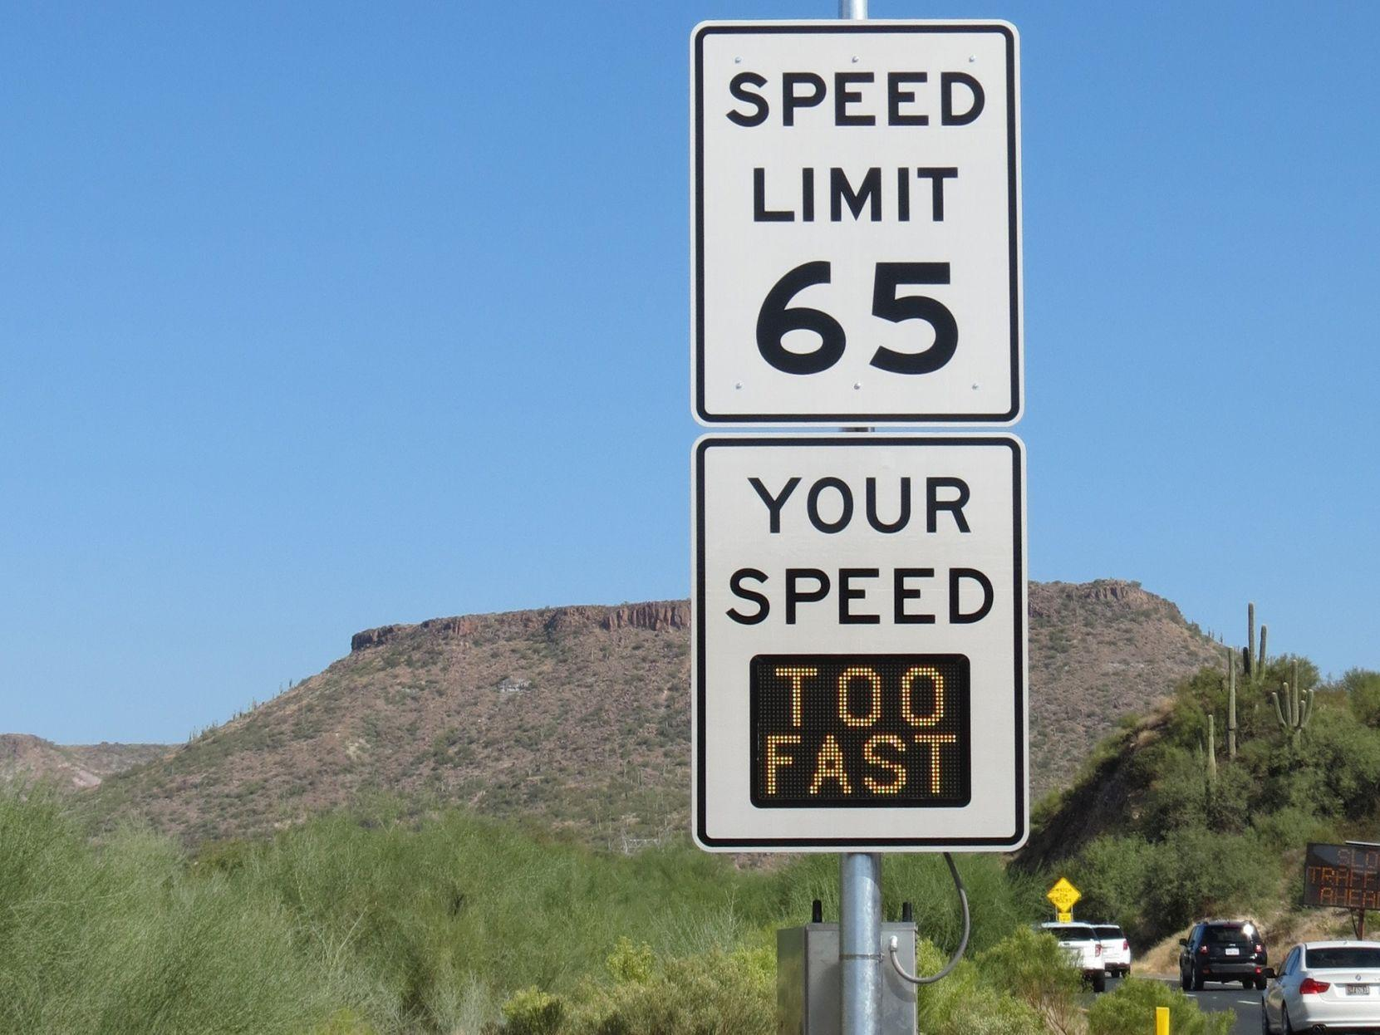

Slide 13
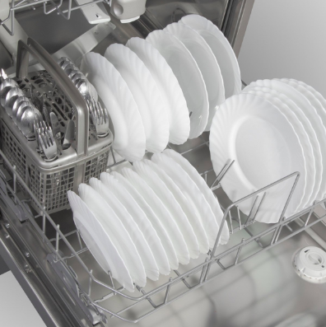
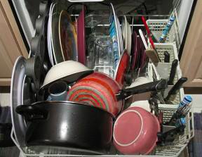
OR

Slide 14
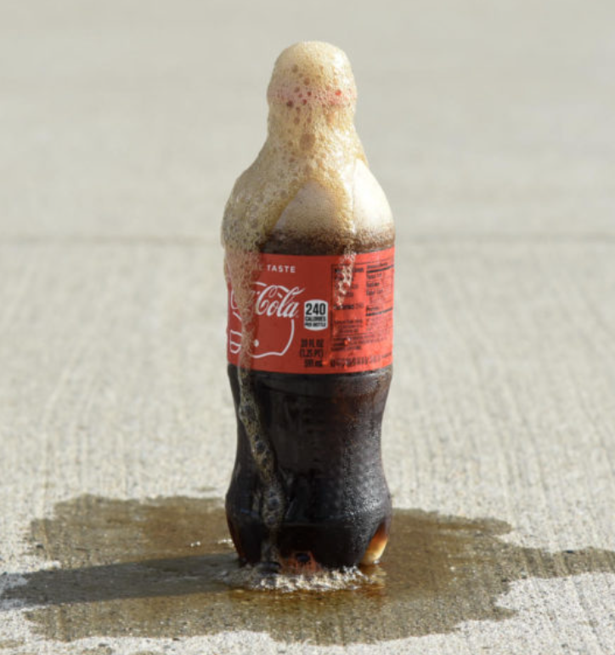
Soda Bottle Challenge

Slide 15

ANGER
SHAME
GUILT
DESIRE
LOVE

Slide 16

ORIGINAL EMOTION
FEAR
FRUSTRATION
HURT
INJUSTICE
ANGER
SHAME
GUILT
DESIRE
LOVE

Slide 17
Unpacking Your Rucksack
Breakout Activity

Slide 18
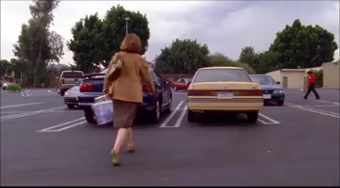

Slide 19
HOT TEMPER
BLAMING
SELF-PITY
BREAKING PROMISES
ANGER
PLAYING THE VICTIM
SHAME
STONEWALLING
GUILT
DESIRE
ISOLATION/WITHDRAWING
LOVE

Slide 20
COMMON CONFLICT IGNITERS
CRITICIZING
DRAGGING YOUR FEET
MAKING EXCUSES
CONTEMPT
LYING
PSYCHOANALYZING YOUR PARTNER
COMPLAINING
MIND-READING
NAME-CALLING
RIDICULING
SWITCHING THE SUBJECT
BRINGING UP MORE THAN ONE ISSUE AT A TIME
PLAYING THE MARTYR

Slide 21
What’s Your Boiling Point?
Breakout Activity

Slide 22
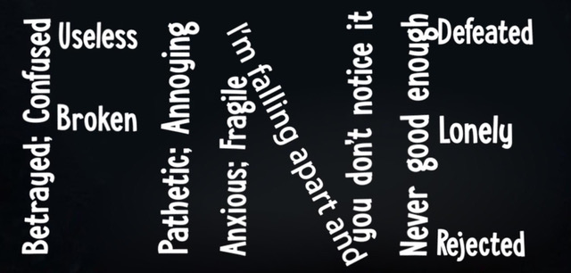

Slide 23

Hyperarousal
(Hypervigilant)
physiological and psychological state of being
Window of Tolerance
Hypoarousal
(Depressive)
Time

Slide 24
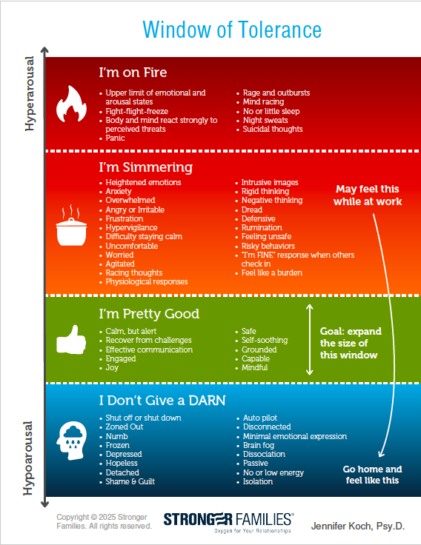

Window of Tolerance
Polyvagal Theory
by Dr. Stephen Porges

Slide 25
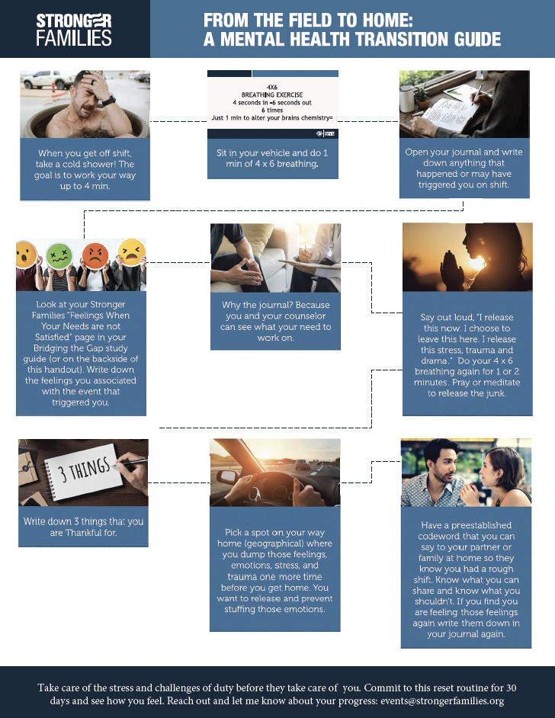

FROM THE FIELD TO HOME
A Mental Health Transition Guide
SCAN ME

Slide 26
Your Personality & How You Handle Stress

Slide 27
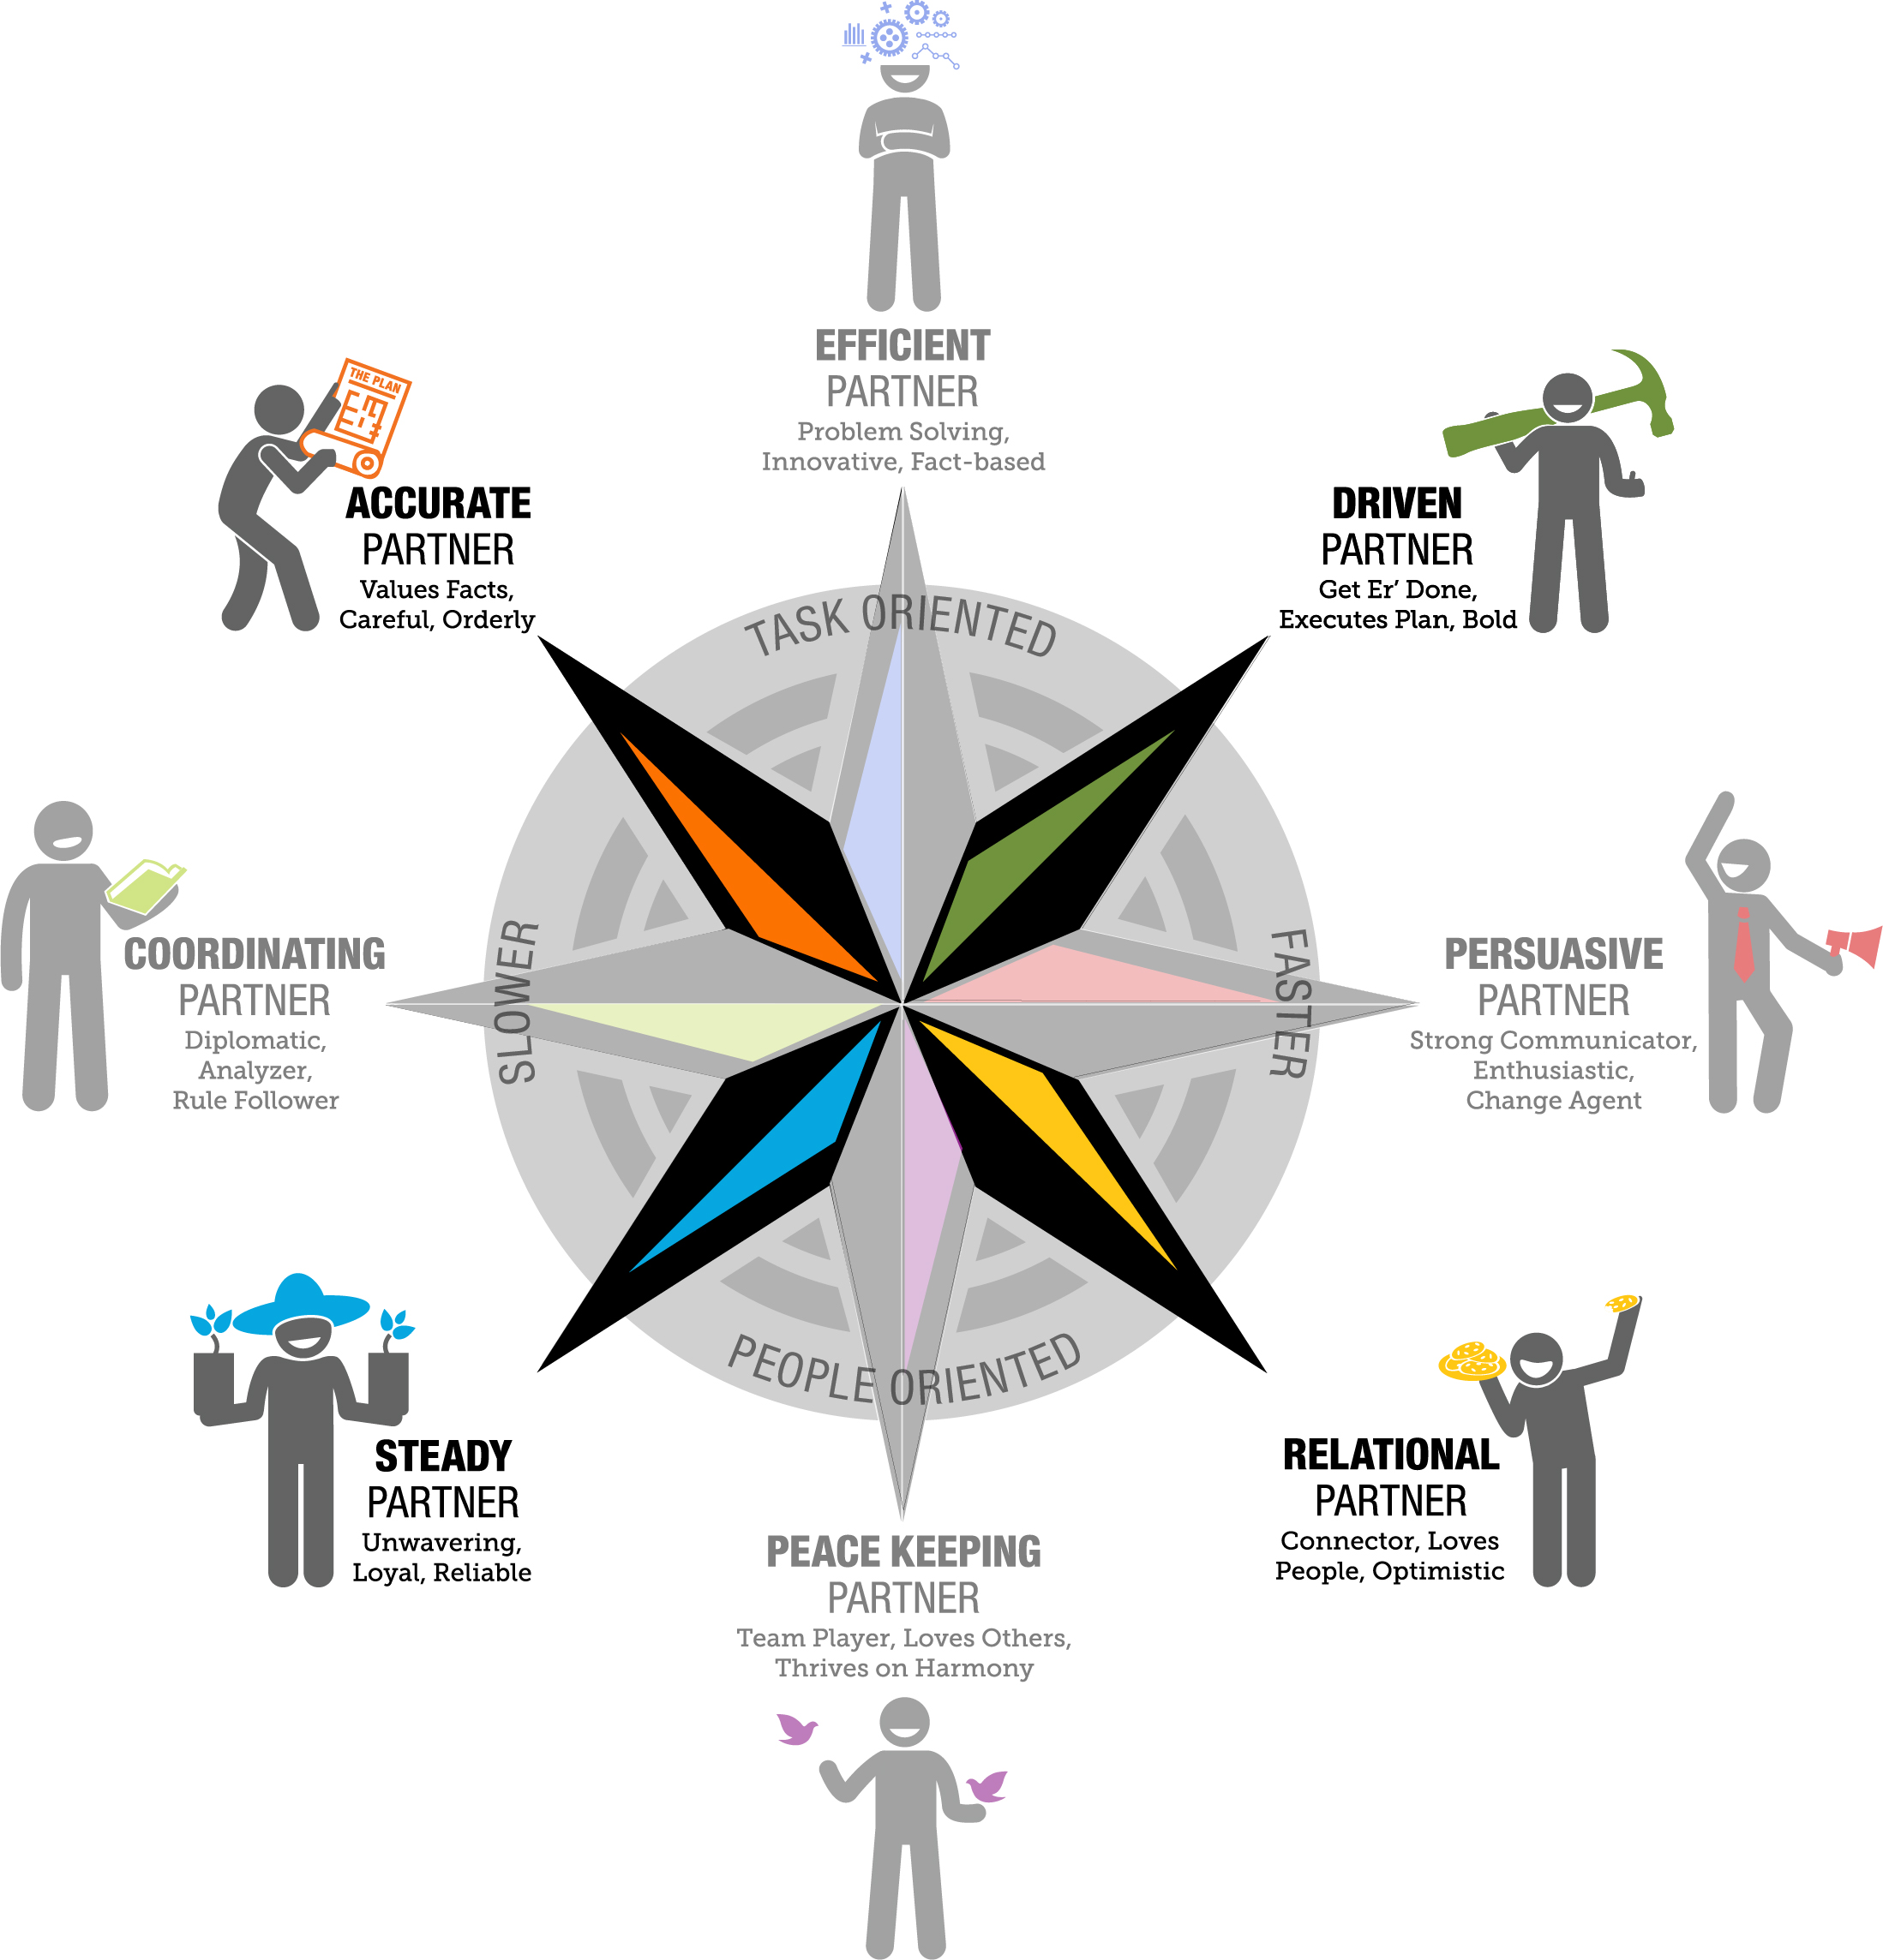
Under Stress = Focus on Task

Slide 28
Under Stress = Focus on People

Slide 29
Under Stress =
Uses Confrontation To Connect

Slide 30
Under Stress = Avoids Confrontation at ALL Cost

Slide 31
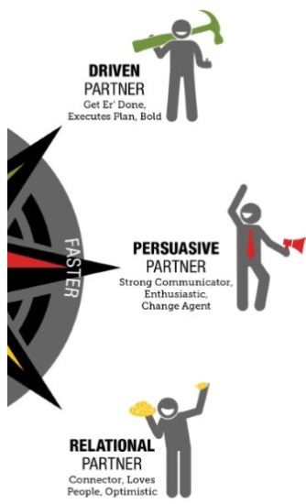
UNDER STRESS =
CHANGE BECOMES
WELCOMED OPPORTUNITY
FASTER
SCALE

Slide 32
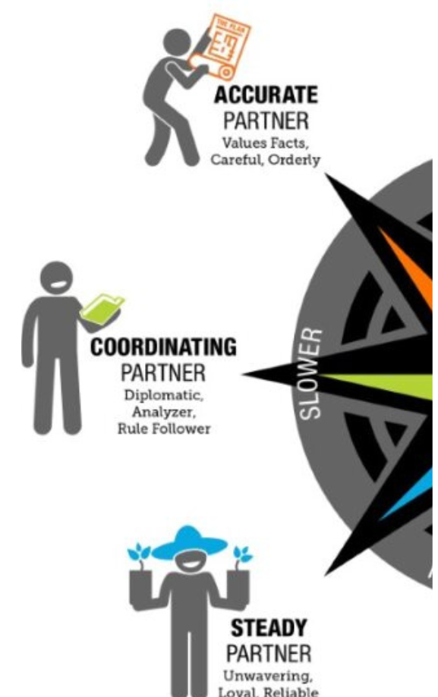
UNDER STRESS =
REACT TO CHANGE WITH A CAUTIOUS, SLOW, AND
DELIBERATE PLAN
SLOWER
SCALE

Slide 33
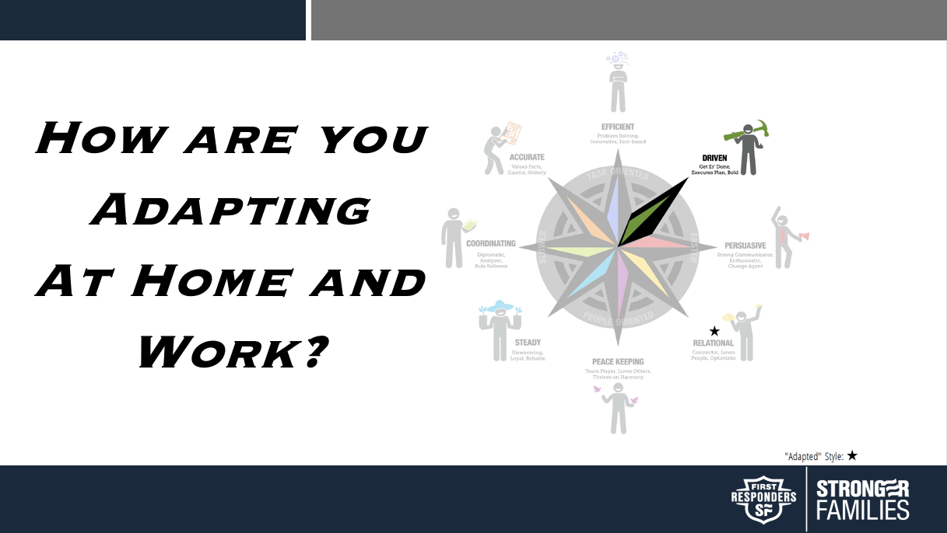

Slide 34
Handling Stress
Breakout Activity

Slide 35
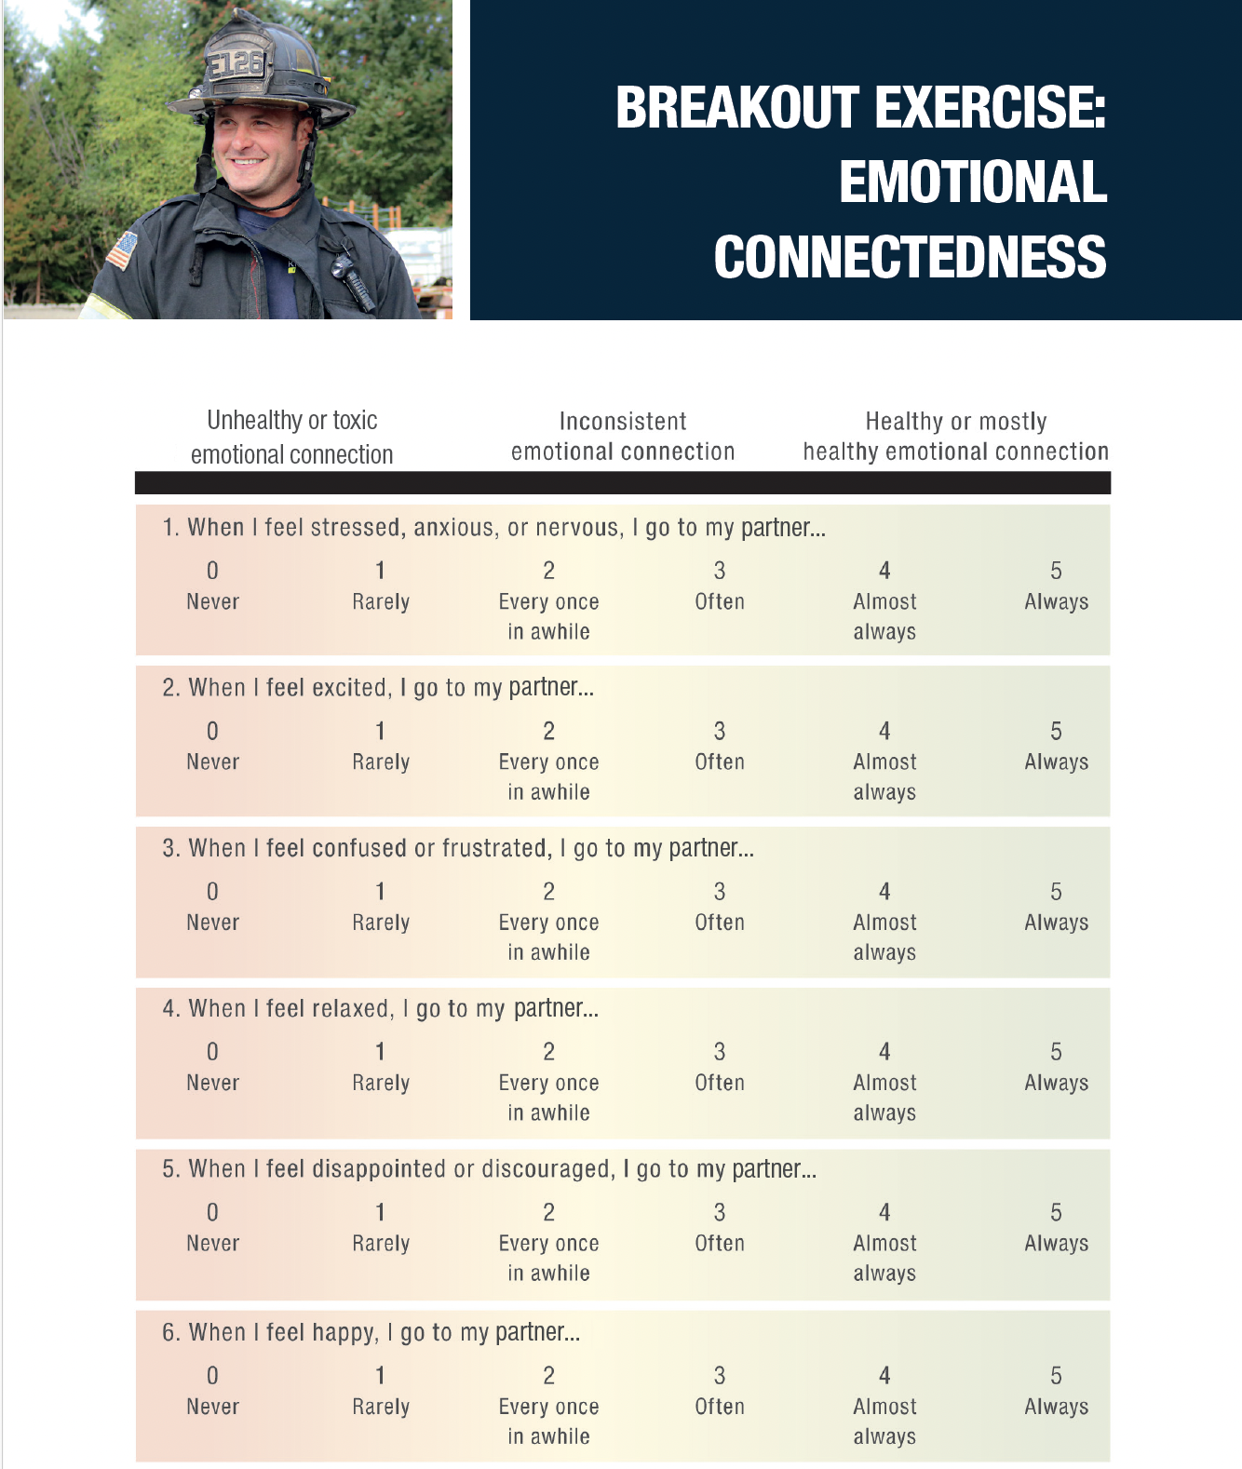
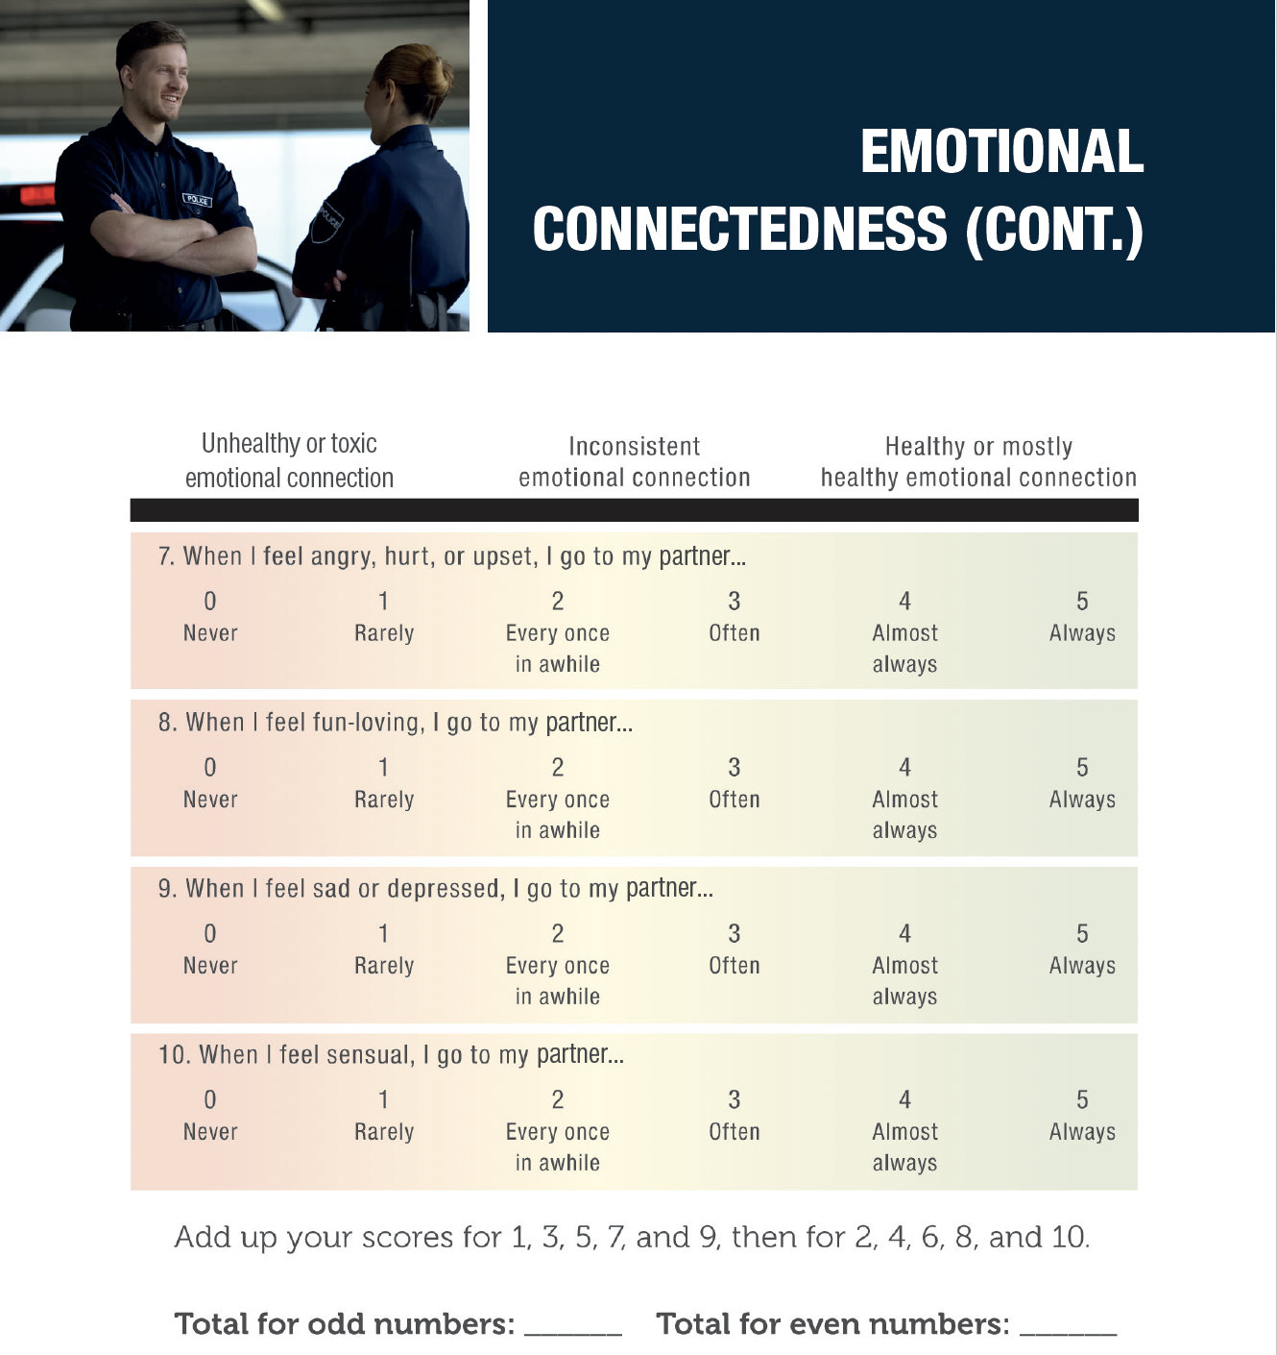

Slide 36
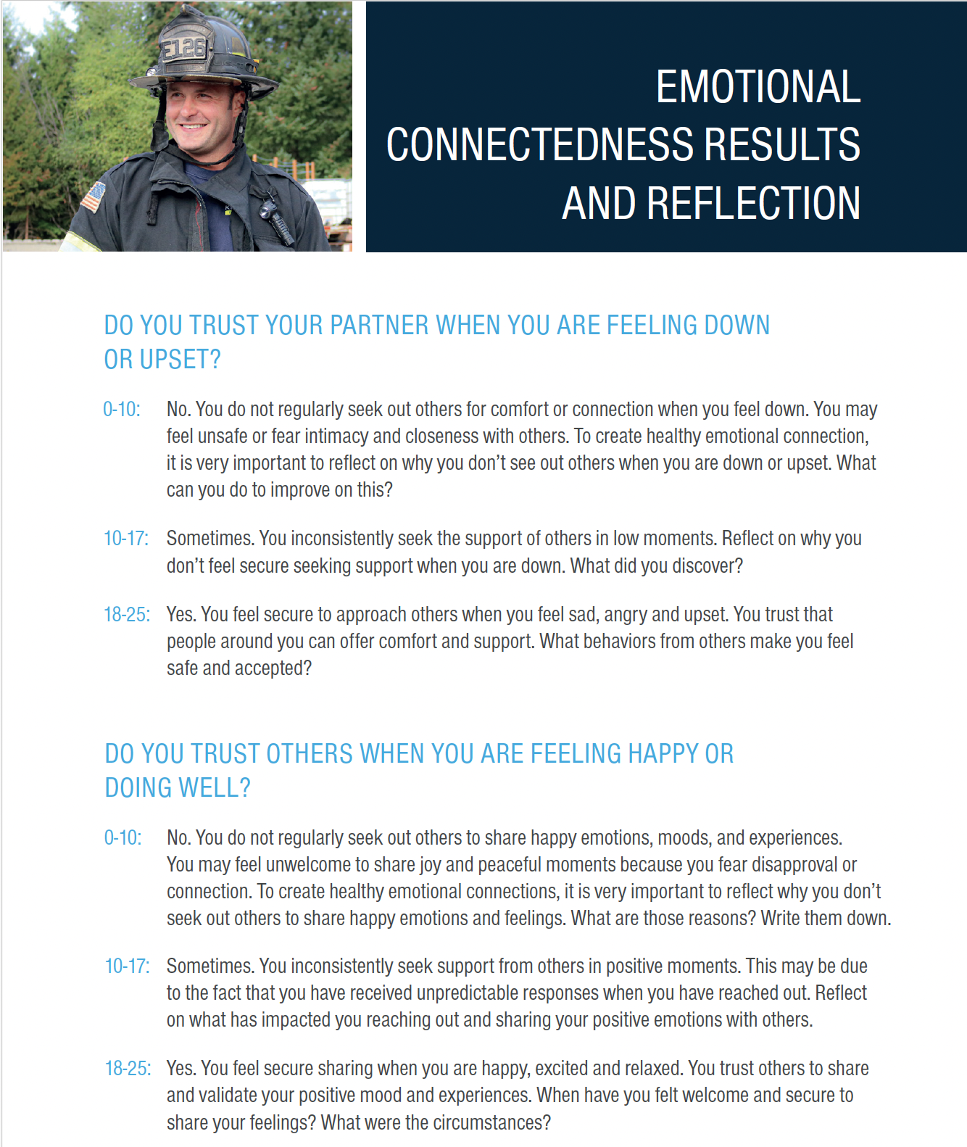

Slide 37
Emotional Connectedness
Breakout Activity

Slide 38
Weekly Emotional Check-In
Breakout Activity

Slide 39
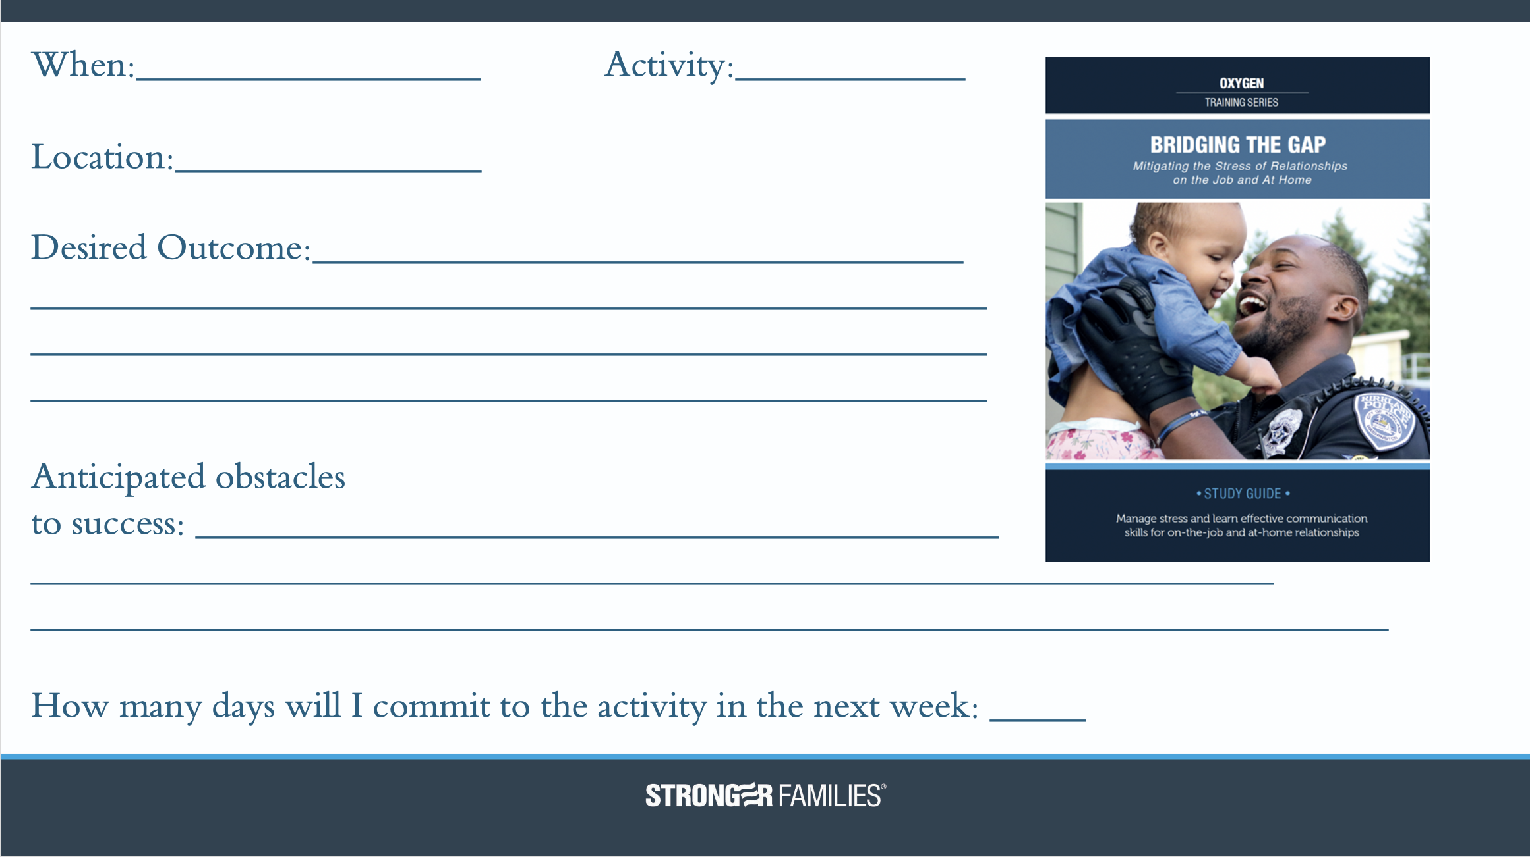
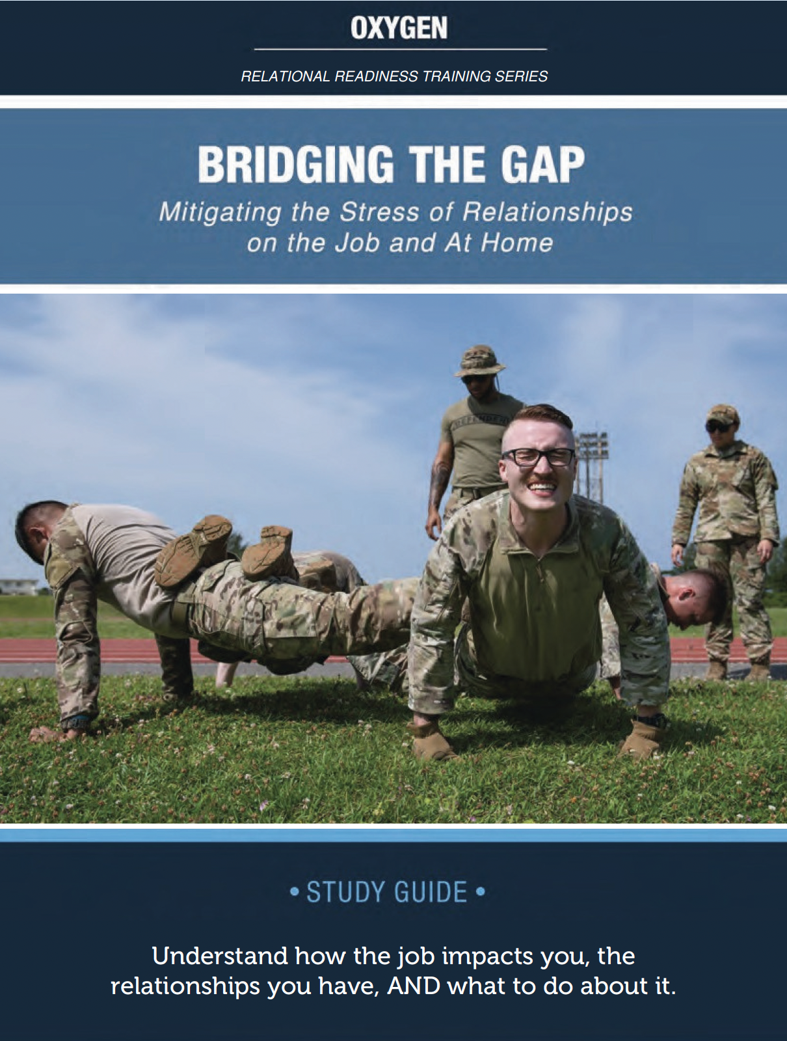
ACTION PLAN

Slide 40


Slide 41
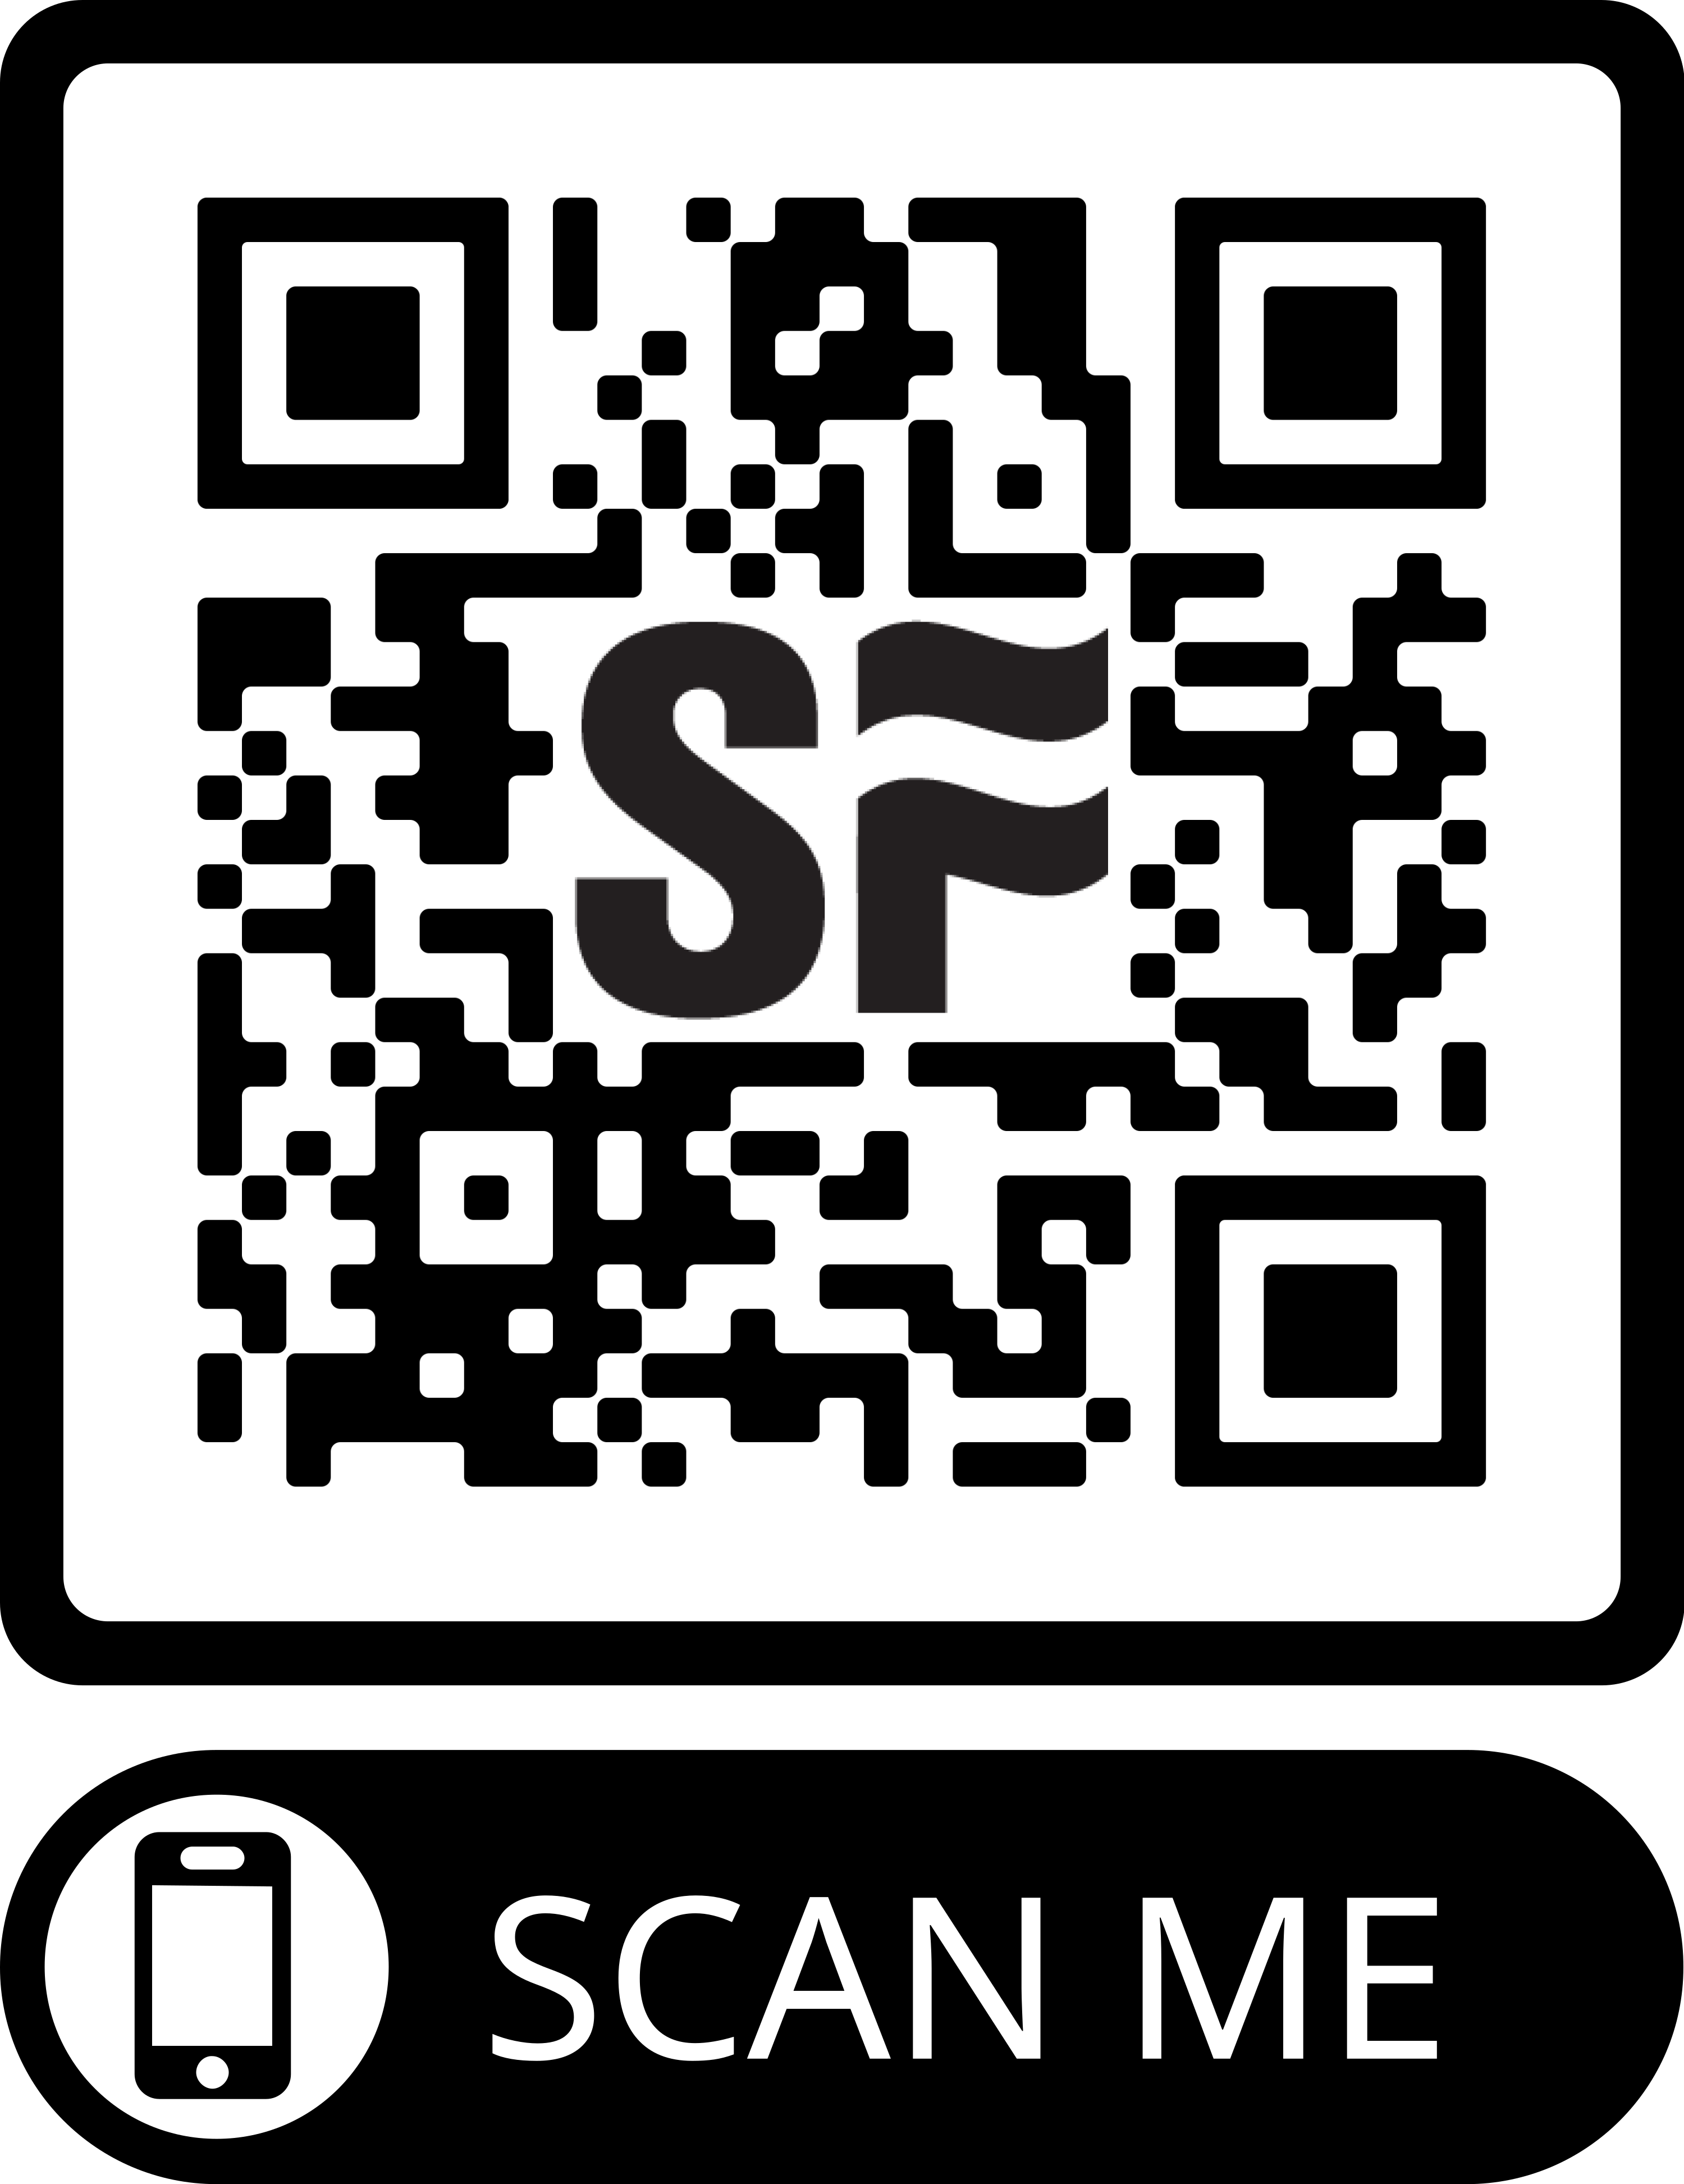
TELL US WHAT YOU THINK
Your input will have a direct impact on the development of this program. Thank you!

Slide 42


Email: noel.meador@strongerfamilies.org
Instagram & Facebook: @noelmeador
Phone: 206-356-1040
Email: nick.bickley@strongerfamilies.org
Phone: 509-699-5769

