Slide 1
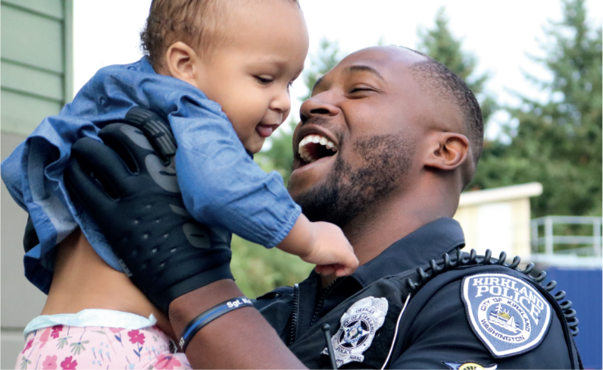

BRIDGING THE GAP
Mitigating The Stress In First Responder Relationships

Slide 2
BRIDGING THE GAP
Mitigating The Stress In First Responder Relationships
Add Your Personal Slides to introduce you (optional)

Slide 3

Add Video: Nick Story Pt. 1
(videos can be downloaded from the following link)

Slide 4
Stress For A First Responder
Looks Different for Each of Us
Life-and-death decisions
Witnessing human suffering
Intense workloads
Risk of personal harm
Separation from family

Slide 5
Stress IS NOT BAD!
Your body’s response to stress/danger is normal and appropriate
  The bodies NATURAL response to UNNATURAL situations
  Your body saying ”Pay attention!”
Your mind is designed to remember stressful/threatening things, not forget them
Velcro for the bad, Teflon for the good,” Rick Hanson PhD
Your mind’s response to the way your body feels is what creates the problem
  Judgment
  Stigma
  Shame

Slide 6


Slide 7
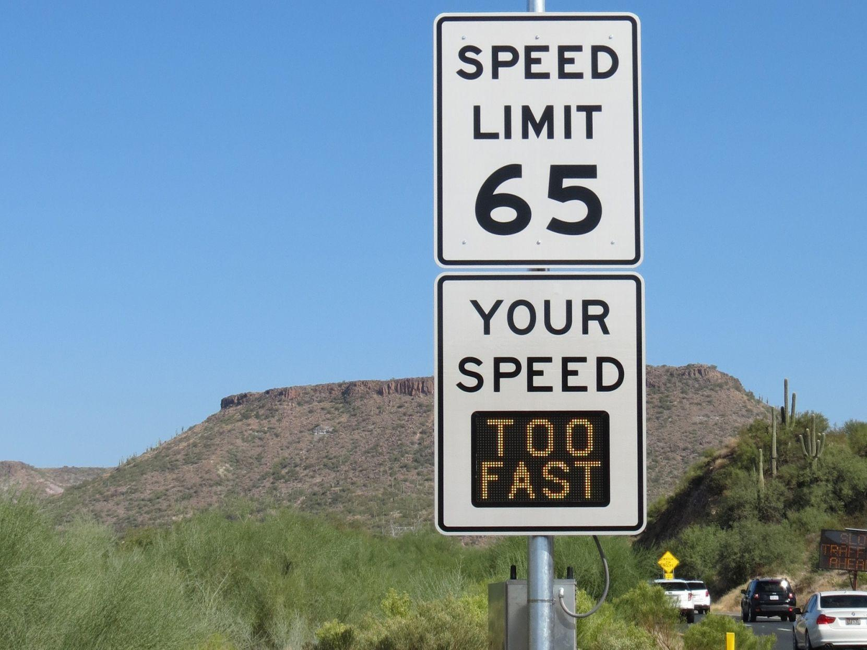

Slide 8
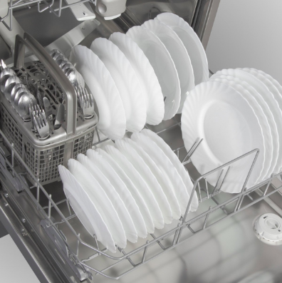
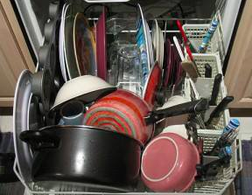
OR

Slide 9
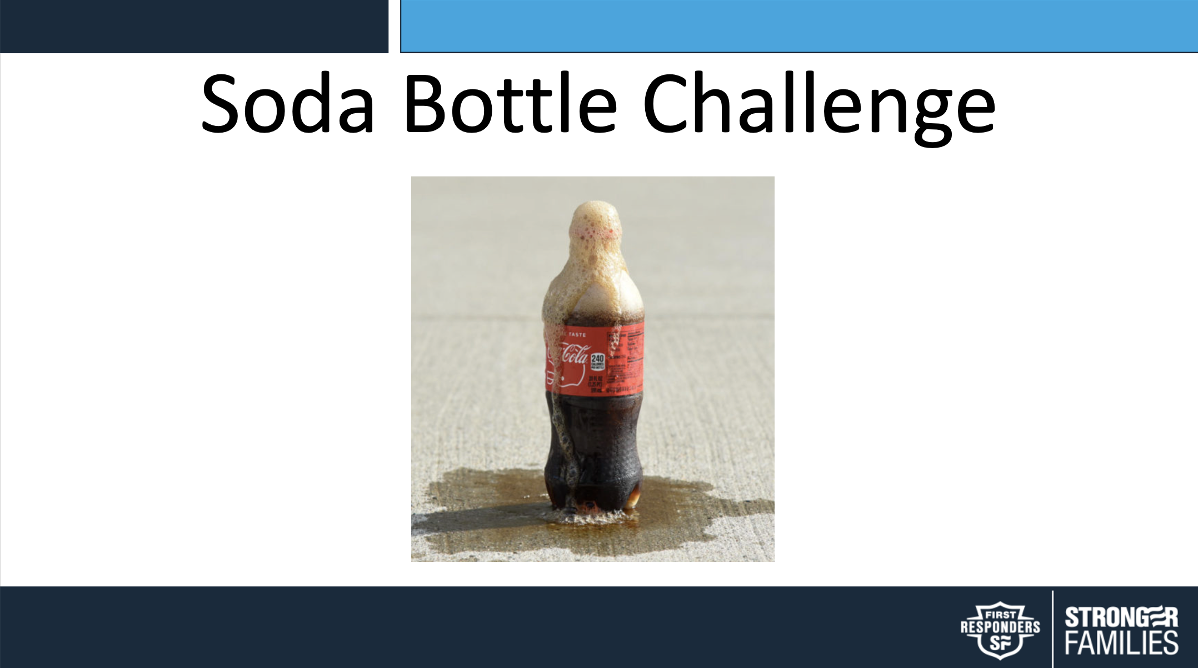

Slide 10


Slide 11
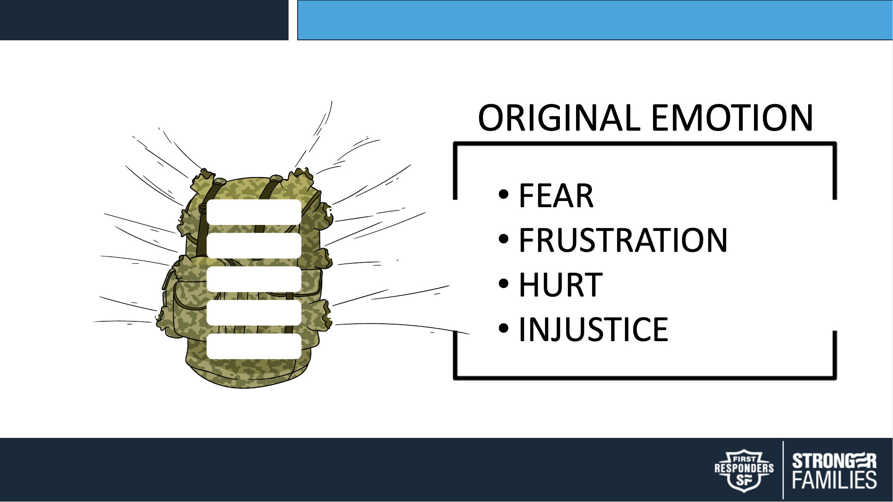
ANGER
SHAME
GUILT
DESIRE
LOVE

Slide 12
Unpacking Your Rucksack
Breakout Activity

Slide 13
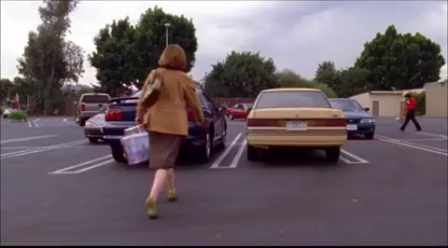

Slide 14

HOT TEMPER
BLAMING
SELF-PITY
BREAKING PROMISES
ANGER
PLAYING THE VICTIM
SHAME
STONEWALLING
GUILT
DESIRE
ISOLATION/WITHDRAWING
LOVE

Slide 15
What’s Your Boiling Point?
Breakout Activity

Slide 16
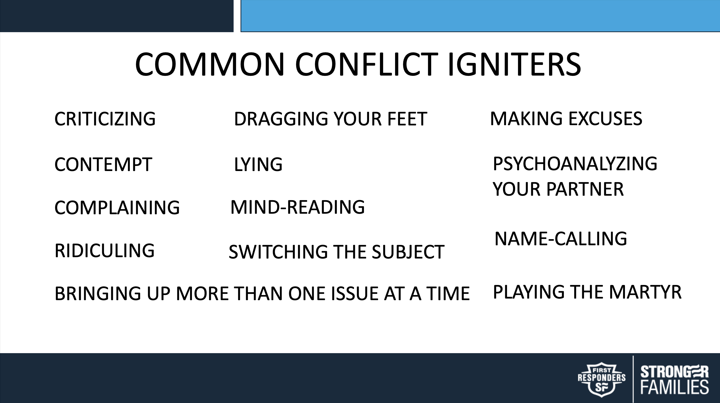

Slide 17
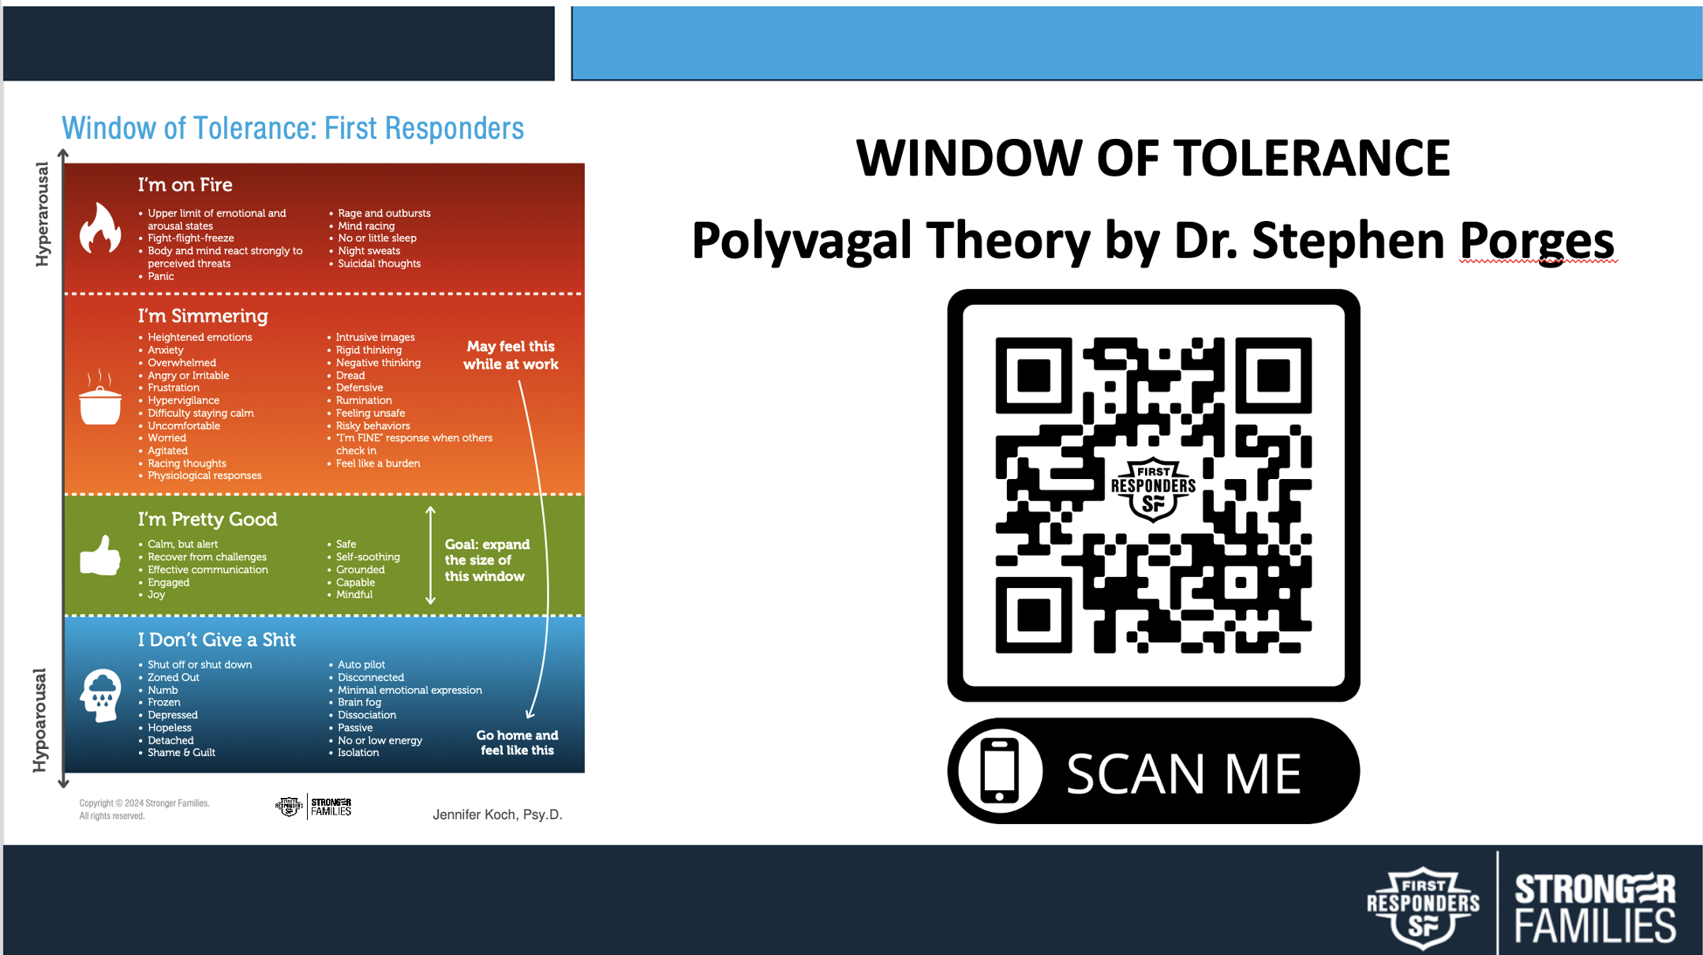

Slide 18
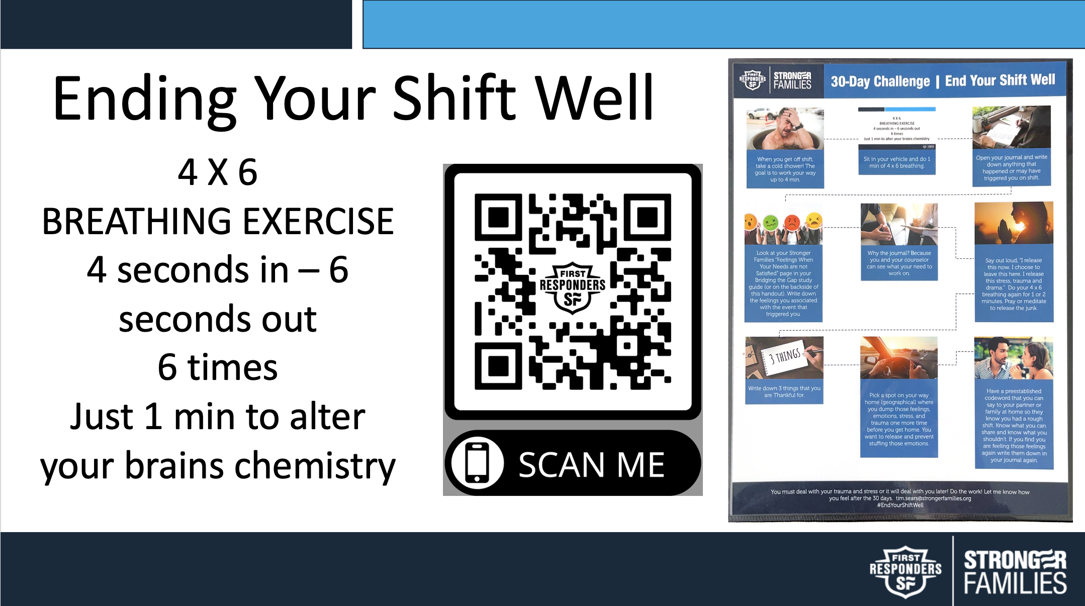

Slide 19
Your Personality & How You Handle Stress

Slide 20

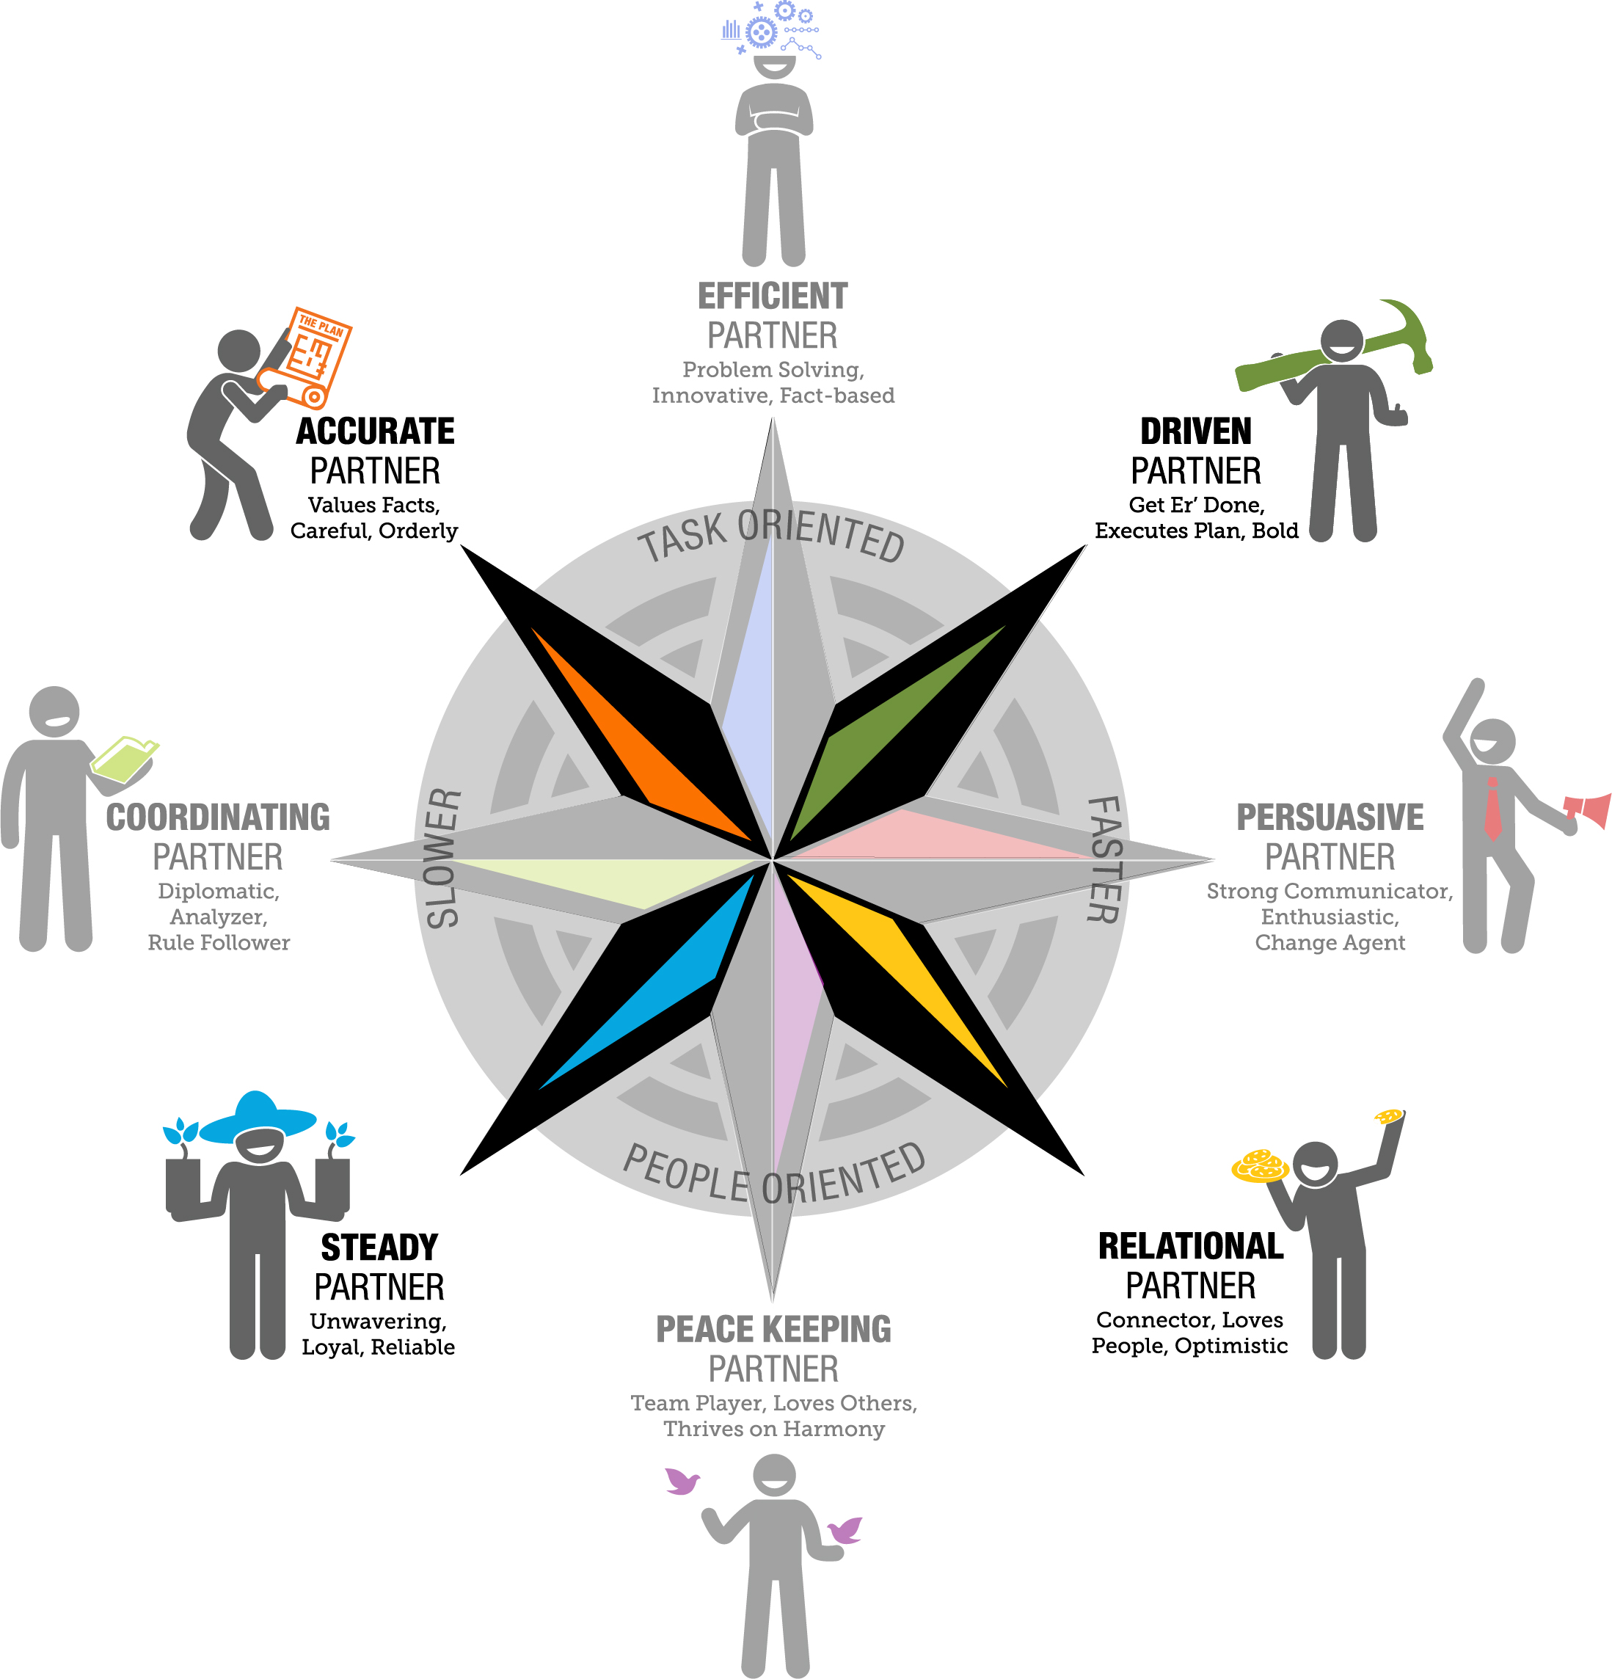
Under Stress = Focus on Task

Slide 21
Under Stress = Focus on People

Slide 22
Under Stress =
Uses Confrontation To Connect

Slide 23
Under Stress = Avoids Confrontation at ALL Cost

Slide 25
How To Respond, Relate, Reinforce when under STRESS

Slide 26
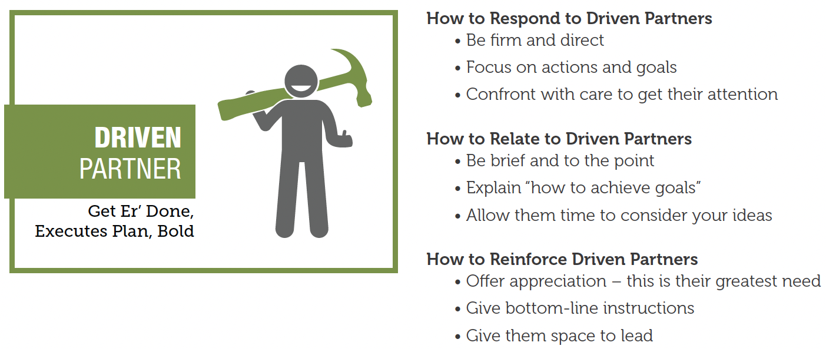

Slide 27
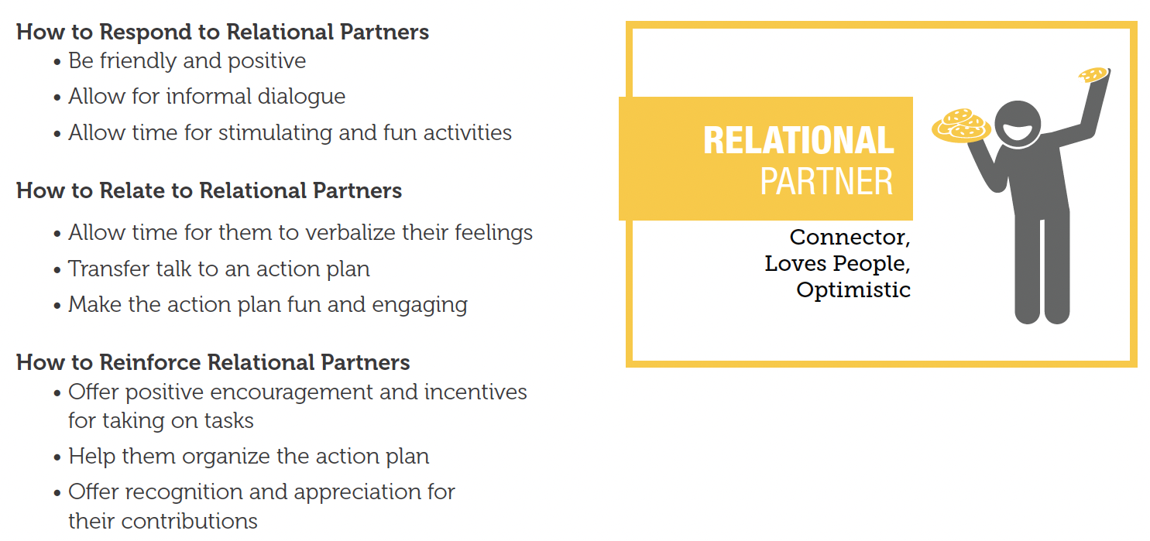

Slide 28
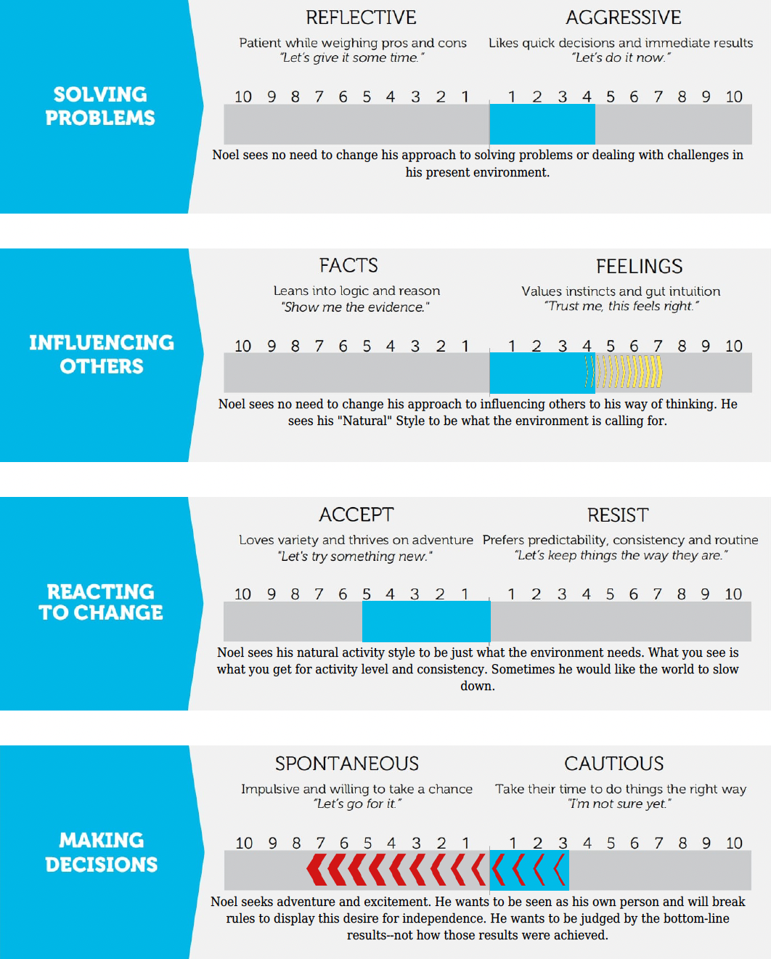
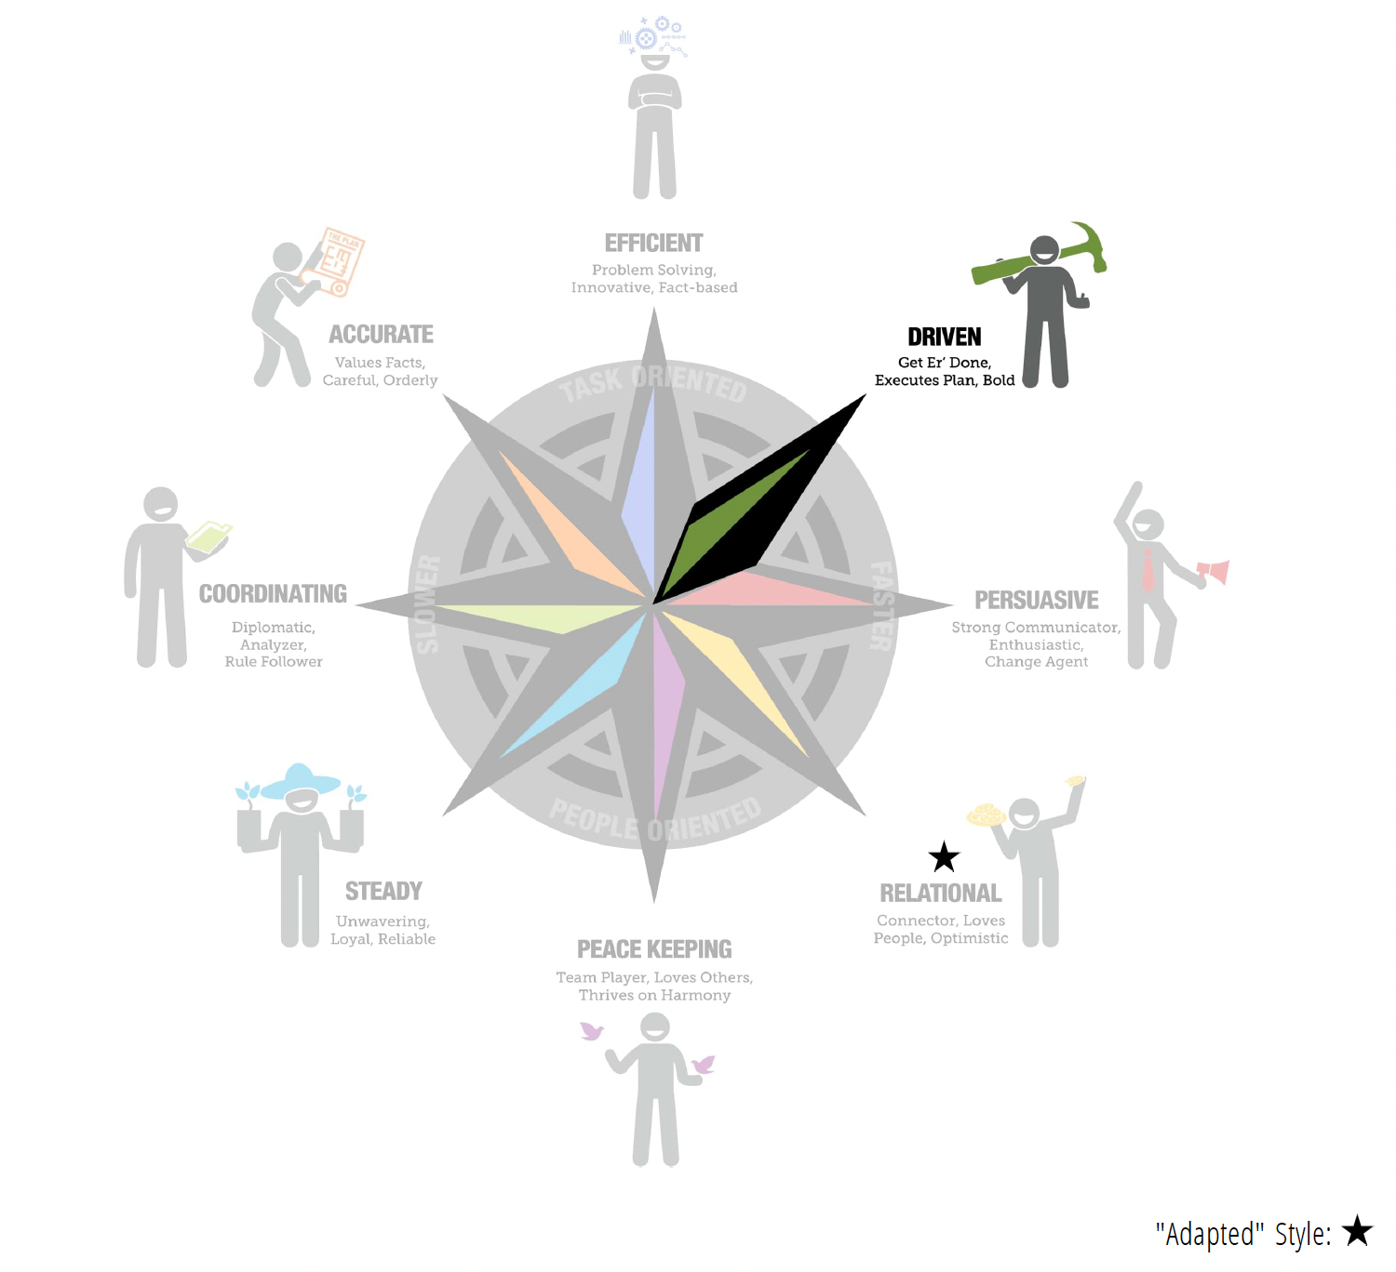
How are you
Adapting
At Home and Work?

Slide 29
Emotional Connectedness
Breakout Activity

Slide 30
Weekly Emotional Check-In
Breakout Activity

Slide 31
Add Video: Nick Story Pt. 2
(videos can be downloaded from the following link)

Slide 32
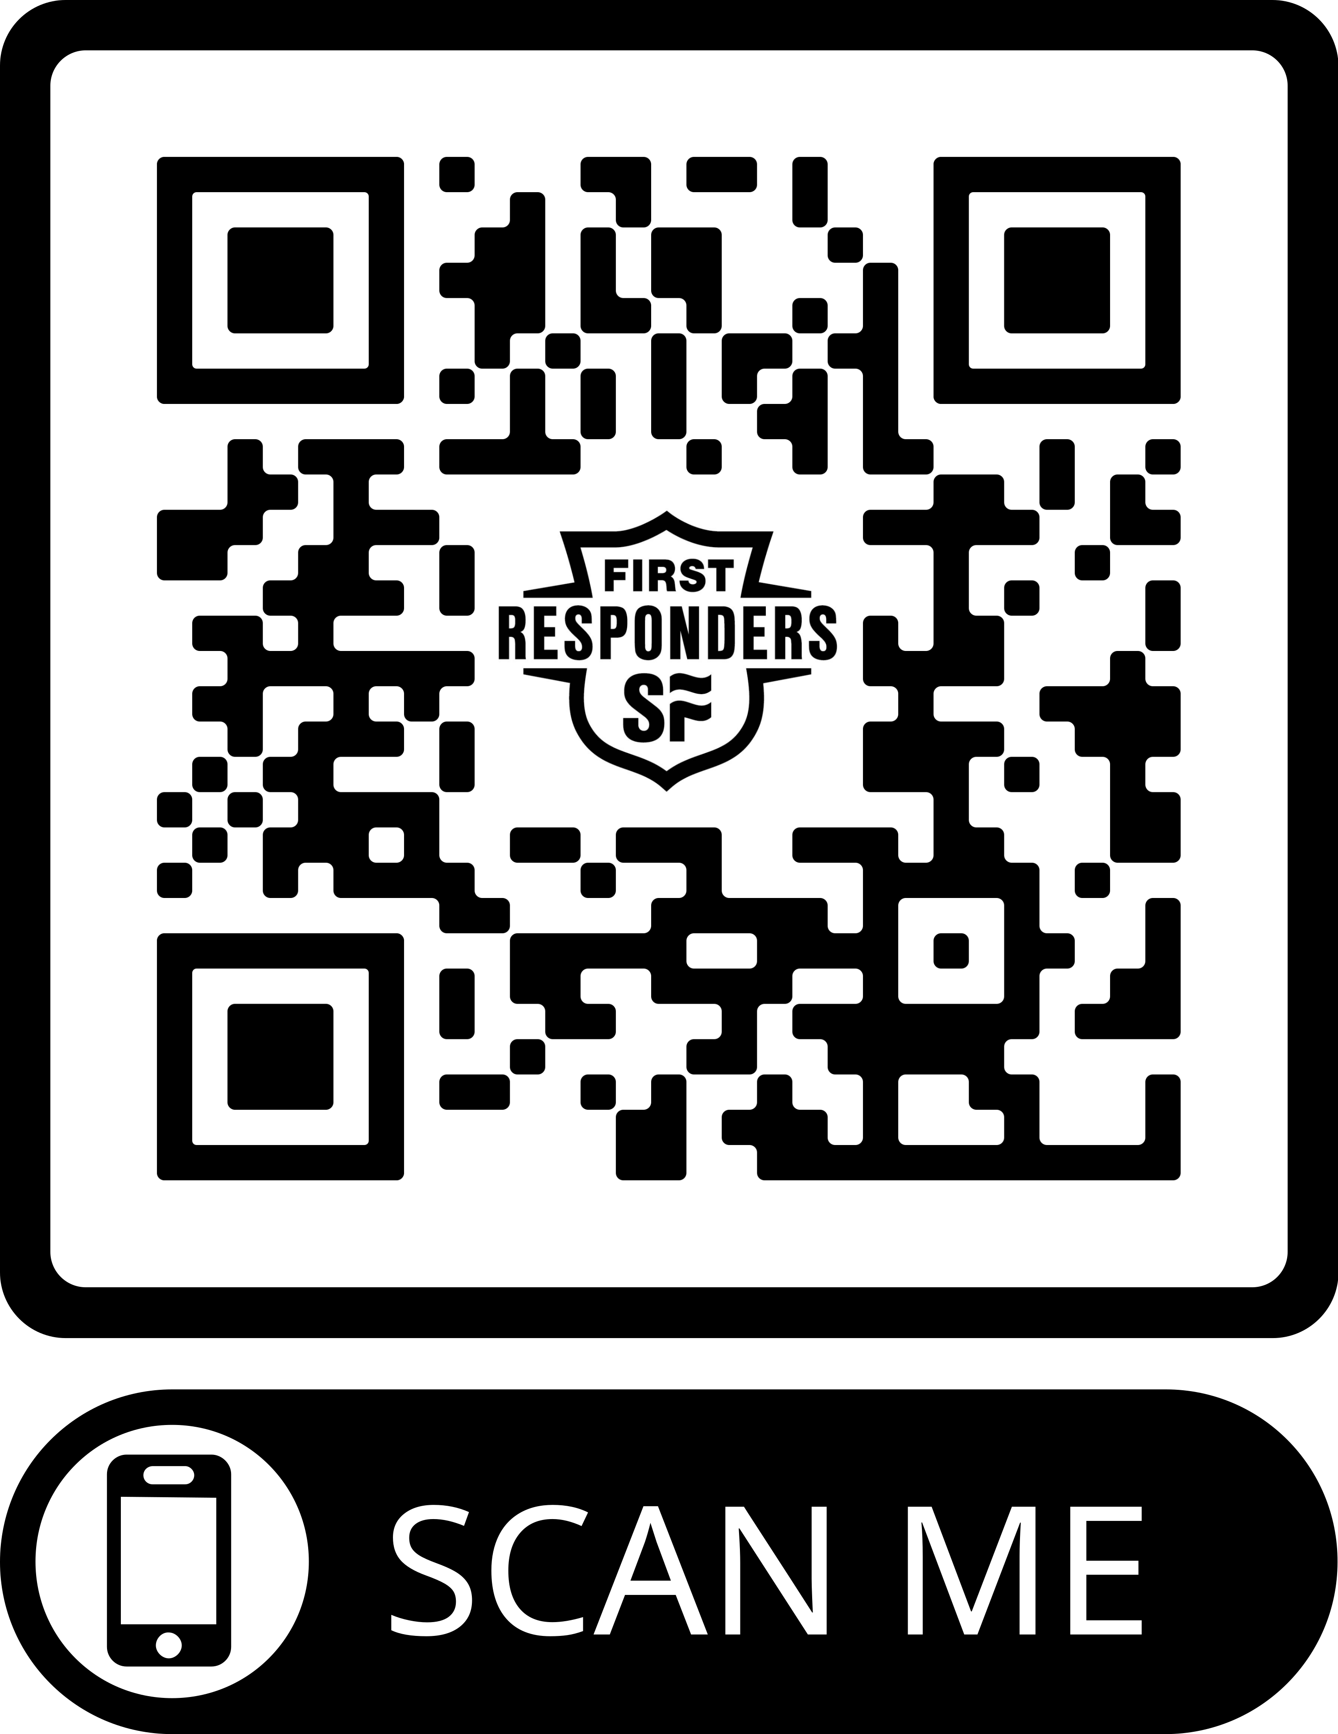
TELL US WHAT YOU THINK
Your input will have a direct impact on the development of this program. Thank you!

Slide 33
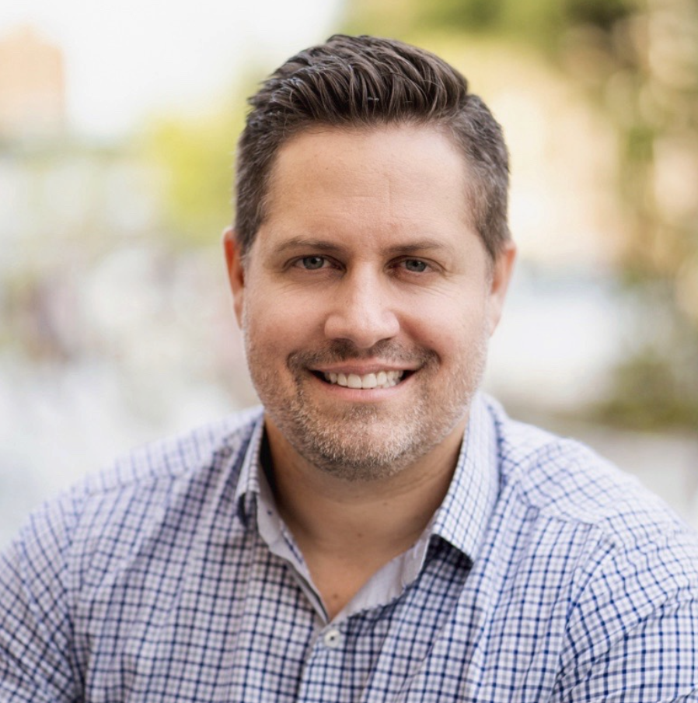
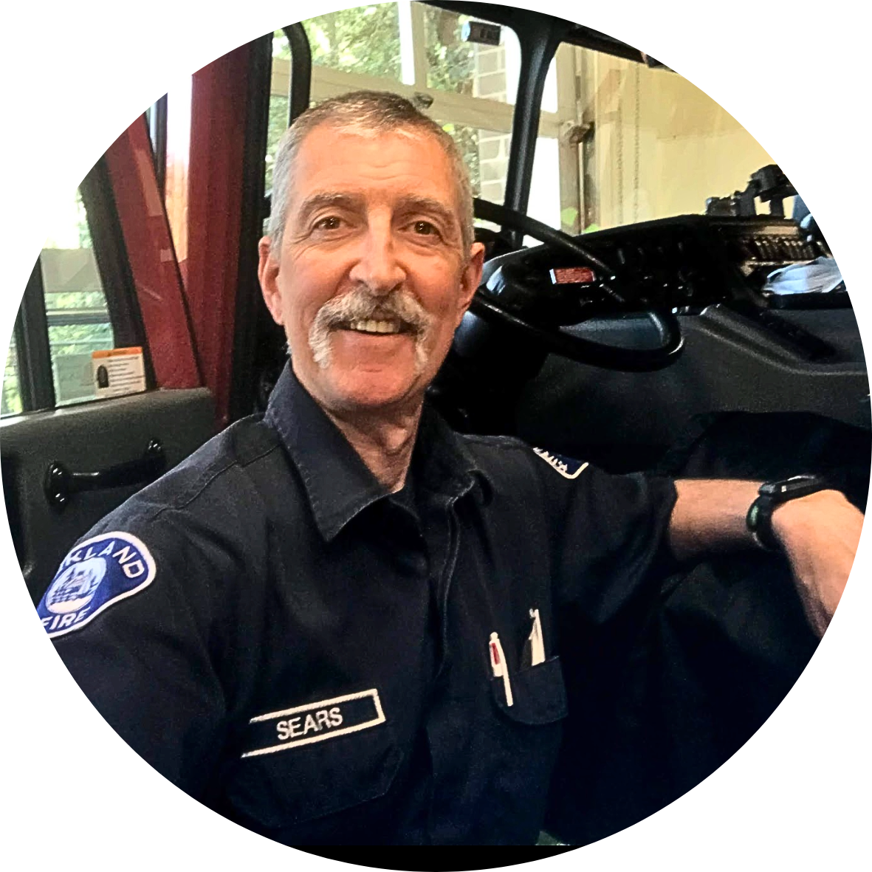
Email: noel.meador@strongerfamilies.org
Instagram & Facebook: @noelmeador
Phone: 206-356-1040
Email: tim.sears@strongerfamilies.org
Phone: 425-231-4861

