Slide 1


Leading From
YOUR STRENGTHS

Slide 2

What makes an effective TEAM?

Slide 3

PROBLEM
SOLVING

Slide 4

INFLUENCING OTHERS

Slide 5
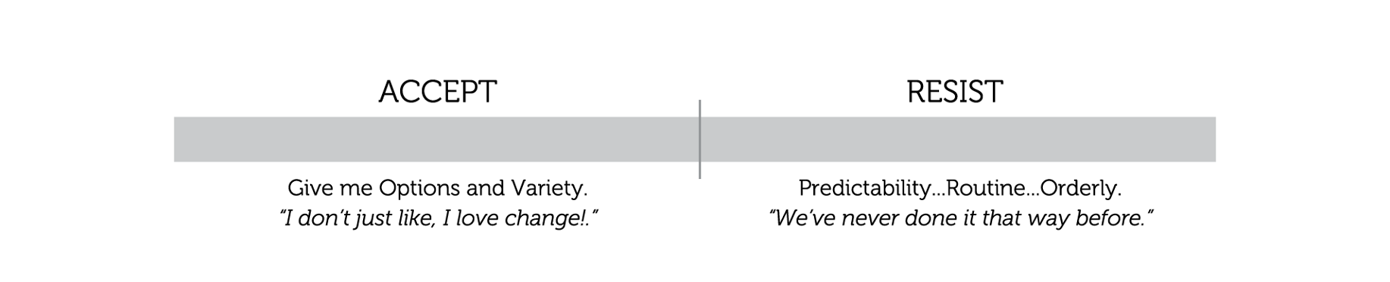
REACTING TO CHANGE

Slide 6
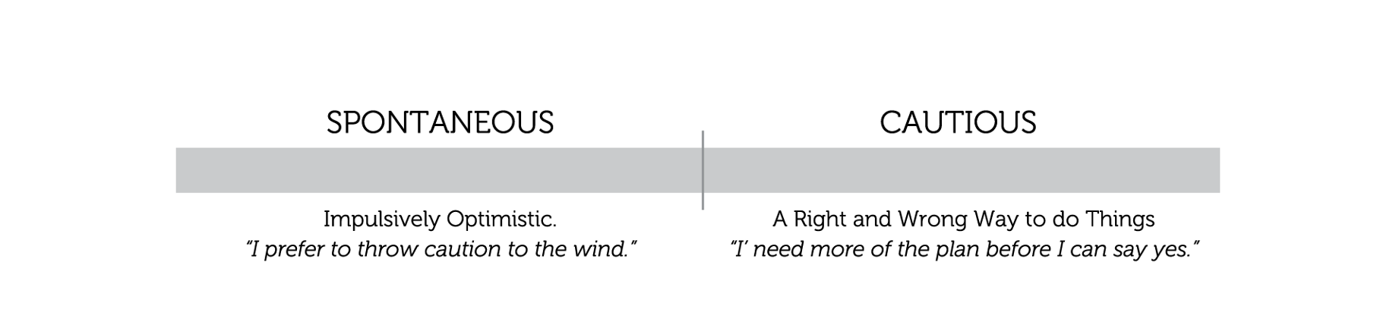
DECISION
MAKING

Slide 7
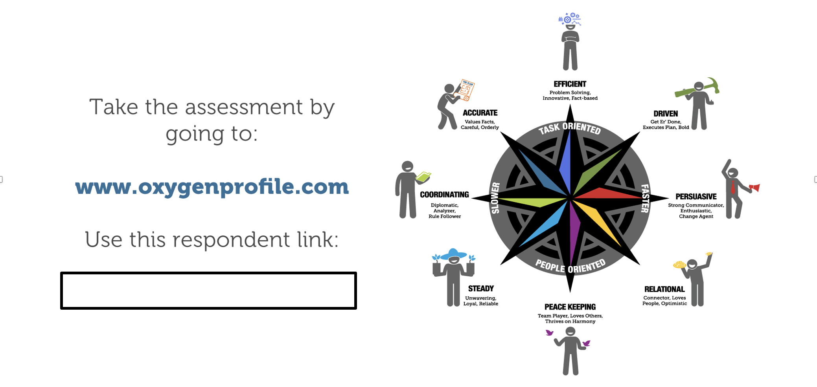

Slide 8
Understanding Your Unique Strength

Slide 9
Study Guide
Pages 3-6
Read through your OXYGEN Profile Assessment Report.
Note how you show up when Solving Problems, Influencing Others, Reacting to Change, and Making Decisions.
Answer the questions for each area found in the Study Guide

Slide 10
SOLVING PROBLEMS
REFLECTIVE QUESTIONS
Question #1:
What have you learned about yourself in this category
(positive or negative) that impacts your team?
Question #2:
What do you need from other members of your team in
order to be successful?

Slide 11
INFLUENCING OTHERS
REFLECTIVE QUESTIONS
Question #1:
What have you learned about yourself in this category
(positive or negative) that impacts your team?
Question #2:
What do you need from other members of your team in
order to be successful?

Slide 12
REACTING TO CHANGE
REFLECTIVE QUESTIONS
Question #1:
What have you learned about yourself in this category
(positive or negative) that impacts your team?
Question #2:
What do you need from other members of your team in
order to be successful?

Slide 13
MAKING DECISIONS
REFLECTIVE QUESTIONS
Question #1:
What have you learned about yourself in this category
(positive or negative) that impacts your team?
Question #2:
What do you need from other members of your team in
order to be successful?

Slide 14
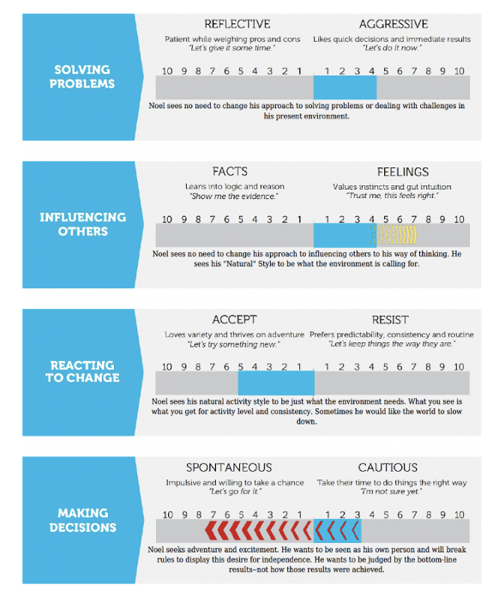
HOW ARE YOU
ADAPTING
AT HOME
AND WORK?

Slide 15
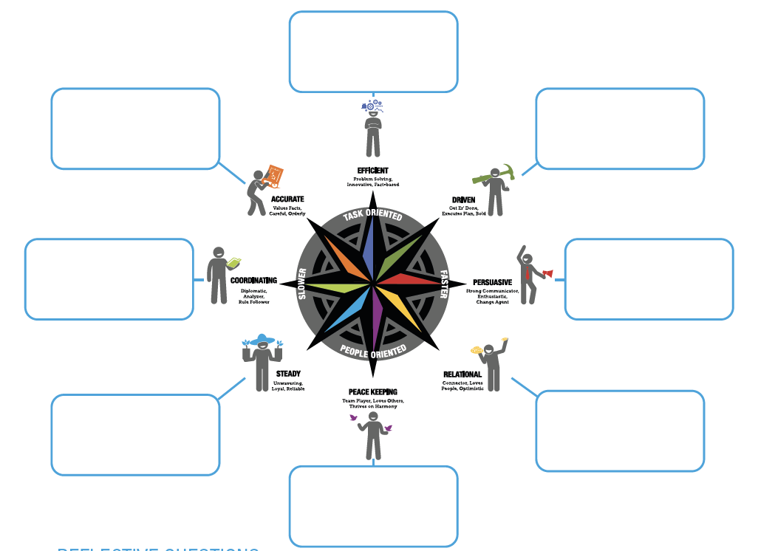
MAPPING YOUR TEAM

Slide 16
MAPPING YOUR TEAM
REFLECTIVE QUESTIONS
Question #1:
Is the map of your team evenly spread around the compass? What
does that mean for your team dynamic?
Question #2:
What strengths are indicated by the map of your team? What is one
thing that your team does very well because of that strength?
Question #3:
What challenges are indicated by the map of your team? Provide an
an example of when your team has had to face that challenge?

Slide 17
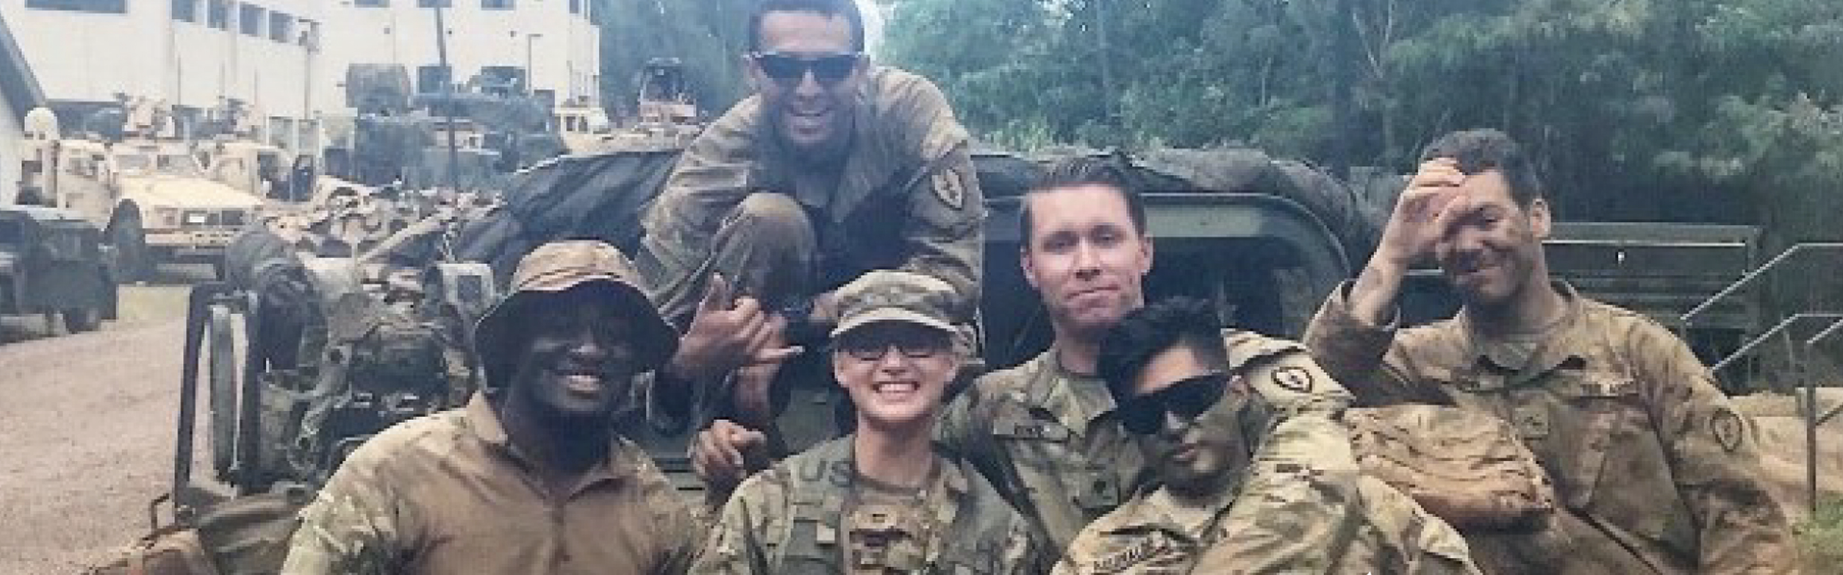
UNDERSTANDING
DIFFERENCES

Slide 18

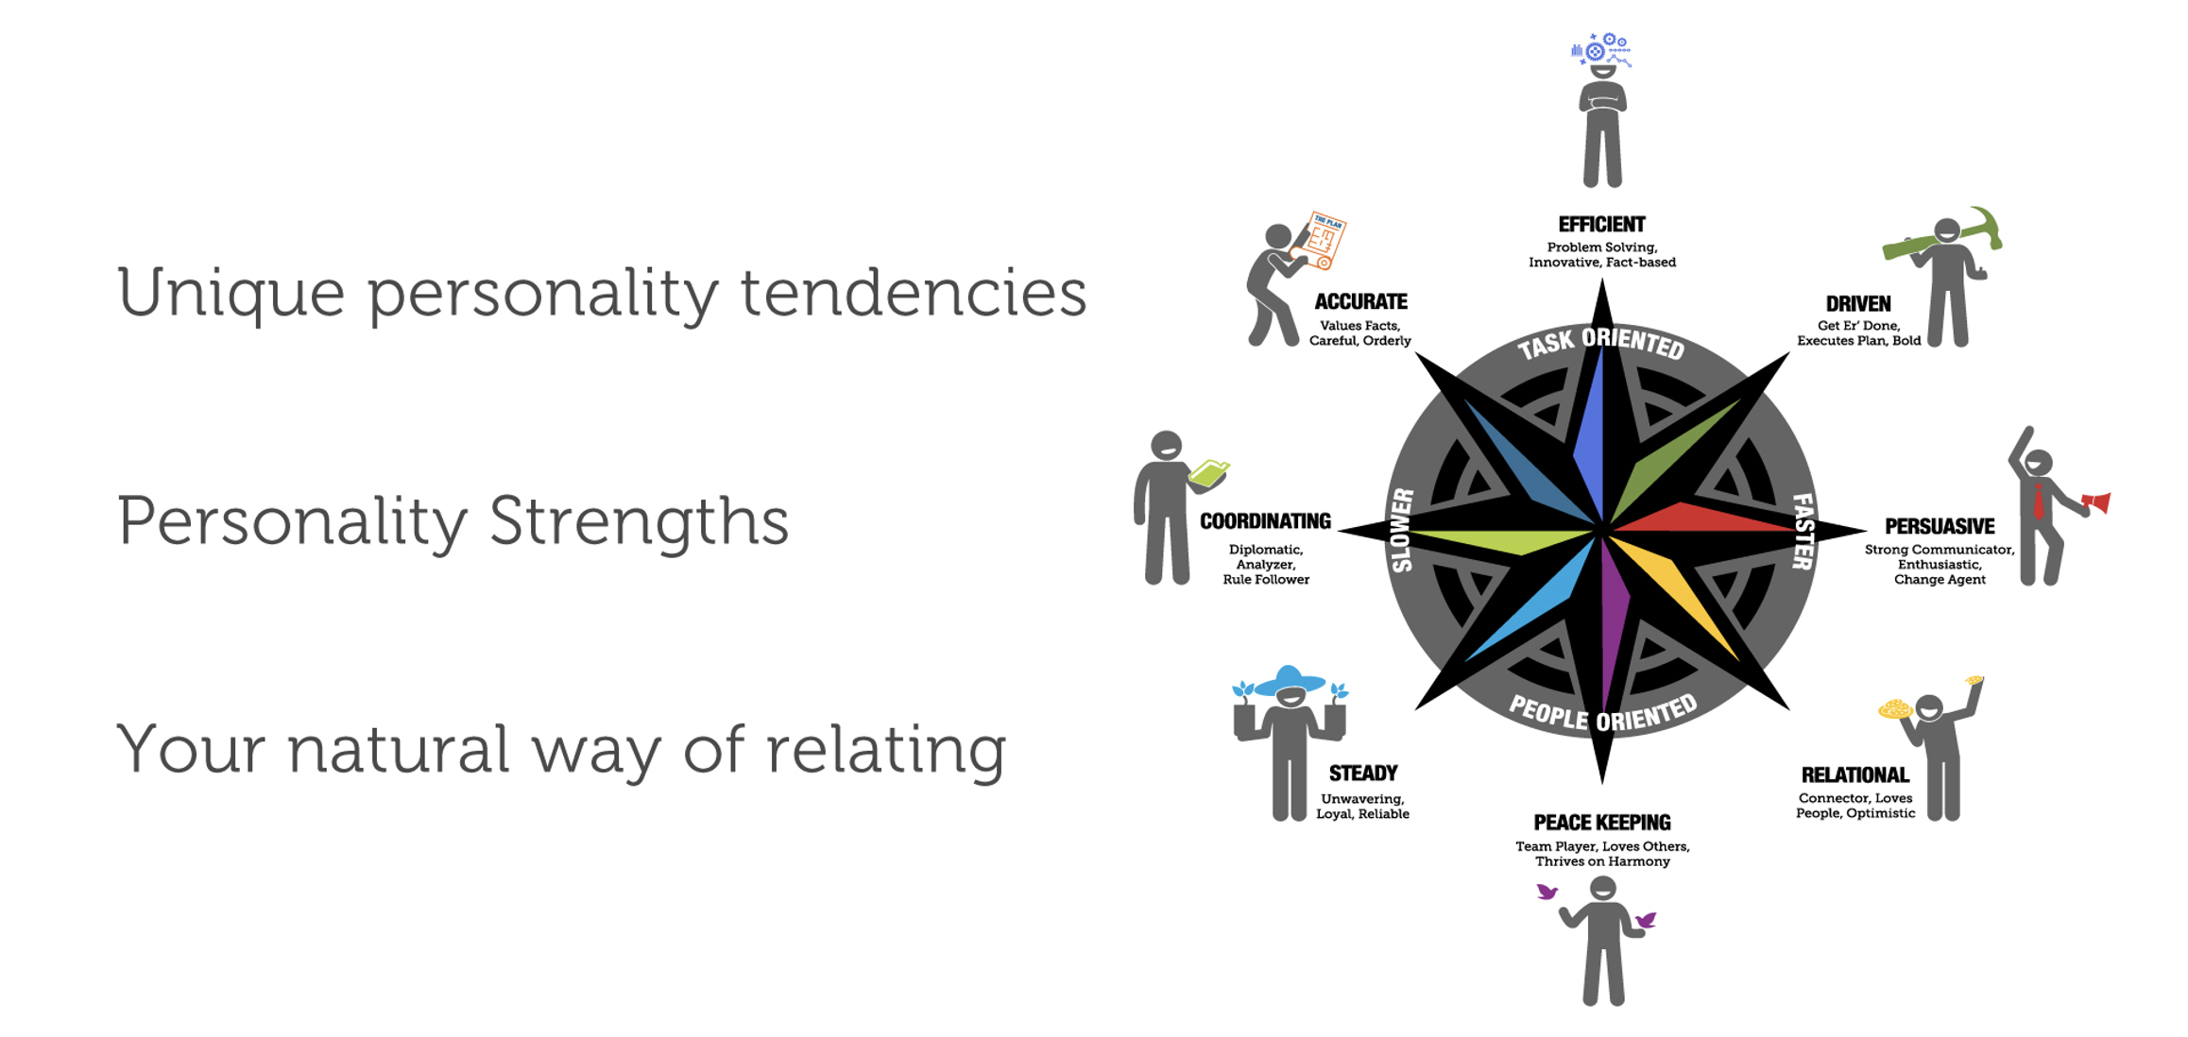

Slide 19
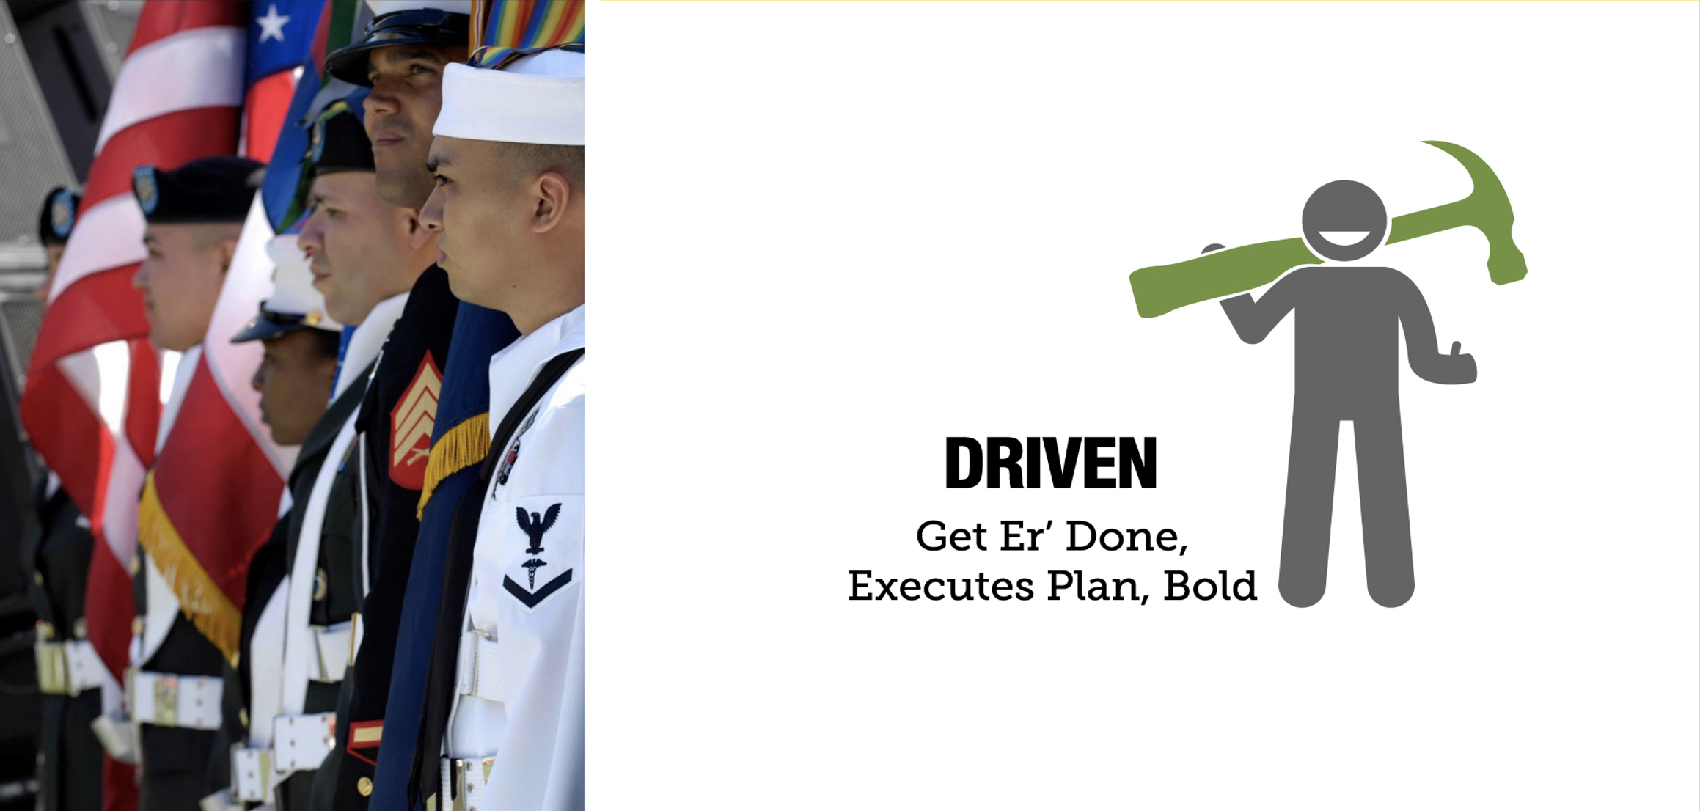

Slide 20


Slide 21


Slide 22


Slide 23


Slide 24
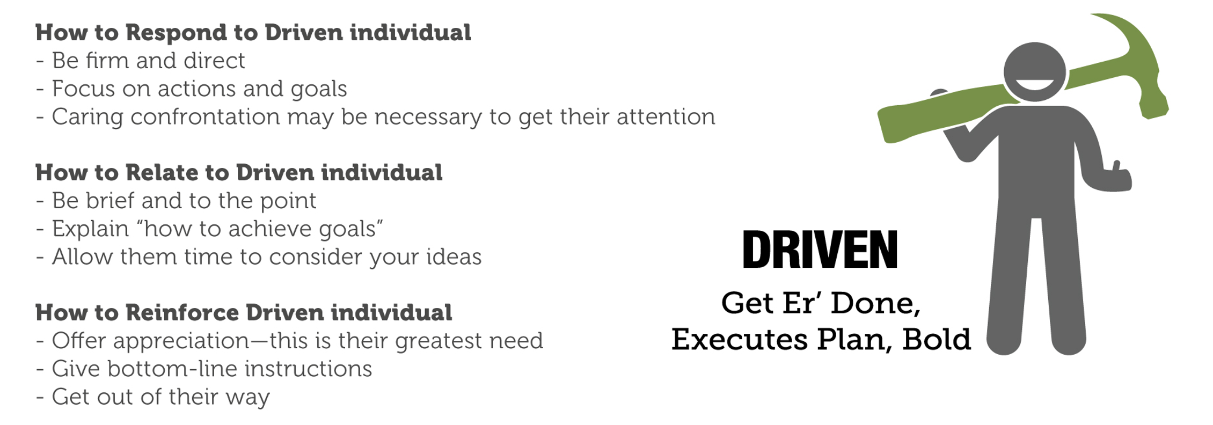
DRIVEN – 3 R’S

Slide 25
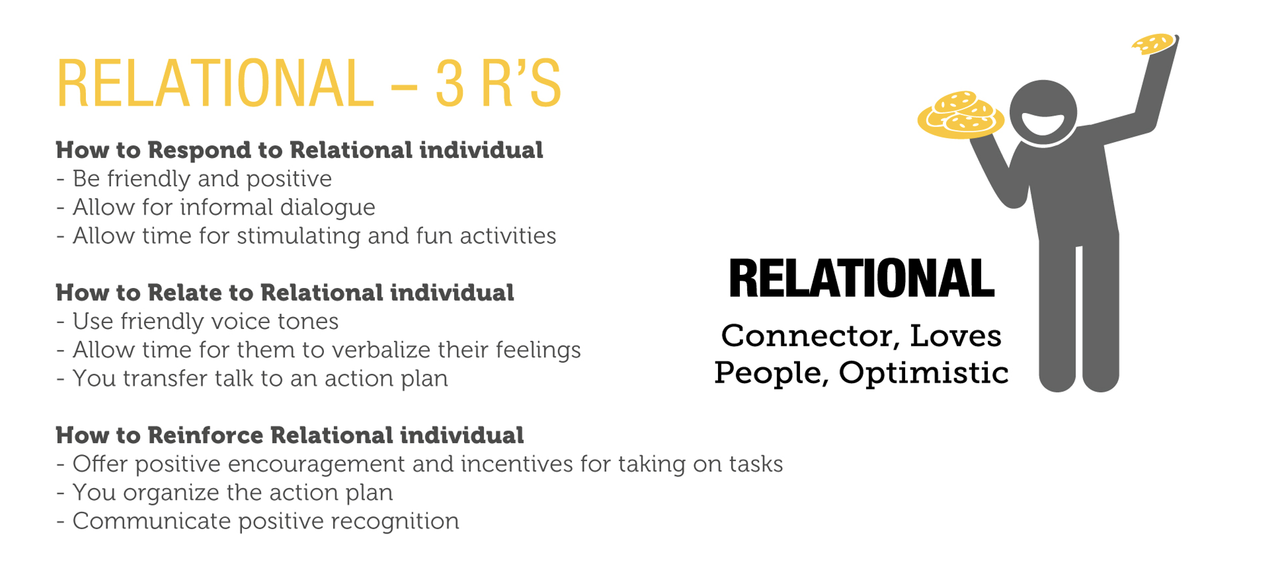
RELATIONAL – 3 R’S

Slide 26
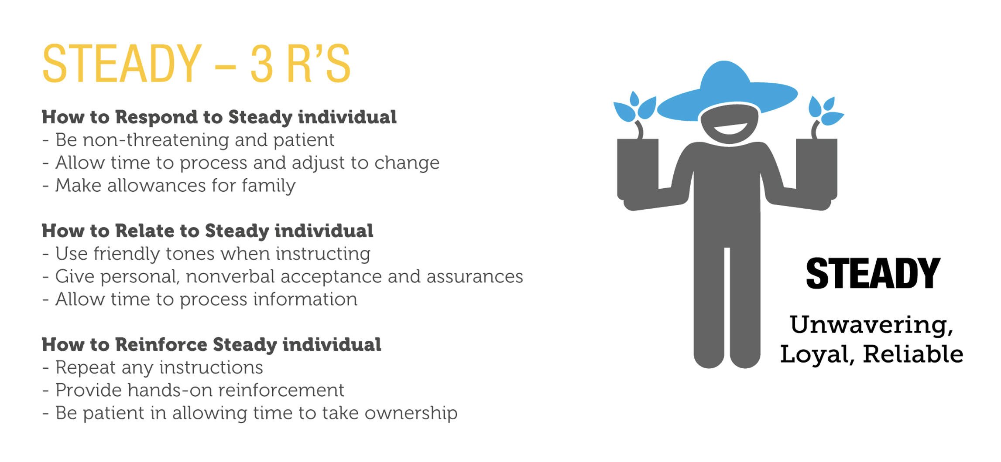
STEADY – 3 R’S

Slide 27
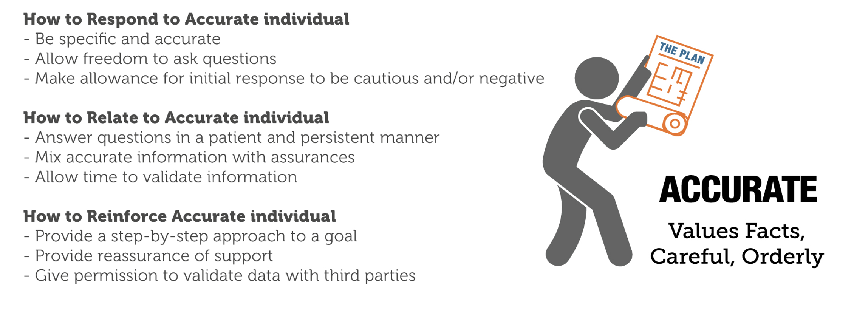
ACCURATE – 3 R’S

Slide 28

KEYS TO MOTIVATING

Slide 29
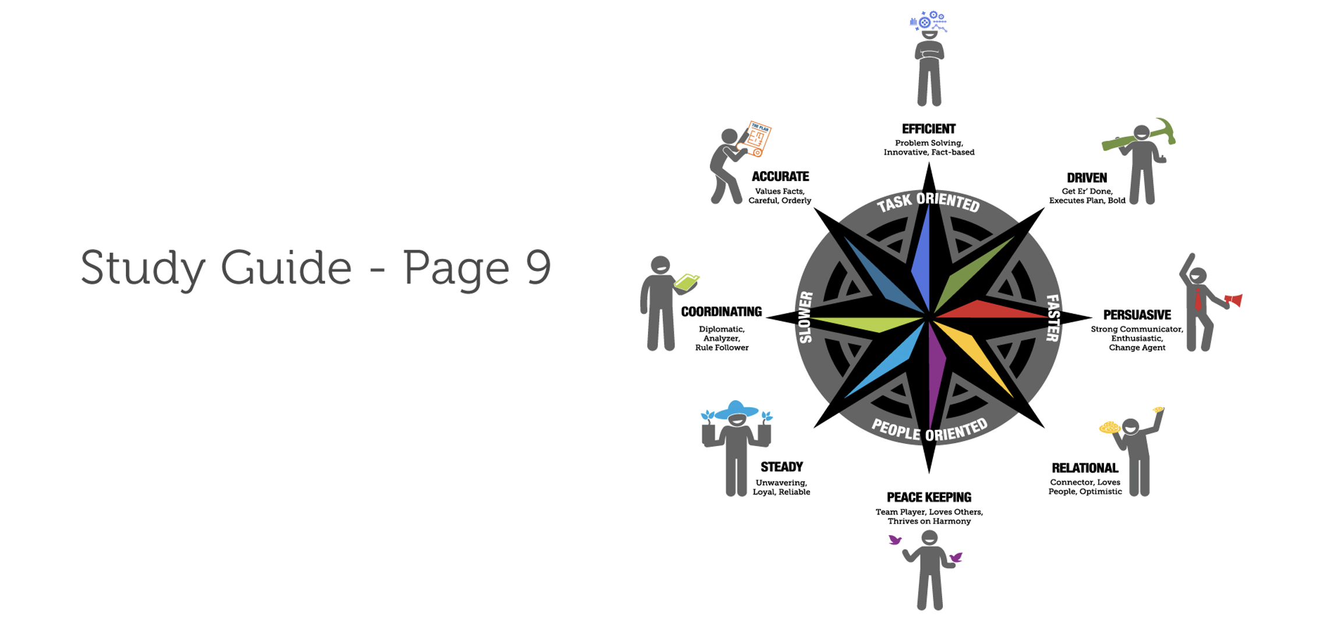
ACTION PLAN

Slide 30

BUILDING EFFECTIVE
COMMUNICATION

Slide 31
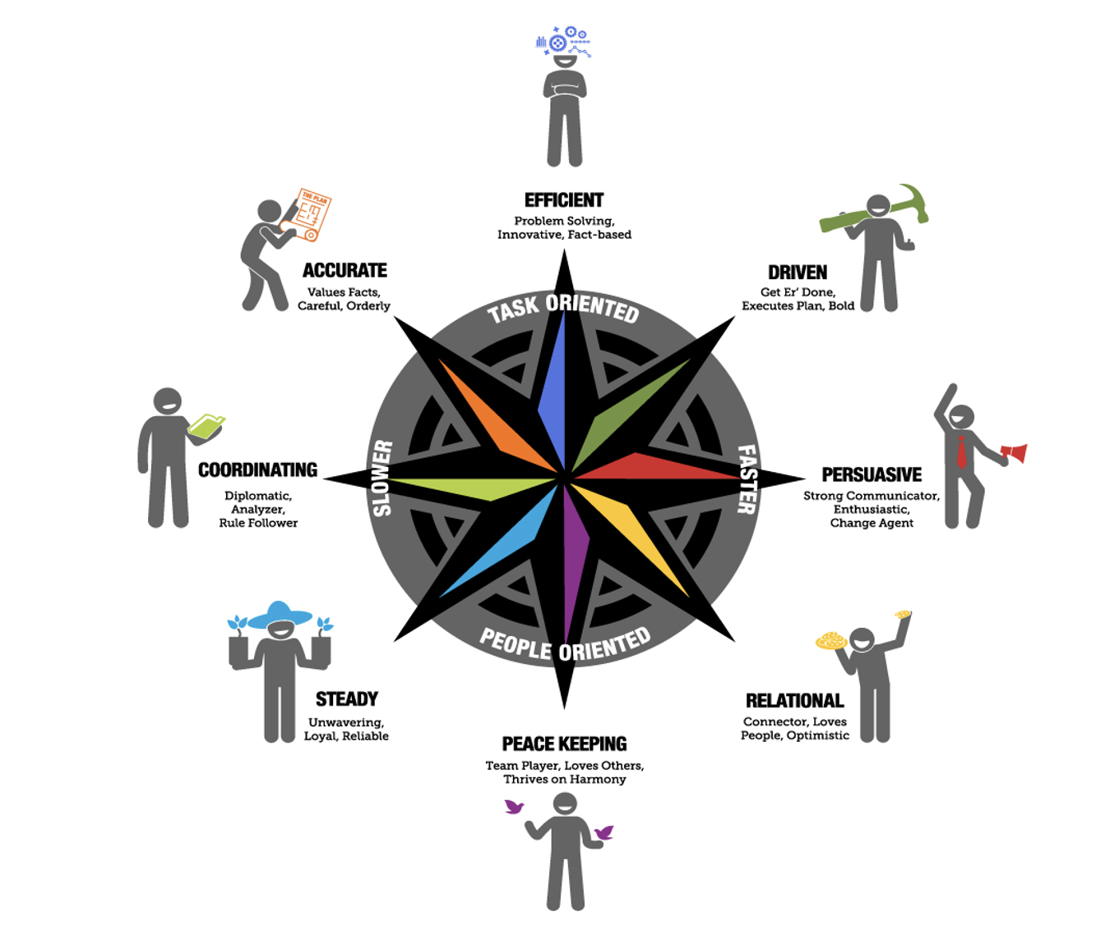
KEYS TO
COMMUNICATION

Slide 32
BREAKOUT ACTIVITY
“Keys to Communication”

Slide 33
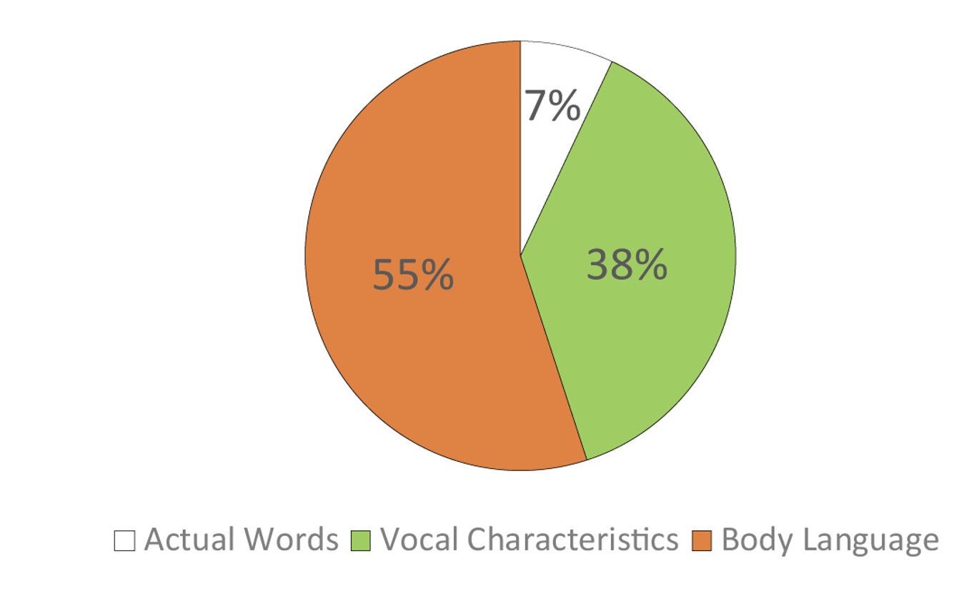
NONVERBAL COMMUNICATION

Slide 34
YOU’RE GETTING ROBBED
“INSERT VIDEO HERE”

Slide 35
THE POWER OF EMPATHY
“INSERT VIDEO HERE”

Slide 36
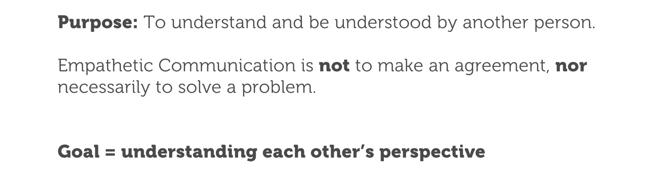
THE EMPATHTIC COMMUNICATION

Slide 37
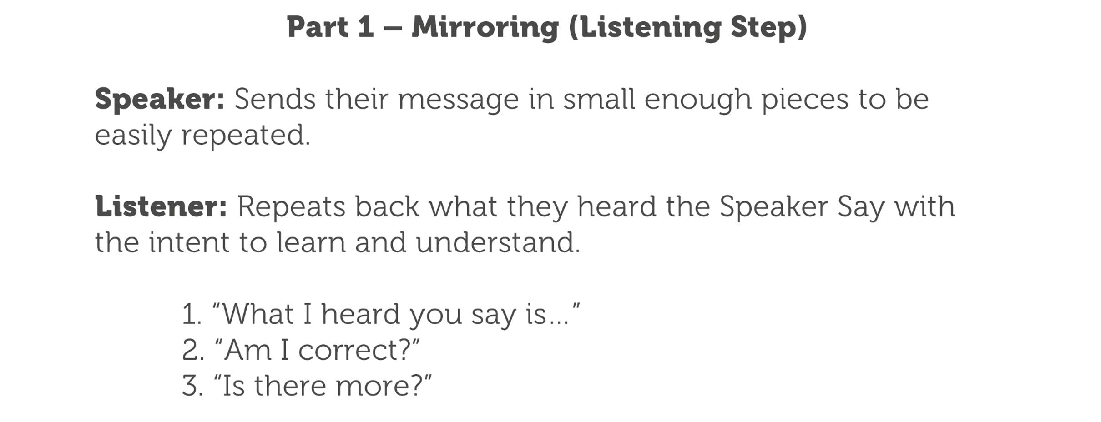
HOW EMPATHTIC COMMUNICATION WORKS

Slide 38
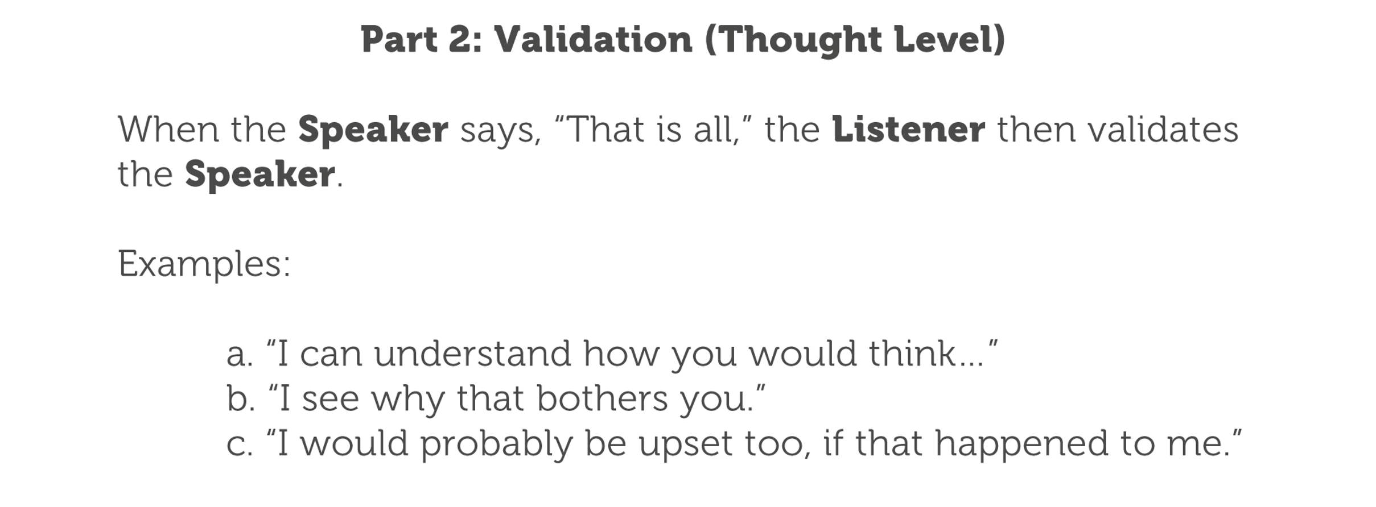
HOW EMPATHTIC COMMUNICATION WORKS

Slide 39
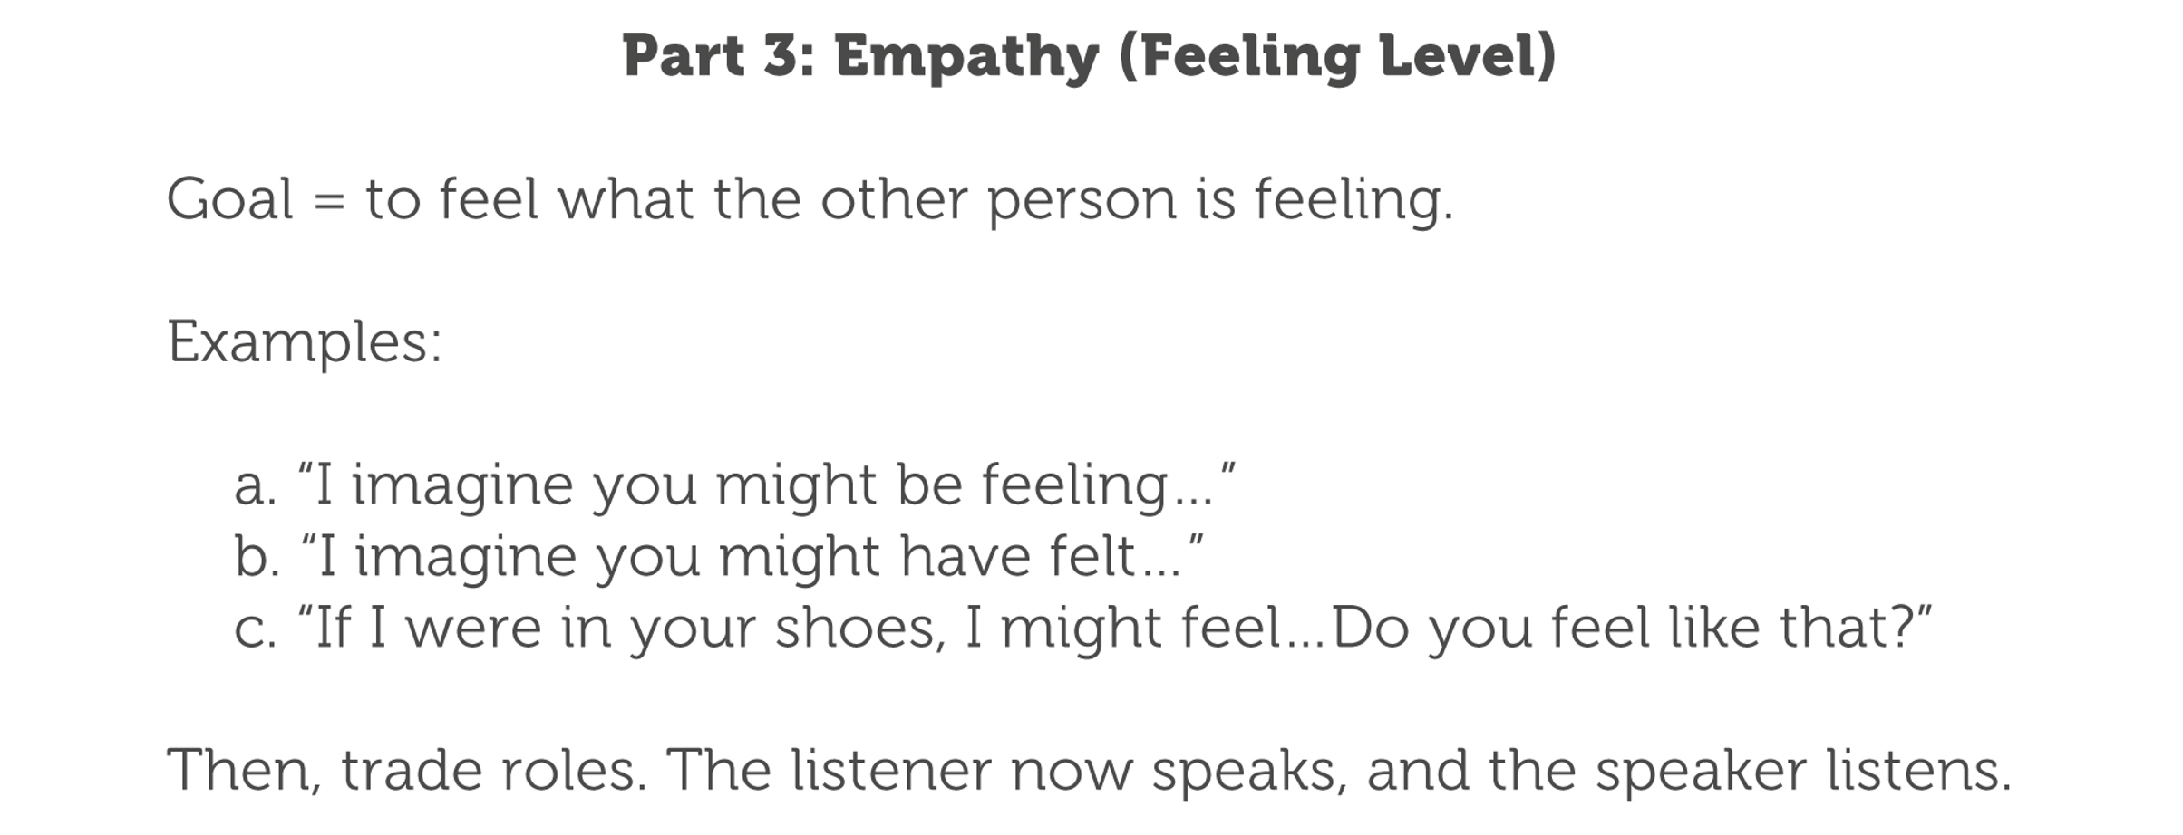
HOW EMPATHTIC COMMUNICATION WORKS

Slide 40
EMPATHETIC
COMMUNICATION
“ACTIVITY”

Slide 41
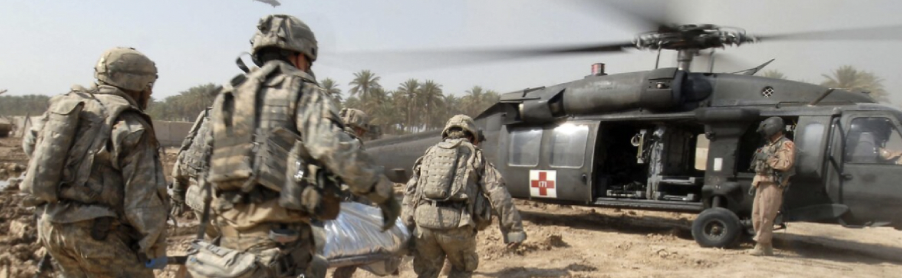
CREATING COLLABORATION THROUGH
CONFLICT

Slide 42
WHAT WE WILL EXPLORE TODAY…
CONFLICT PERSONAS
CONFLICT CONTAINED
GETTING STUCK: ACTIONS VS FEELINGS

Slide 43
DUEL AT THE MALL
“INSERT VIDEO HERE”

Slide 44

THE
BLAME
GAME

Slide 45
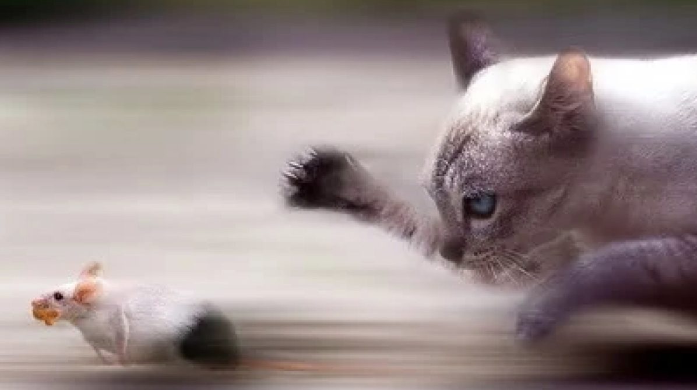
CAT
AND
MOUSE

Slide 46

TEA
POT

Slide 47

THE
FREEZE
OUT

Slide 48
CONFLICT & YOUR PERSONALITY
(Study Guide – Pages 3 & 4

Slide 49
PUTTING OUT THE FIRE – TIME OUT
Recognize
Request
Relax
Remember
Resume

Slide 50
WHERE DO YOU GET STUCK?
SSG Jones says…
“I get stuck when you _______________________ ,
When I get stuck, I feel_______________________ ,
When I feel this way, I _______________________ ,
How does this impact you?
RAISE YOUR INTENSITY
OVERWHELMED
SHUT DOWN/DON’T ENGAGE
- ACTION
- FEELINGS

Slide 51
WHERE DO YOU GET STUCK?
SSG Smith says…
“I get stuck when you _______________________ ,
When I get stuck, I feel_______________________ ,
When I feel this way, I _______________________ ,
How does this impact you?
SHUT DOWN/DON’T ENGAGE
UNHEARD
RAISE YOUR INTENSITY
- ACTION
- FEELINGS

Slide 52
BACK ON COURSE
OWNER: FEELINGS: NEGATIVE ACTION: ALTERNATIVE ACTION:
JONES
UNCERTAIN
SHUT DOWN
CLEARLY STATE MY STATUS
SMITH
UNHEARD
RAISE INTENSITY
ASK FOR FEEDBACK

Slide 53
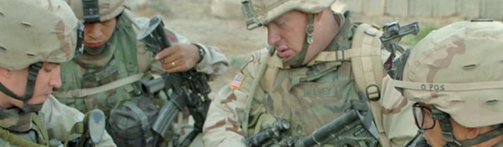
APPRECIATION STYLES IN THE WORKPLACE

Slide 54
THE ONE WITH THE SPAGHETTI
A SCENE FROM FRIENDS
(INSERT VIDEO HERE)

Slide 55

STEP 3
CONNECTION
STEP 2
COMMITMENT
STEP 1
COMRADERY
Step 1
COMRADERY

Slide 56
QUESTIONS FOR REFLECTION
BREAKOUT ACTIVITY
Study Guide – Pages 3

Slide 57
APPRECIATION STYLE
ASSESSMENT
Study Guide – Pages 6-7

Slide 58
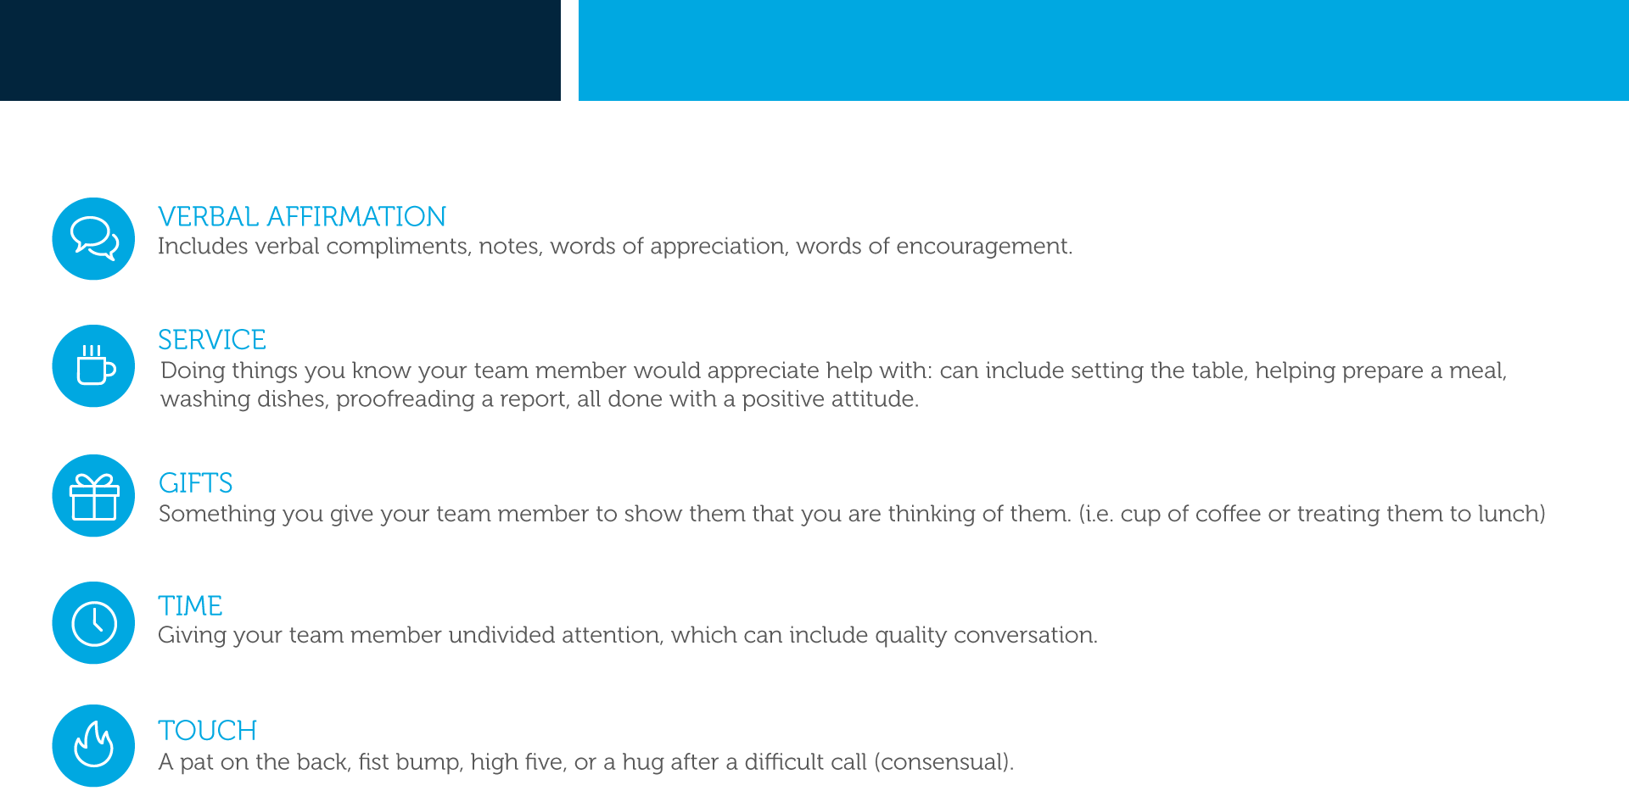

Slide 59
SUBJECT MATTER
EXPERT ACTIVITY

Slide 60

TRANSITION: MANAGING LIFE’S TRANSITIONS

Slide 61


Slide 62


Slide 63
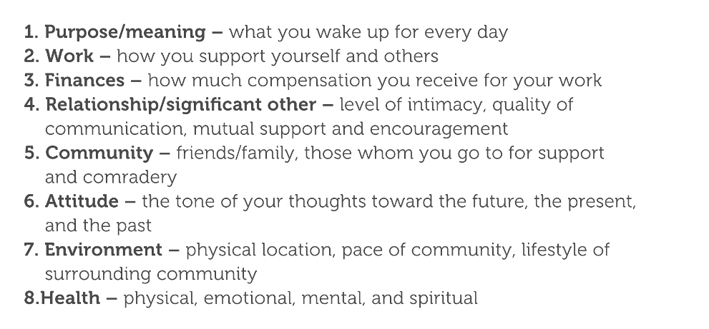

Slide 64
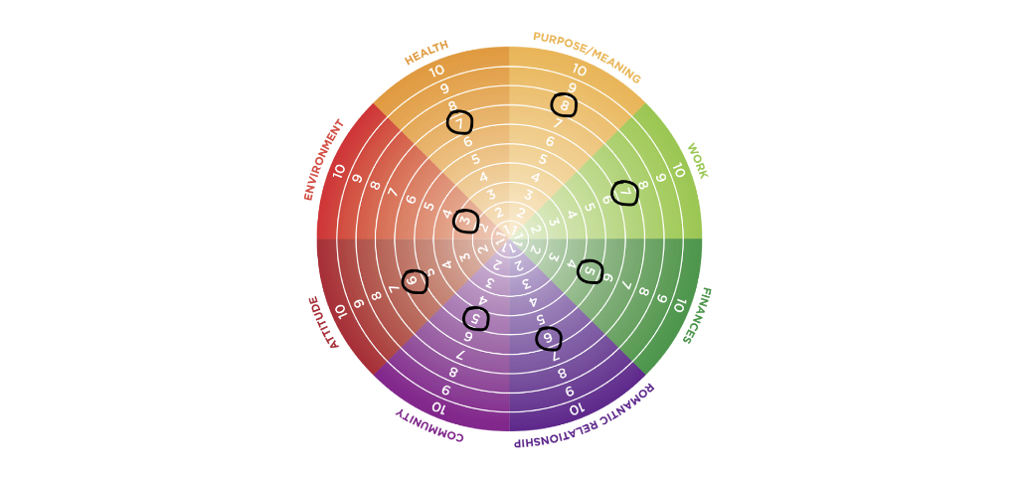

Slide 65
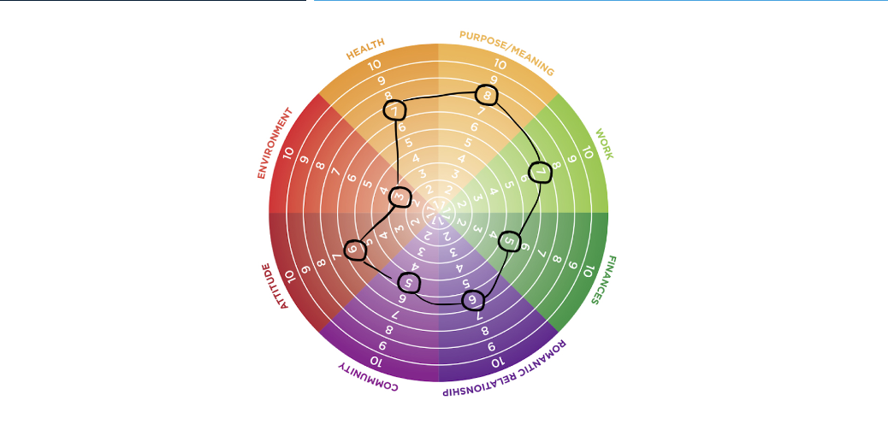

Slide 66
WHICH 5 WORDS
DESCRIBE YOU?

Slide 67
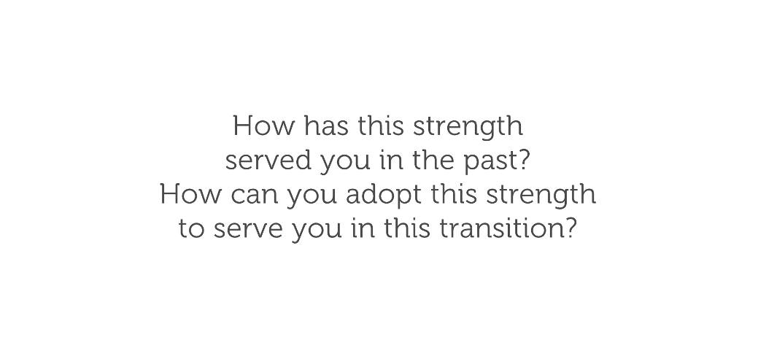

Slide 68
DON’T GO
IT ALONE!

Slide 69
ACTION PLAN
Identify One thing you can do
To move One spoke on the Wheel
Up One level of satisfaction

Slide 70


Slide 71
