Slide 2
121780JVP
http://strongerfamilies.com/couple-checkup

Slide 3
Introductions… 1. How long have you been together? 2. The first thing you noticed about your spouse? 3. Something unique about your relationship?

Slide 4
Add Family Intro (optional)

Slide 5
Understanding & Building on our DIFFERENCES

Slide 7
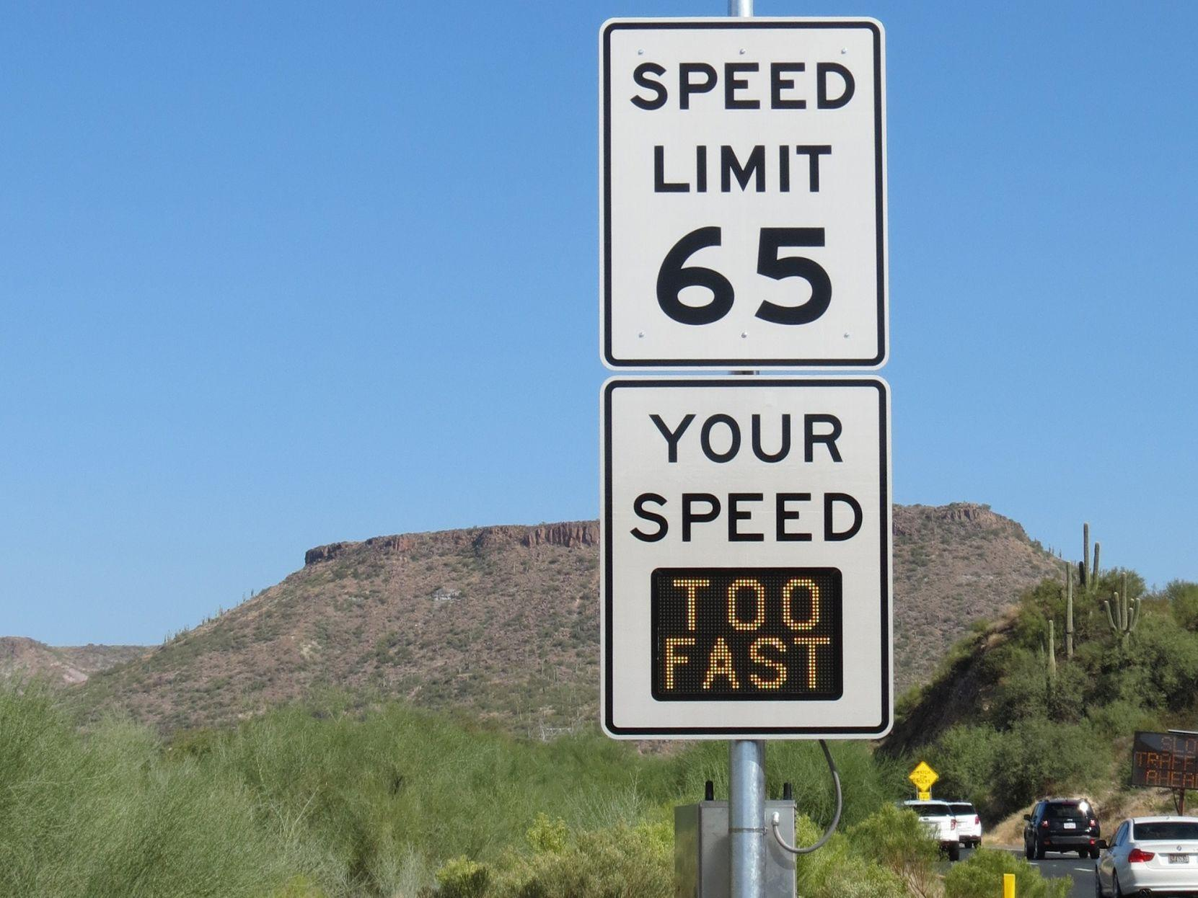

Slide 8
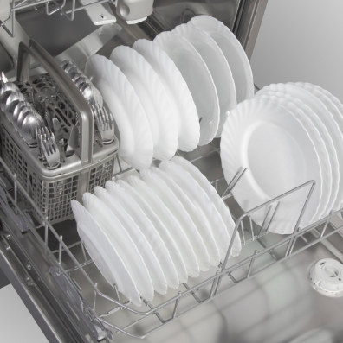
OR

Slide 9
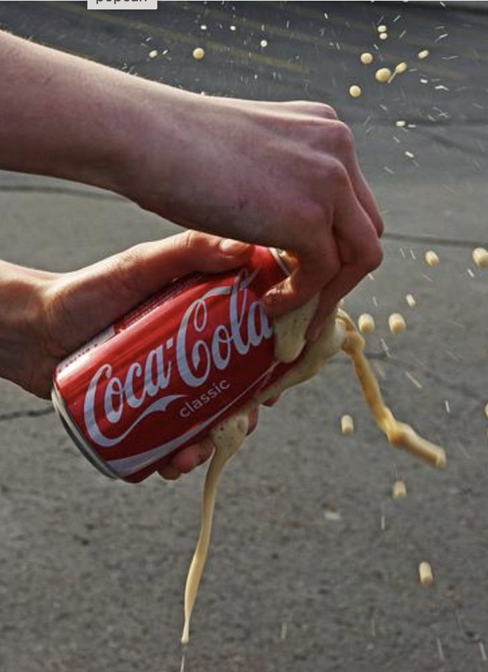
First Responder Relationships
Life-and-death decisions
Witnessing human suffering
Intense workloads
Risk of personal harm
Separation from family

Slide 10
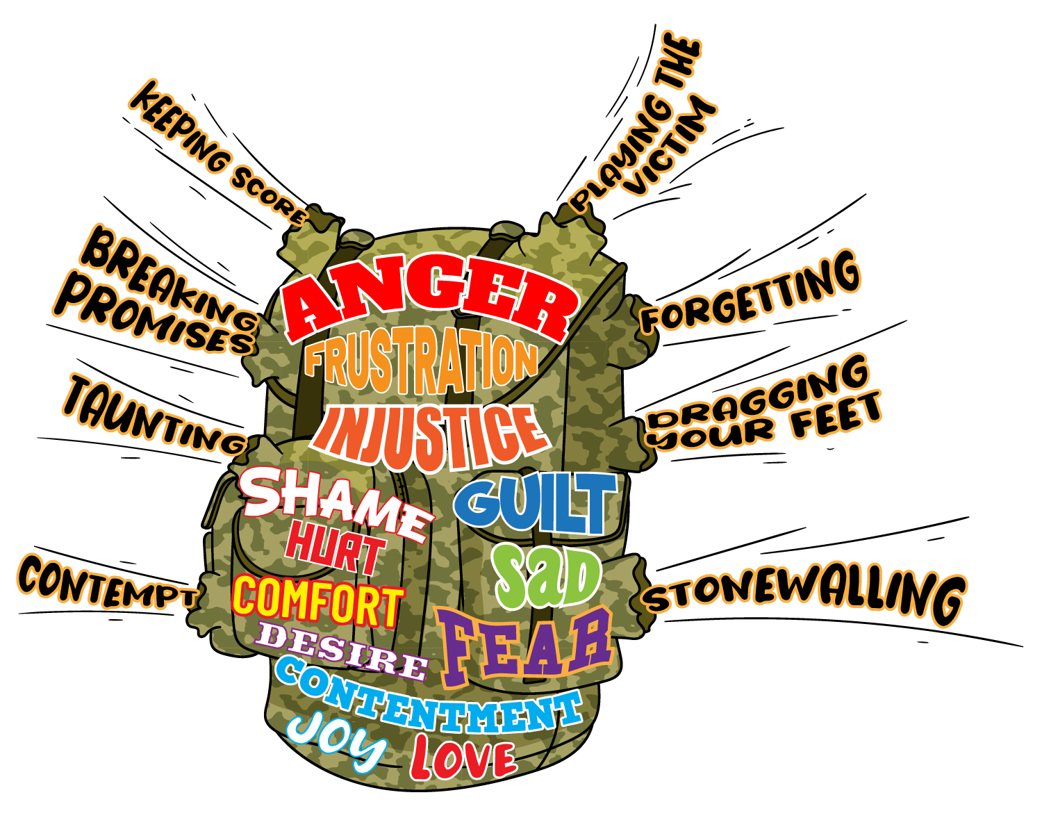

Slide 11
BREAKOUT Emotional Needs Activity (Sticky Dots)

Slide 12
Men
Women
Affection
Sexual Fulfillment
Conversation
Recreational Companionship
Honesty & Openness
Attractiveness of Spouse
Financial Support
Domestic Support
Family Commitment
Admiration/Respect
Source: Willard Harley

Slide 14
ACTION PLAN Investor vs Consumer

Slide 15
Check Your Pulse: Reviewing the Couple Checkup

Slide 16
Check Your Pulse: Reviewing the Couple Checkup

Slide 17
Strength vs Growth Areas

Slide 18
Communication – How we share feelings and understand each other
Conflict Resolution – How we are able to discuss and resolve our differences
Financial Management – How we agree on our budget and financial matters

Slide 19
Leisure Activities – How we balance activities together and apart
Sexuality and Affection – How comfortable we are discussing sexual issues and affection
Family and Friends – How we feel about our relationships with relatives and friends

Slide 20
Relationship Roles – How we share decision making and responsibilities
Children and Parenting – How we view issues related to having and raising children
Spiritual Beliefs – How we view religious values and beliefs.

Slide 21
Uniquely Made:
Understanding & Applying the OXYGEN PROFILE

Slide 22
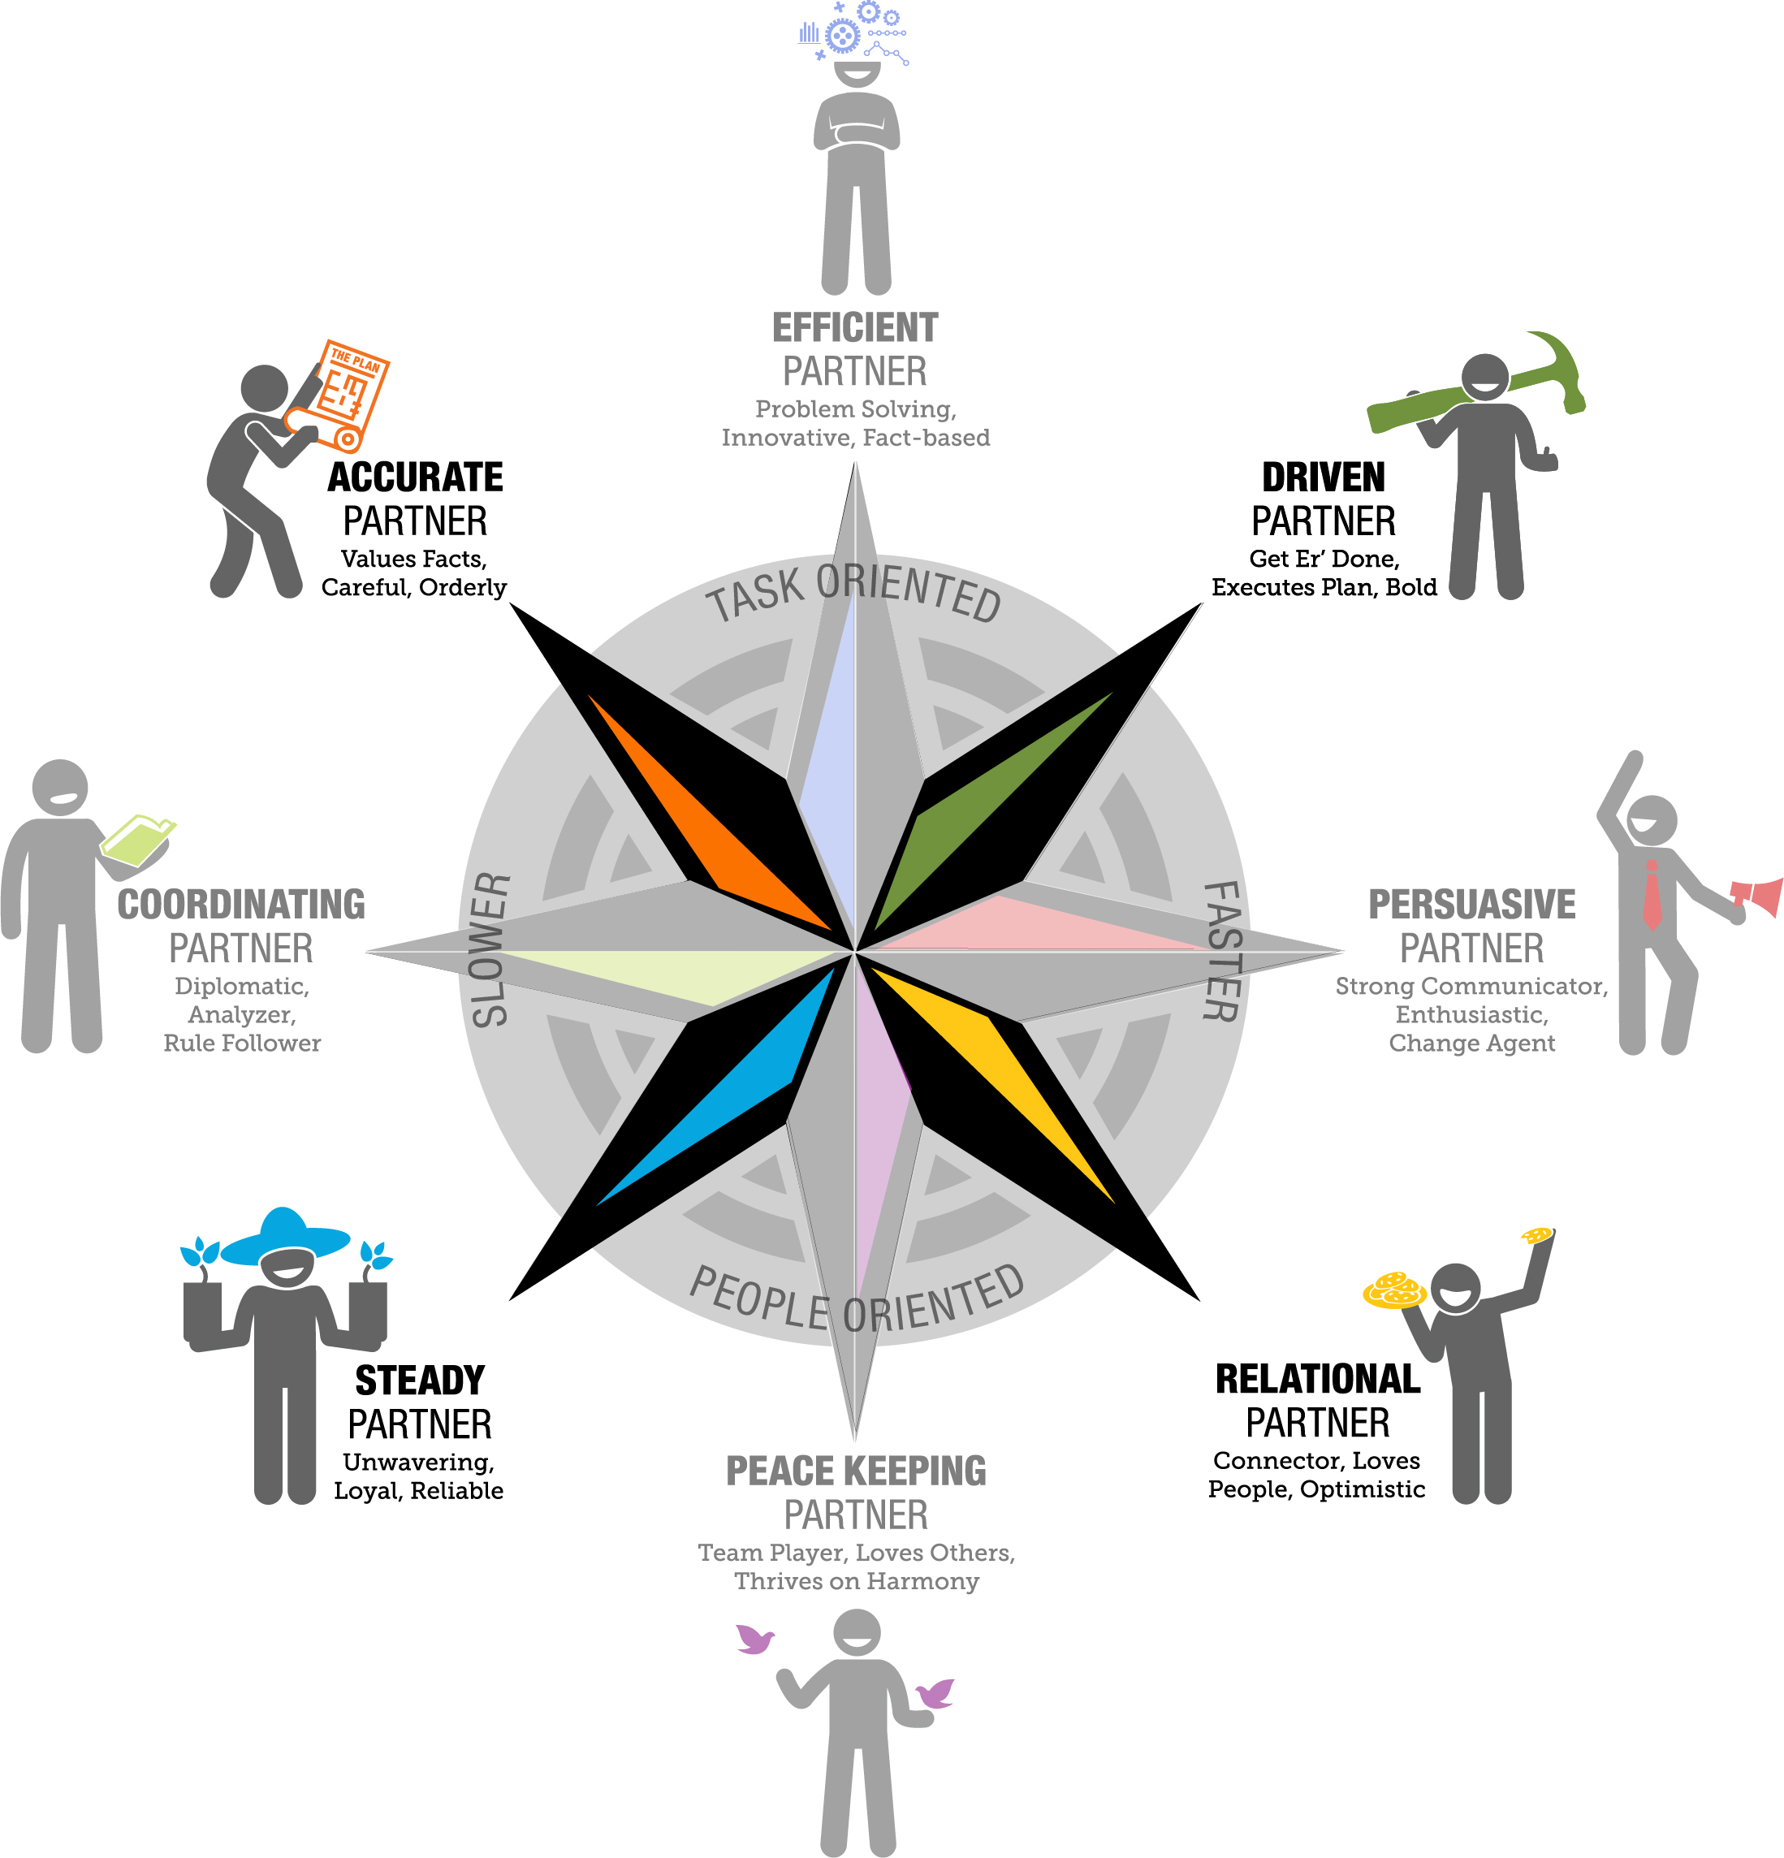
OXYGEN Compass

Slide 23
OXYGEN Compass

Slide 24
Personality Insights (in YOUR report)
A Narrative about YOU:
General statements
Strengths and Personality Style
Reflective of your Natural way of relating

Slide 25
Keys to Motivating (report)
Motivations = Wants and/or Desires
General statements
Current and Active Motivations
Goals to reach

Slide 26
BREAKOUT Mapping Your OXYGEN Profile

Slide 27
3R’s: Respond, Relate, Reinforce

Slide 28
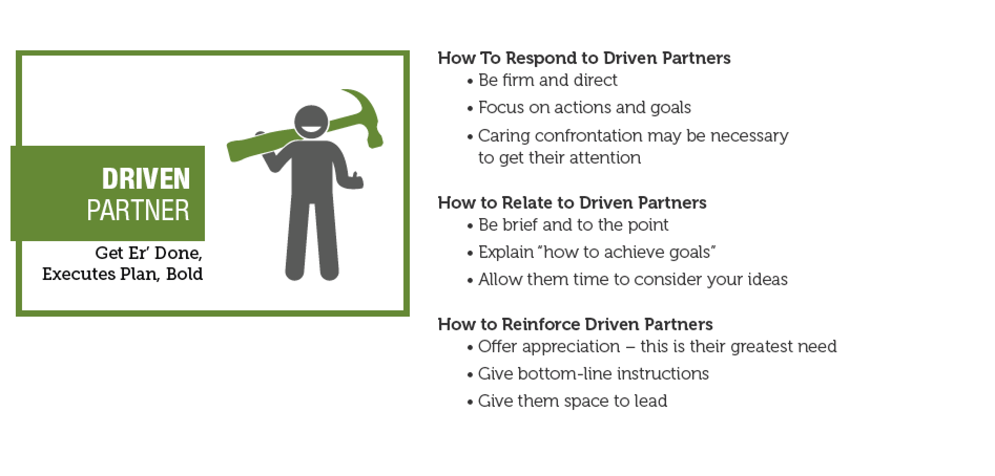
3R’s: Respond, Relate, Reinforce

Slide 29
ACTION PLAN Exploring Your Keys To Motivating

Slide 30
Great Communication: Love, Respect & Empathy

Slide 31
Add “Your Getting Robed” Video

Slide 32
Nonverbal Communication

Slide 33
Add “The Office – Non Verbal Communication” Video

Slide 34
BREAKOUT Focusing Exercise

Slide 35
“All of Me” by John Legend

Slide 36
Focusing Exercise Questions: 1. What did you experience/feel during this exercise? 2. What was difficult for you in this exercise? 3. What did you learn about your spouse during this exercise?

Slide 37
Add Video: Empathy vs Sympathy By Brene Brown

Slide 38
The Couplelogue

Slide 39
The Goal:
Each partner to be understood by the other
NOT necessarily agreement
NOT to solve a problem

Slide 40
How the Couplelogue Works
Part I: Mirroring (Listening Part)
SPEAKER: Send message, in small enough pieces to be mirrored
LISTENER:
“What I heard you say is…”
“Is that correct?” and
“Is there more?”

Slide 41
Part 2: Validation (Thinking Part)
LISTENER: Crafts a statement validating the Speakers thought process based on what they just heard.
EXAMPLES:
“I can see how you would think…”
“You make a good point about…”

Slide 42
Part 3: Empathy (Feeling Part)
LISTENER: Crafts a statement empathizing with how the speaker may feel about the situation.
EXAMPLES:
“It sounds as if you may be feeling… Is that right?”
“If I was in your shoes, I might feel… Is that how you feel?”

Slide 43
Stu and Missy

Slide 44
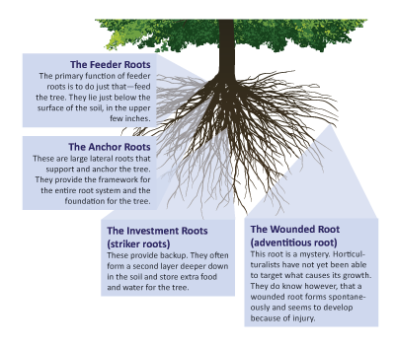

Slide 45
ACTION PLAN Reflecting on Your Past

Slide 46
PTSD & Your Relationship

Slide 47
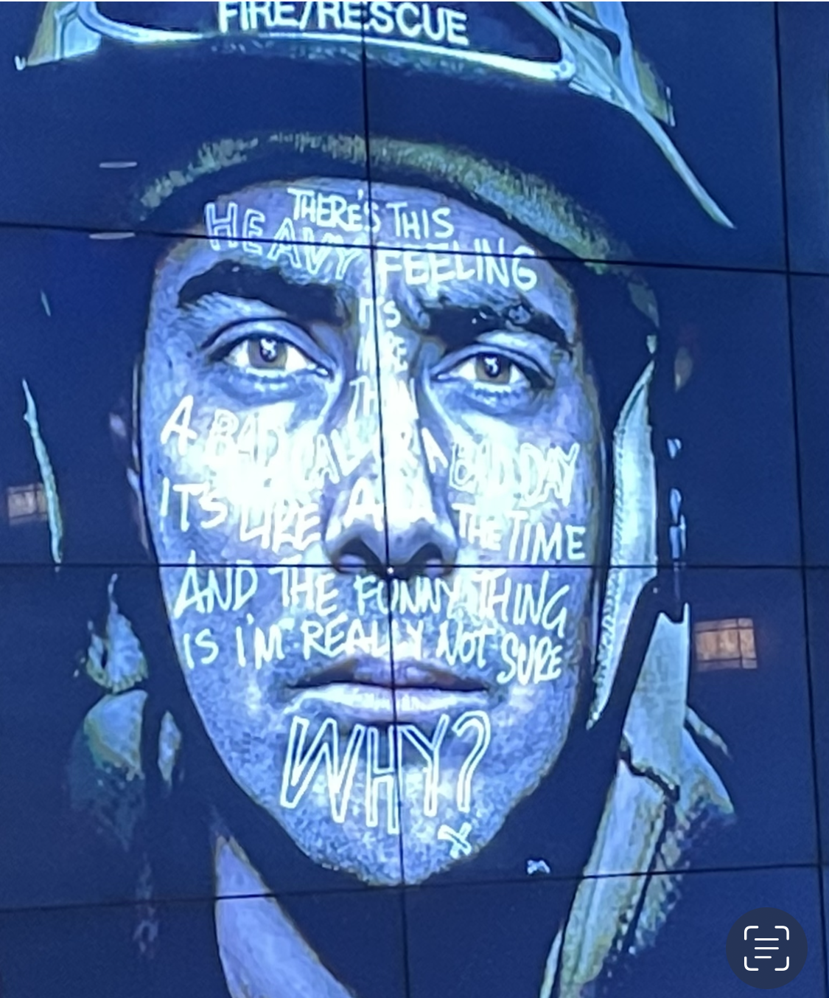

Slide 48
PTSD SYMPTOMS
DEPRESSION/ANXIETY
GUILT
SHAME
HOPELESSNESS
EMOTIONAL NUMBNESS/DETACHMENT
NEGATIVE SELF-TALK
SUICIDAL IDEATION AND SUICIDAL GESTURES
FLASHBACKS
NIGHTMARES
DIFFICULTY SLEEPING
DIFFICULTY CONCENTRATING
LOSS OF INTEREST IN ACTIVITIES AND HOBBIES
WITHDRAWAL/ISOLATION
LACK OF MOTIVATION TO MAINTAIN RELATIONSHIPS
AVOIDANCE OF TRIGGERS
HYPERVIGILANCE
COMPASSION FATIGUE
ALCOHOL/SUBSTANCE ABUSE

Slide 49
Add “Pete & CJ’s PTS Story” Video

Slide 50
Text Your Questions

Slide 51
The Couplelogue

Slide 52
Putting Out Fires: Communicating Through Conflict

Slide 53
Add Video: Dual At the Mall

Slide 54
Stop, Drop & Roll – Time Out
1. RECOGNIZE your need for a time-out
2. REQUEST a time-out
3. RELAX and calm down
4. REMEMBER what’s important
5. RESUME the conversation

Slide 55
BREAKOUT What’s Your Boiling Point?

Slide 56
The Fuel Behind the Fire: ANGER
Anger is a secondary emotion that we
default to because we are unable or unwilling to deal with the primary emotion we are feeling.

Slide 57
Passivity & Control
Passivity: When one partner lacks engagement in the relationship and/or the family
Control: When one partner does not allow space for the other partner’s involvement in the relationship and/or the family

Slide 58
ACTION PLAN 10 Steps to Resolving Conflict

Slide 59
Forgiveness Matters “It is easier to forgive an enemy, then to forgive a friend.” William Blake

Slide 60
Forgiveness is NOT:
Burying your emotions and not dealing with the hurt
Giving someone permission to disrespect your boundaries
Accepting unhealthy behavior or communication
Avoiding the situation and hanging onto negative emotions regarding your spouse
About forgetting the offense

Slide 61
Forgiveness IS:
A decision, NOT an emotion
A choice to let go of negative emotions
Not necessarily a one-time event
Not always granted based on being asked for it
A choice to release your spouse from any debt you feel he/she “owes” you because of the offence
Taking responsibility for your own actions (including your own response of bitterness and unforgiveness toward the one who hurt or betrayed you)
About offering to someone else what you would hope for in the same circumstance

Slide 62
Two approaches to Forgiveness
FORGIVE… and let go
FORGIVE… and address

Slide 63
BREAKOUT No Elephants Allowed

Slide 64
ACTION PLAN Let’s Dig In

Slide 65
7 Keys to Incredible Sex

Slide 66
Play Video: Business Time

Slide 67
The Love Pyramid
Passion
Intimacy
LOVE
Commitment

Slide 68
7 Keys To Incredible Sex
KEY #1
Foreplay Starts
in the Kitchen

Slide 69
7 Keys To Incredible Sex
KEY #2
Talk About Sex (Outside the Bedroom)

Slide 70
7 Keys To Incredible Sex
KEY #3
Cherish Each Other

Slide 71
7 Keys To Incredible Sex
KEY #4
Explore And Be Adventerous

Slide 72
7 Keys To Incredible Sex
KEY #5
Lend a Helping Hand

Slide 73
7 Keys To Incredible Sex
KEY #6
Find Your Sexy

Slide 74
7 Keys To Incredible Sex
KEY #7
Learn Your Love Languages

Slide 75
BREAKOUT Identify Your Love Language

Slide 76
52 Week Love Style Challenge

Slide 77
Post Event Survey https://qrco.de/FRsurvey

Slide 78
Our Contact Info:

Slide 79
Your Relationship Game Plan

Slide 80
BREAKOUT Your Relationship Game Plan

Slide 81
BREAKOUT Creating Your Mission Statement

Slide 82
Add “Derek Redmond’s Olympic Story” Video

Slide 83
Thank You for Attending!

