Slide 2
Personalize this slide with your story or delete it. (Please use only 1 slide)

Slide 3
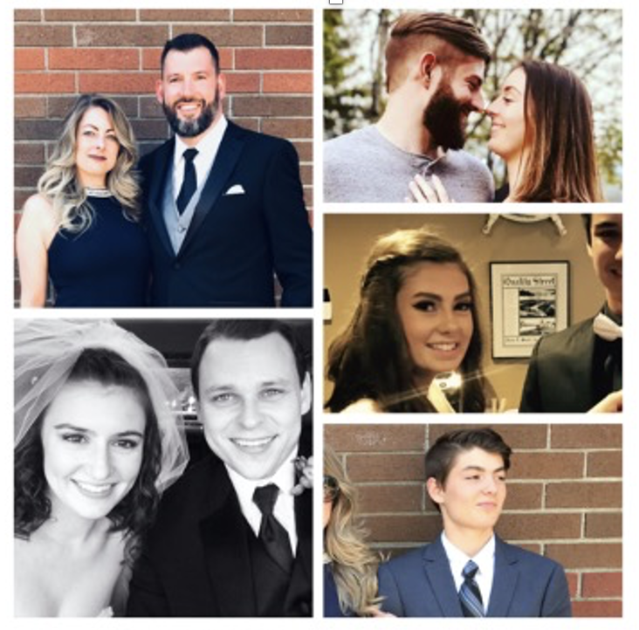
Personalize this slide with your story or delete it. (Please use only 1 slide)

Slide 4
Personalize this slide with your story or delete it. (Please use only 1 slide)

Slide 5
Personalize this slide with your story or delete it. (Please use only 1 slide)

Slide 6
Transitions are
an inevitable part of life.
What are some of the
Transitions represented
here today?

Slide 7
The Wheel of a Life in Transition

Slide 8
Purpose/meaning – what you wake up for every day
Work – how you support yourself and others
Finances – how much compensation you receive for your work
Relationship/significant other – level of intimacy, quality of communication, mutual support and encouragement
Community – friends/family, those whom you go to for support and comradery
Attitude – the tone of your thoughts toward the future, the present, and the past
Environment – physical location, pace of community, lifestyle of surrounding community
Health – physical, emotional, mental, and spiritual

Slide 9
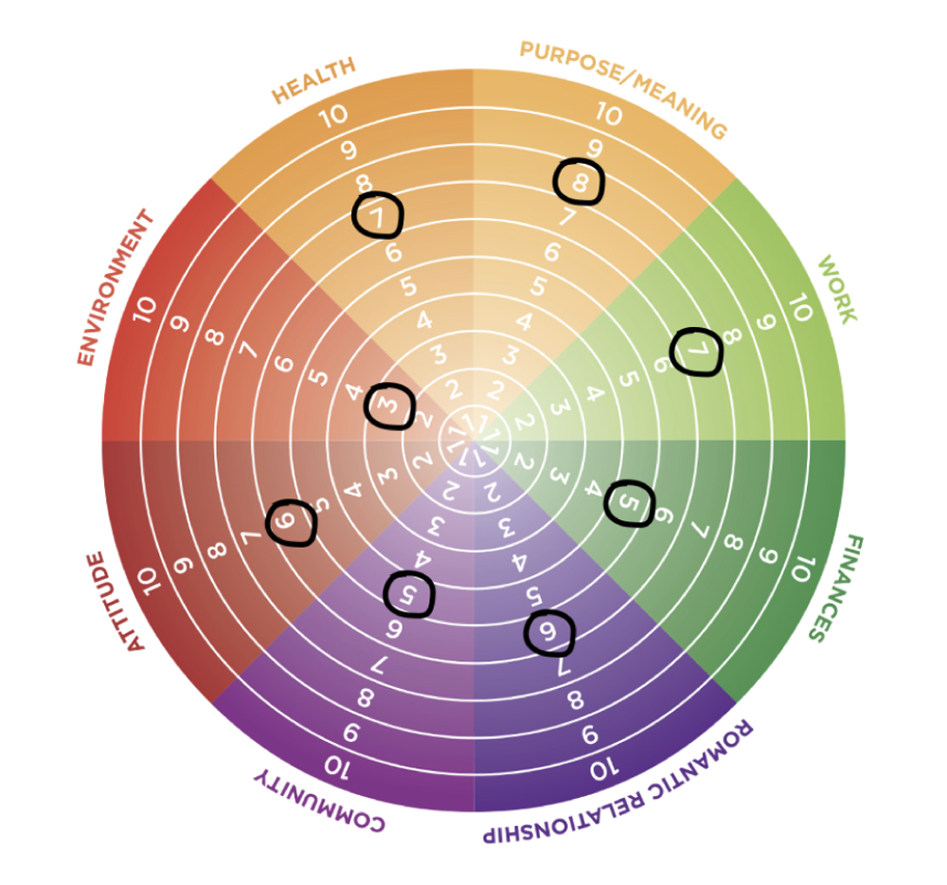

Slide 10
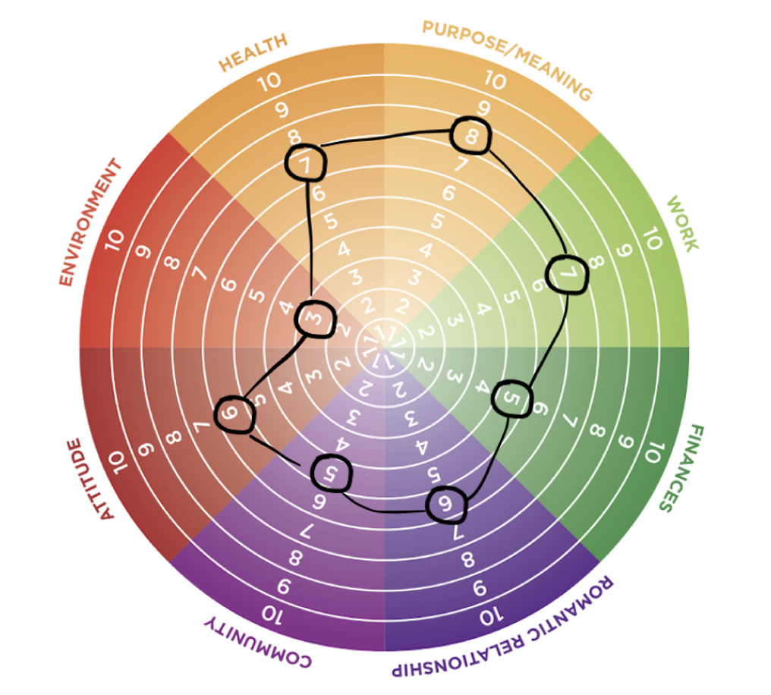

Slide 11
Which 5 words describe you?

Slide 12
How has this strength
served you in the past?
How can you adopt this strength
To serve you in this transition?

Slide 13
Don’t go it alone!

Slide 14
Which 5 words describe you?

